Slide 1
Session 3: Single-cell RNA-seq
Normalization, Differential Expression and Batch Correction
Reuben Thomas
Gladstone Bioinformatics Core
Jan 27th, 2023

Slide 2

scRNA-seq workflow
Experimental Design
Read count matrix
Clustering
Find Marker Genes
Library preparation & sequencing
Quality control and filter poor quality cells
Gene set enrichment analysis
Demultiplex, read alignment and quantification
Normalization
Cell-type annotation
Feature selection
Association with phenotypes
Dimensionality reduction
Network analysis
Planning and pre-processing
Data processing
Downstream statistical analyses

Slide 3
Typical scientific questions
Identify the cell types in your sample of interest
Identify which cell types change under condition of interest
Identify genes whose expression is modulated in relevant cell types

Slide 4
Outline for this session
Main messages
Introduce the data and the research questions (5 min)
Primer on statistics (5 min)
Normalization (10 min)
Finding marker genes (5 min)
Batch correction (15 min)
  Hands-on
Multi-sample multi-condition comparison (30 min)
  Hands-on
Reiterate the main messages

Slide 5
Main points I want to convey
State of art of the design and statistical analyses of scRNAseq data is still in flux
  Benchmarks in different areas are becoming increasingly available
There are better designs
  Most important: Please include replicates drawn from the population you want to make a claim about
There are better statistics/ways to get “more” reproducible results.
  Normalization
  Identification of marker genes
  Multi-sample multi-condition comparison
  Batch correction
Notes:
Every scRNA-seq data may look similar to tools like Seurat/scNetViz.
But underlying the data is a story, a design
Whatever tests we perform to estimate p-values, should take into account this design.
Unless the variability and dependency implicit in the design is taken into account in estimating fold-changes, the associated p-values are incorrect. We are therefore not controlling the number false positives in any resulting list of genes. Our designs and associated analyses may then end up black lists created by John Ionidis.

Slide 6
Outline for this session
Main messages
Introduce the data and the research questions (5 min)
Primer on statistics (5 min)
Normalization (10 min)
Finding marker genes (5 min)
Batch correction (15 min)
  Hands-on
Multi-sample multi-condition comparison (30 min)
  Hands-on
Reiterate the main messages

Slide 7
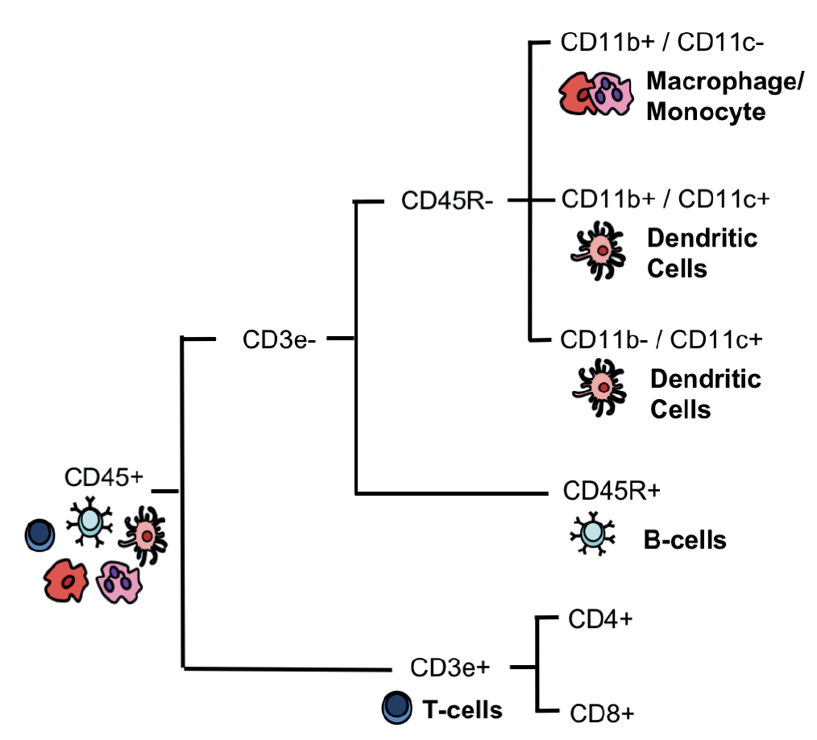

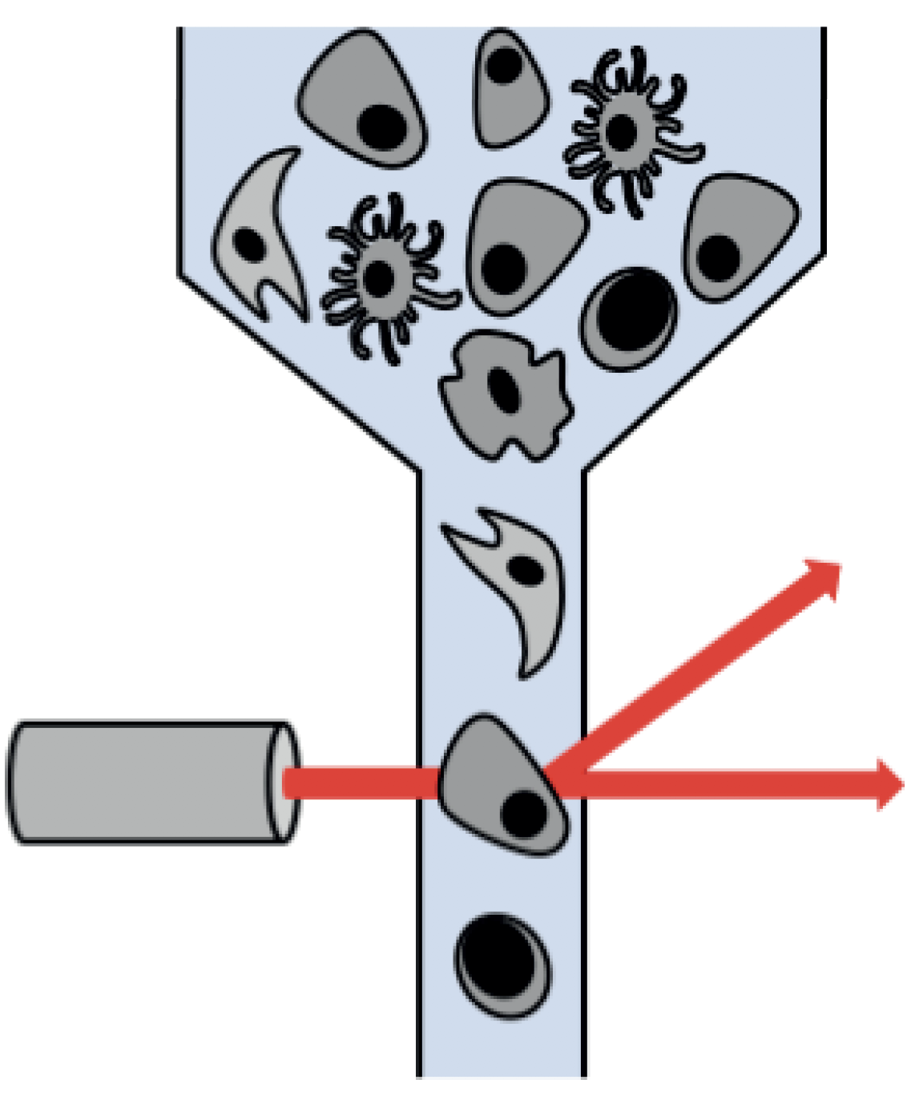
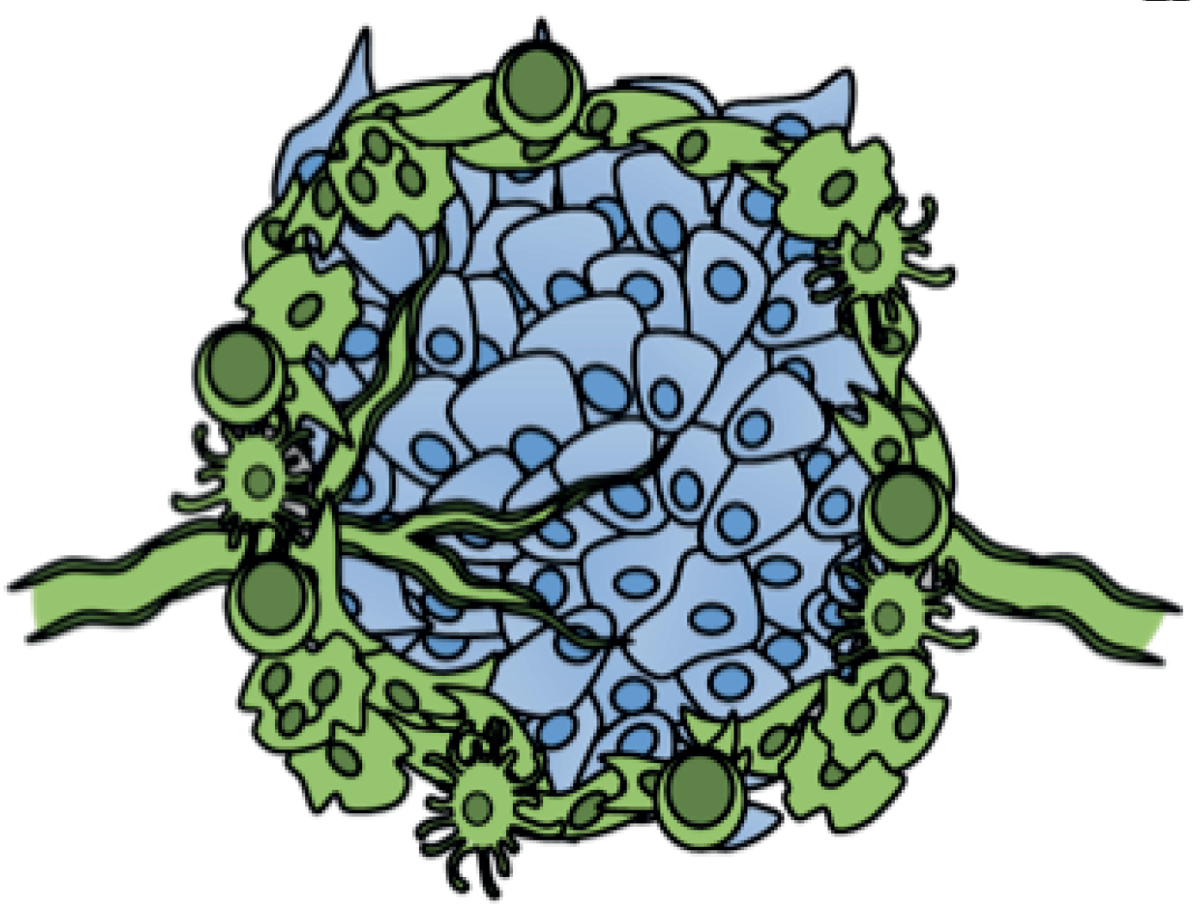
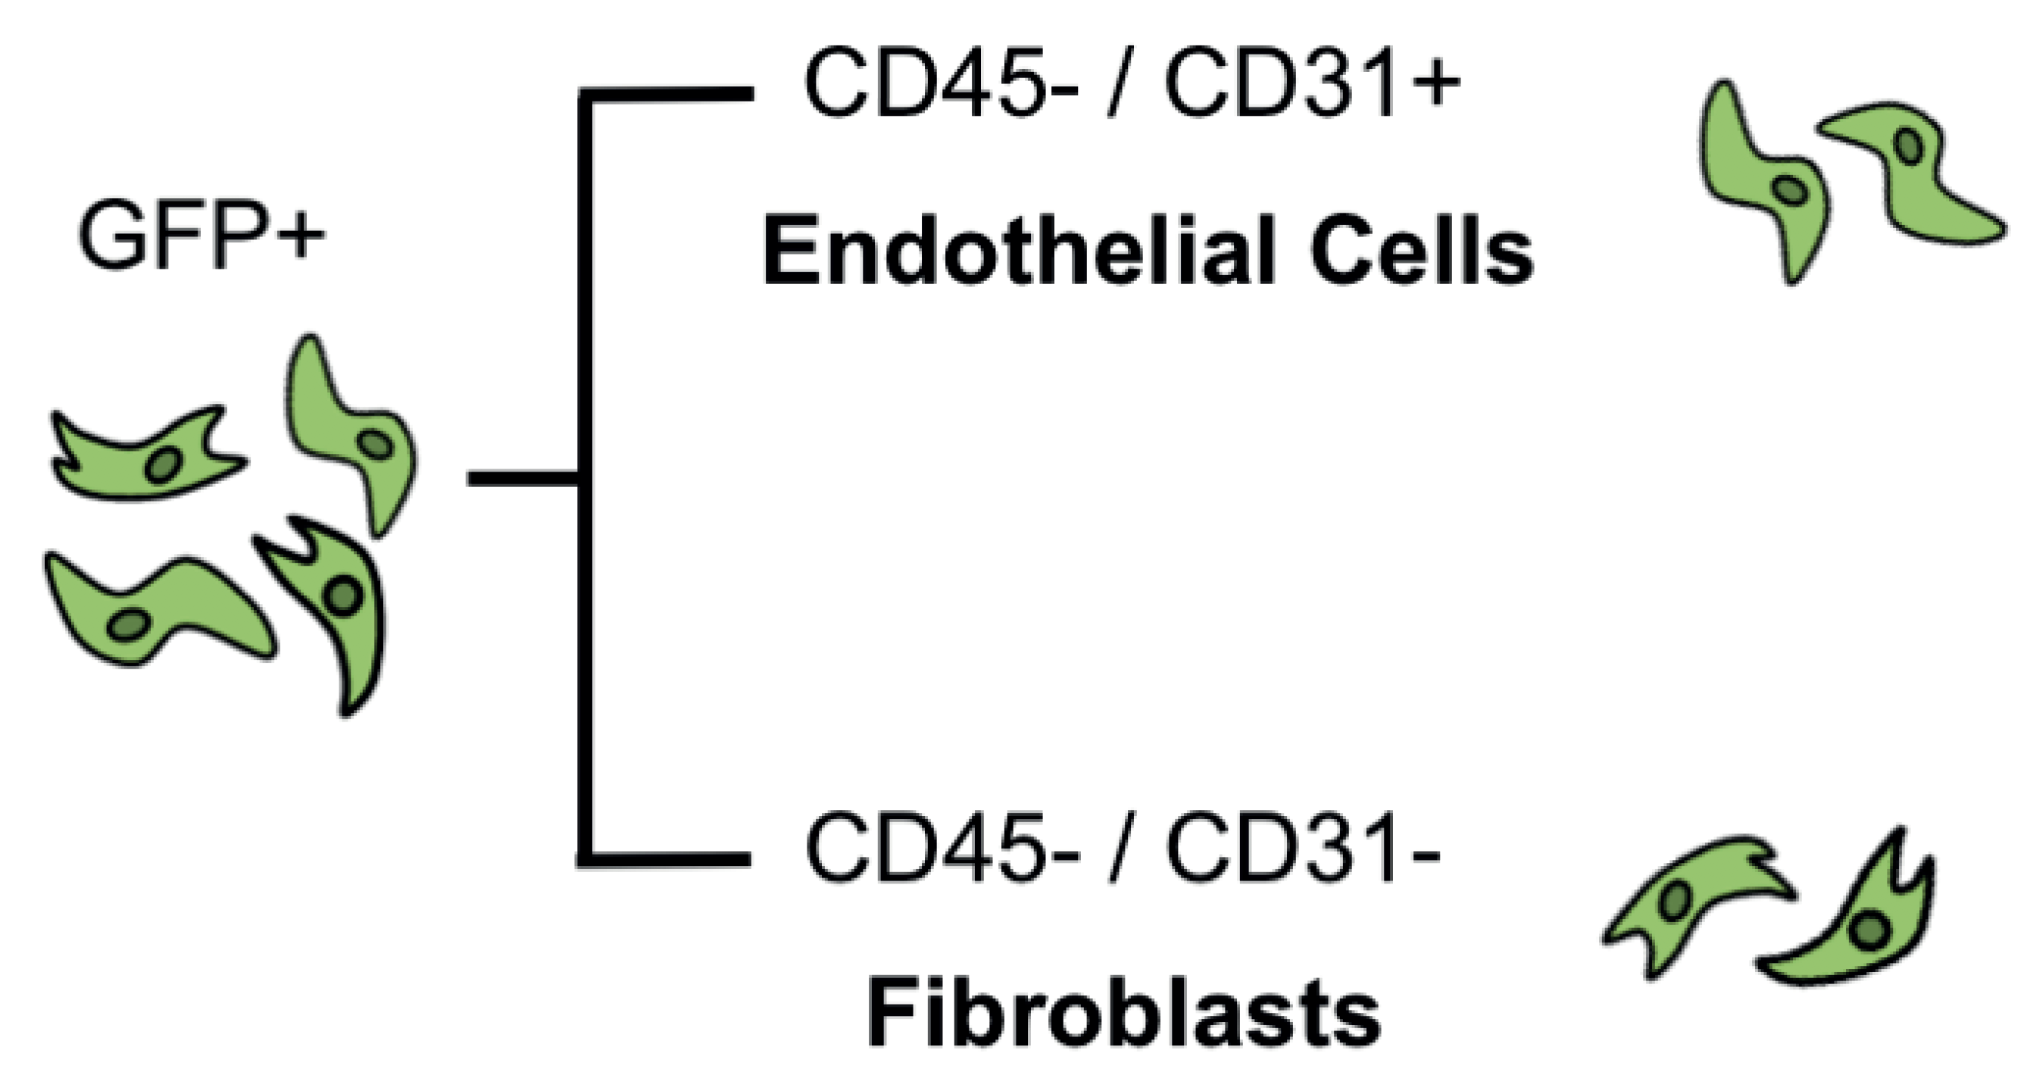
Dissecting the Tumor Microenvironment
GFP+ Mice were injected with a melanoma cell line
Host and tumor cells were then sorted and sequenced
Grow tumor (5, 11 days)
FACS sort cells
Source: David Joy
Davidson et al. bioRxiv 2018

Slide 8
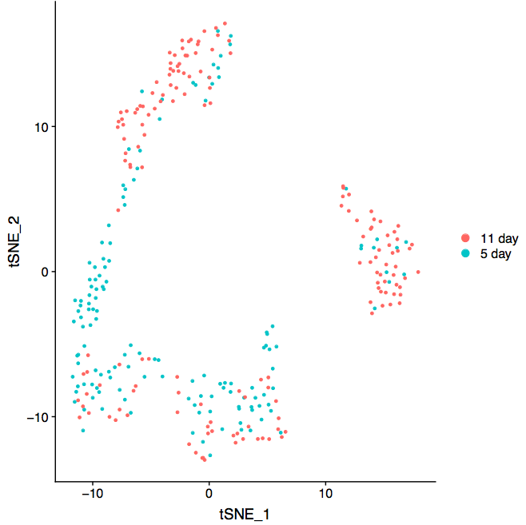
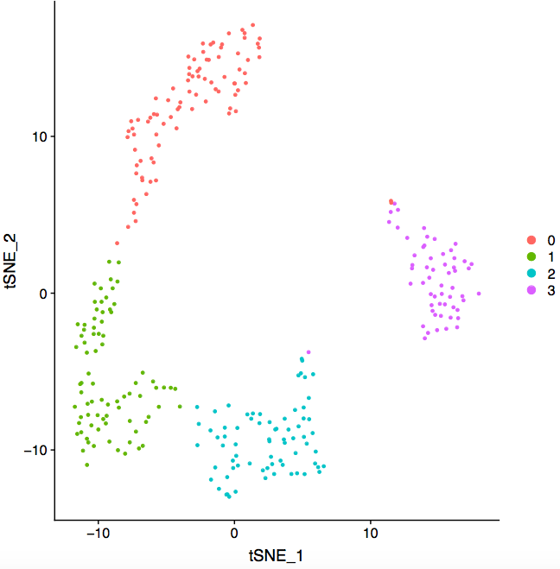
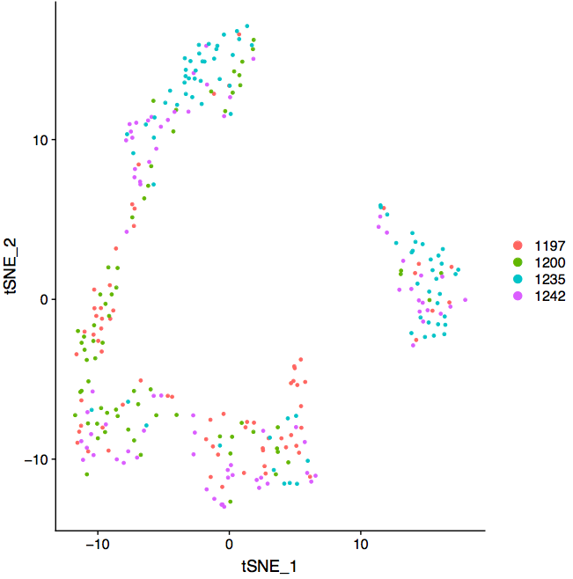
Fibroblast cells over Time, Clusters and Individuals
Time
Cluster
Individual

Slide 9
Research Questions
Genes associated with time: which genes change their expression in the host fibroblast cells from the 5 day time-point to the 11 day time-point?
Would like to take into account inter-individual variability – make generalizable claims
Would make claims specific to particular clusters or implied cell-types to this population of cells – after all we have scRNA-seq data, ☺.
Would like to avoid the multiple testing problem and make statistically rigorous claims

Slide 10
Outline for this session
Main messages
Introduce the data and the research questions (5 min)
Primer on statistics (5 min)
Normalization (10 min)
Finding marker genes (5 min)
Batch correction (15 min)
  Hands-on
Multi-sample multi-condition comparison (30 min)
  Hands-on
Reiterate the main messages

Slide 11
Predictors of gene expression in a given cell
Time
Individual
Gene 1
Cell-type
Exp. factors

Slide 12
We could use cluster as surrogate for cell-type
Cell-type ~ cluster
WARNING:
Data dredging: use the same data to define
clusters of cells and differences in gene expression
between these clusters

Slide 13
Predictors of gene expression
Time
Individual
Gene 1
Cell-type
Cluster
Exp. Factors

Slide 14
Predictors of gene expression
Gene1
Gene 7000
Time
Time
Individual
……..
Individual
Gene 1
Gene 7000
Cluster
Cluster
Exp factors
Exp factors

Slide 15
Distribution of p-values across all genes and reproducibility(simulated data)
We would like for our claims to reproducible across repeated experiments!
Log odds ratio of the same gene
having a logFC > 1 in two
independent experiments = 8

Slide 16
Outline for this session
Main messages
Introduce the data and the research questions (5 min)
Primer on statistics (5 min)
Normalization (10 min)
Finding marker genes (5 min)
Batch correction (15 min)
  Hands-on
Multi-sample multi-condition comparison (30 min)
  Hands-on
Reiterate the main messages

Slide 17
Why all this fuss about normalization and batch correction?
We would like to minimize variation/bias in gene expression due to technical and unwanted biological sources
Significance of conclusions will be questioned if one does perform these steps
RNA-seq counts are representative of RELATIVE and NOT ABSOLUTE levels of gene expression
  Covid-19 sample1 in USA has body temperature 102 while
  Covid-19 sample2 in UK has body temperature 39.
  Gata4 gene has 103 read counts in replicate 1 at E9.5,
  has 576 read counts in replicate 3 at E11.5

Slide 18
Normalization vs batch effects
Normalization aims to remove/reduce technical sources of variation
Technical sources: sequencing depth, cDNA capture or PCR amplification efficiency across cells
Technical sources tend to affect all genes
Batch effects aims to remove both technical and biological sources of variations arising due to processing in different batches
Batch effects may not affect all genes equally

Slide 19
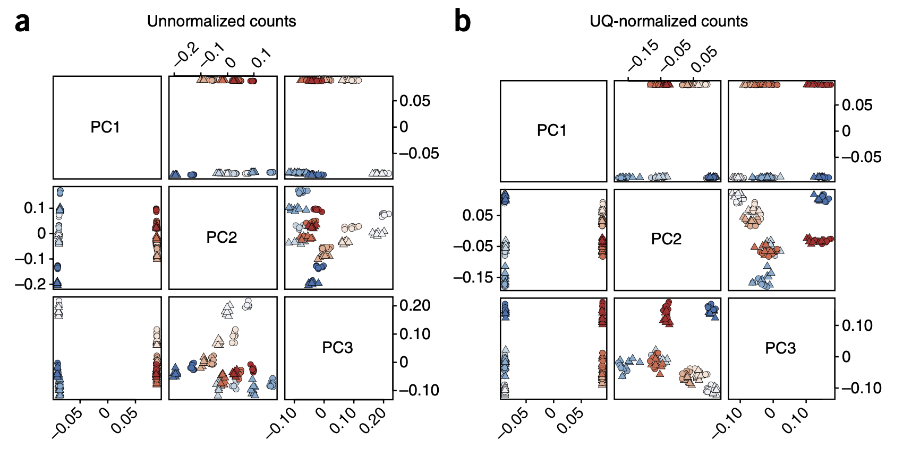
Red/Blue: different biological conditions
Shade of color: library prep date
Circles and Triangles: two different flow cells
Notes:
Risso et al 2014

Slide 20
Why normalize for scRNA-seq
Effects performance in all essential questions asked of data
  Cell-type/cluster identification
  Low-dimensional representation
  Differential expression analyses
  Trajectory analysis

Slide 21
Four main classes of normalization
Library-size normalization: LogNormalize in Seurat
Deconvolution normalization: scran Bioconductor package
Spike-in normalization
Variance stabilizing transform-based normalization: sctransform in Seurat

Slide 22

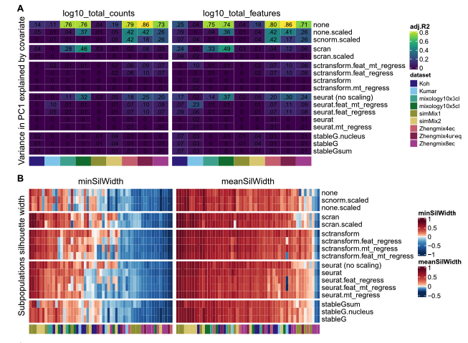
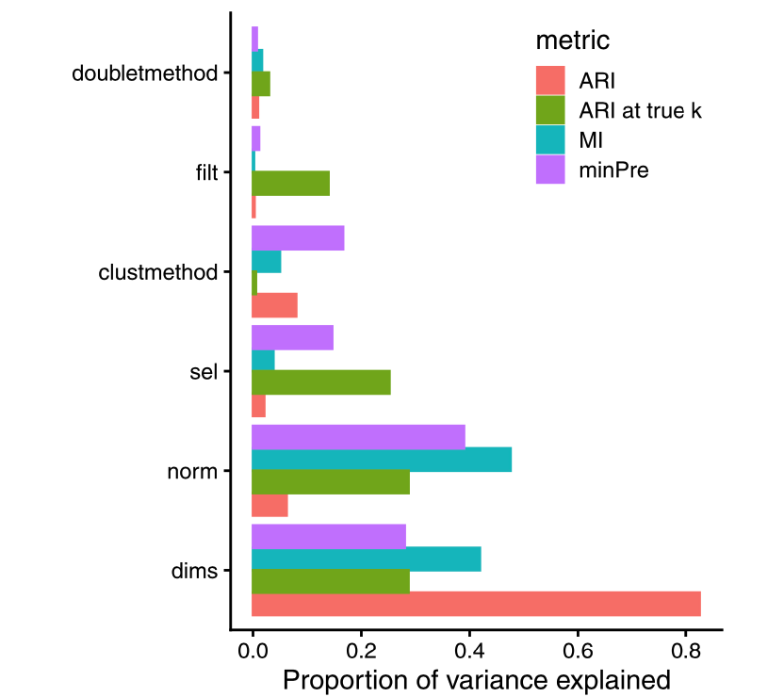
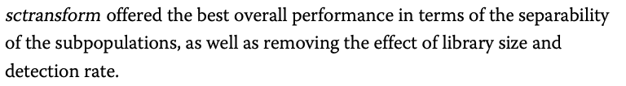
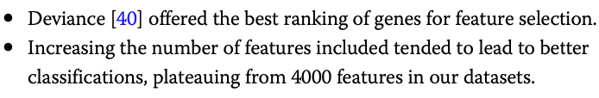

Slide 23
Outline for this session
Main messages
Introduce the data and the research questions (5 min)
Primer on statistics (5 min)
Normalization (10 min)
Finding marker genes (5 min)
Batch correction (15 min)
  Hands-on
Multi-sample multi-condition comparison (30 min)
  Hands-on
Reiterate the main messages

Slide 24
Cluster identification: marker genes
Identify genes whose expressions define particular clusters
Compare the distribution of normalized expression of each gene among cells in given cluster versus cells from all other clusters
Two sample t-test, Wilcoxon tests?
More sophistical methods?

Slide 25
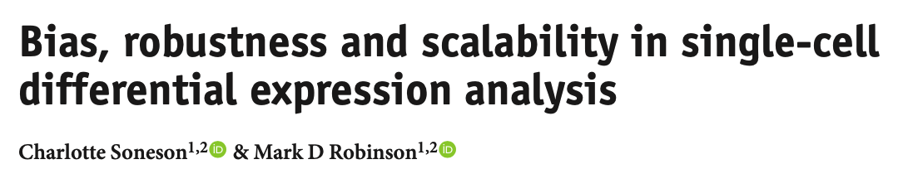
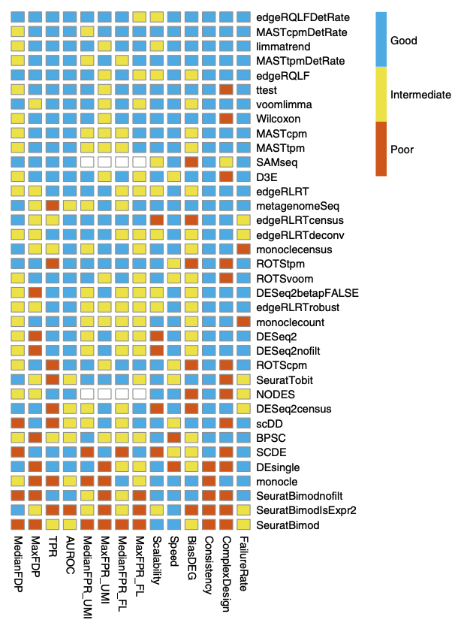
Simple methods like the two-sample t-test and Wilcoxon tests do well!!
For more sophisticated methods like edgeR, MAST – filtering of low
expressed genes very important for good performance

Slide 26
Outline for this session
Main messages
Introduce the data and the research questions (5 min)
Primer on statistics (5 min)
Normalization (10 min)
Finding marker genes (5 min)
Batch correction (15 min)
  Hands-on
Multi-sample multi-condition comparison (30 min)
  Hands-on
Reiterate the main messages

Slide 27
Define batch effects
“Batch effects are sub-groups of measurements that have qualitatively different behavior across conditions and are unrelated to the biological or scientific variables in a study”: Leek et al 2010

Slide 28
Batch effects could arise
In your experiments where subset of samples are processed are differently – different times, people, library prep
When you want to compare your data to publicly accessible data

Slide 29
Factors to be controlled for in your experimental design
Date of sample perfusion
Date of nuclear isolation
Litter
Date of sequencing
Age of mouse
Person processing the sample
The reagents used
Person doing the preps
Animal models
Drug treatments

Slide 30
Choice of samples within a batch
Idea: Samples within batches are balanced in terms of biological end-points of interest
Ideal: to have samples from each of the end-points being compared
Don’t: have all samples from the same end-point
Ok: to have samples from a smaller subset of end-points

Slide 31
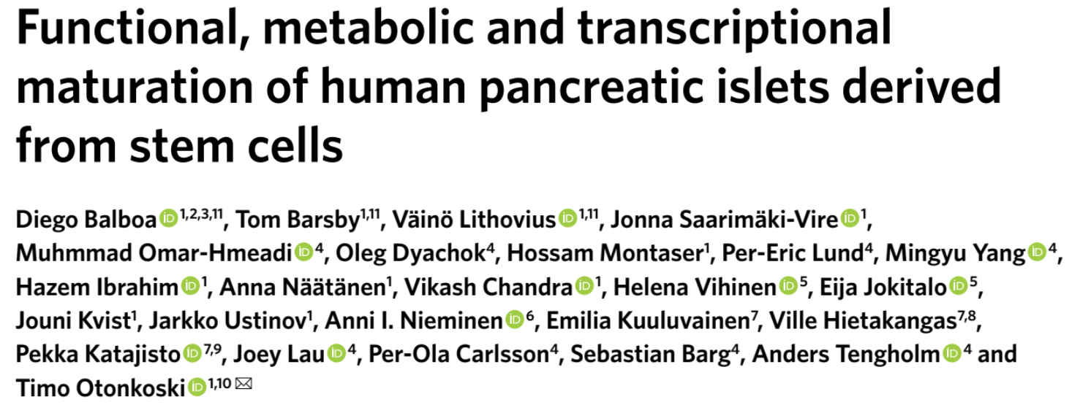
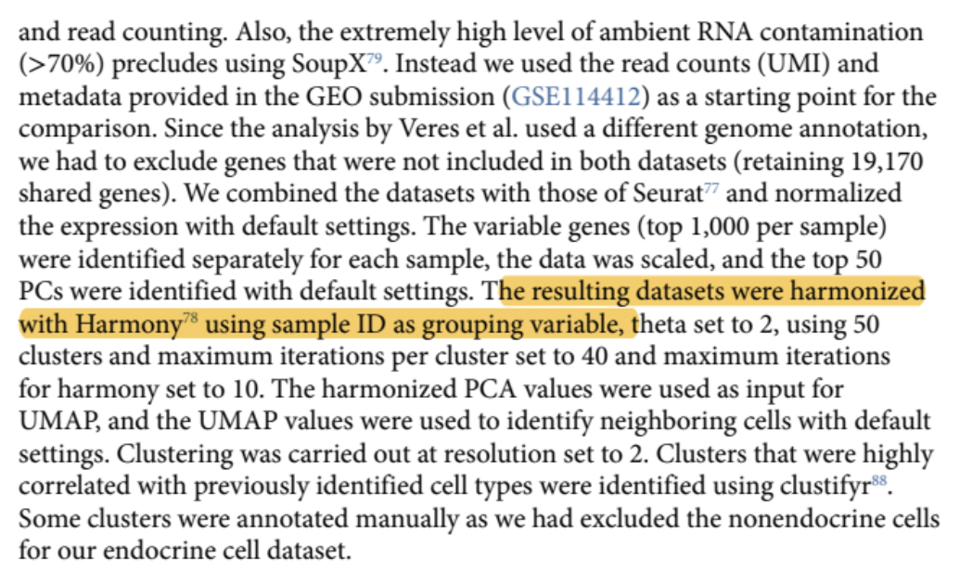
Caution: Avoid sample-wise batch correction!

Slide 32

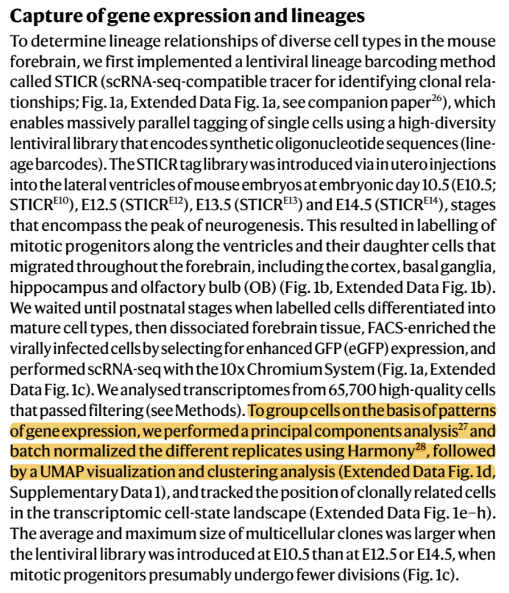
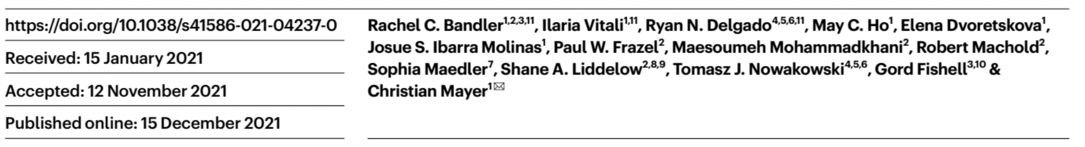
Sample-wise batch correction is often applied

Slide 33
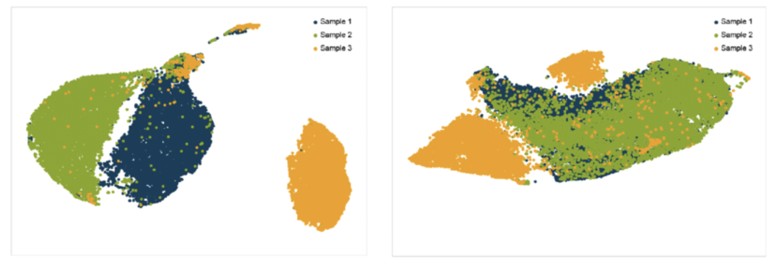
Potential loss of biological variation between conditions/genotypes
Sample 1
Sample 2
Sample3
Sample 1
Sample 2
Sample3
Control sample
Disease sample
Adapted from Xu et al., 2019

Slide 34
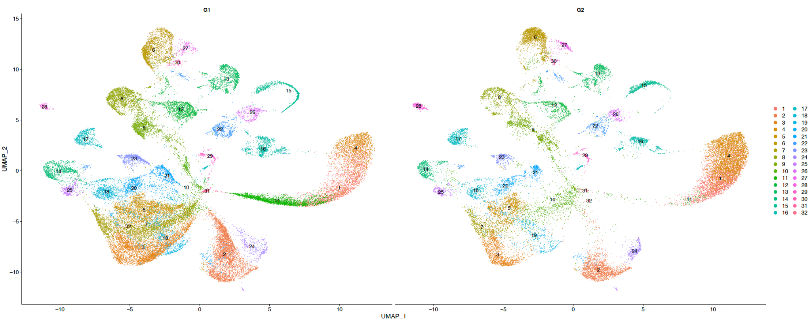


Cells clustering without sample-wise batch correction suggests gain of cluster 11-like cells in fE4 mice
fE4
fE3
Michela Traglia
Isabella DeLoa

Slide 35
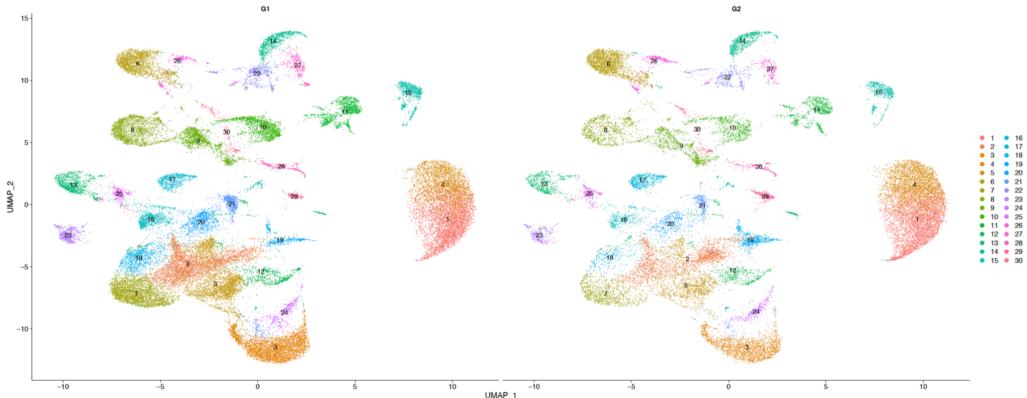
Cells clustering after sample-wise batch correction showed less diseases-relevant cell types
fE4
fE3
Loss of relevant cell types
Less clusters

Slide 36
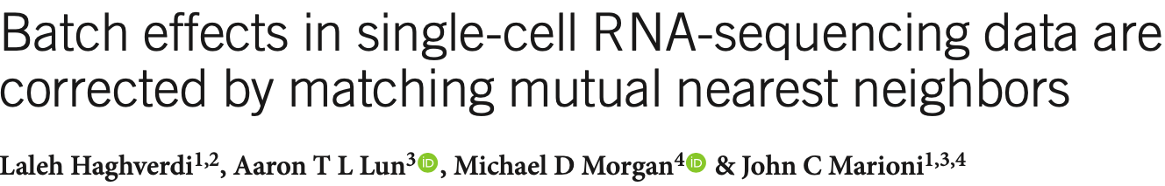
Important assumptions for batch correction methods
There is at least one cell-type that is common between the two data sets being integrated
Batch effects are orthogonal to the biological effects
Variation in batch effects across cells is much smaller than variation in biological effects

Slide 37

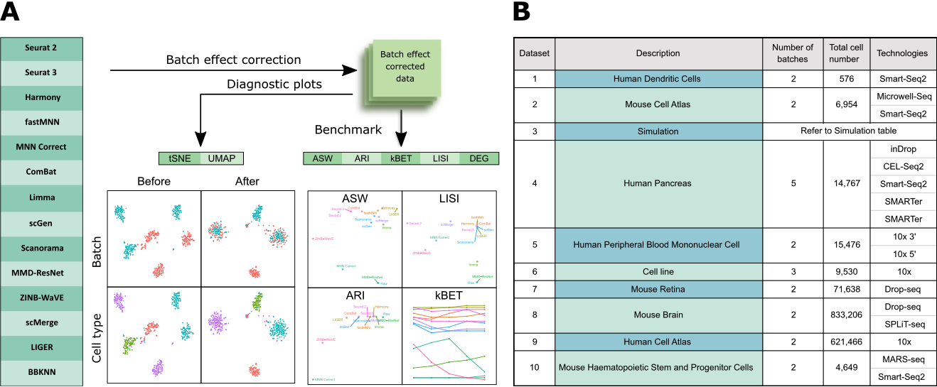
LIGER, Harmony and Seurat 3 top 3 performing methods!!

Slide 38
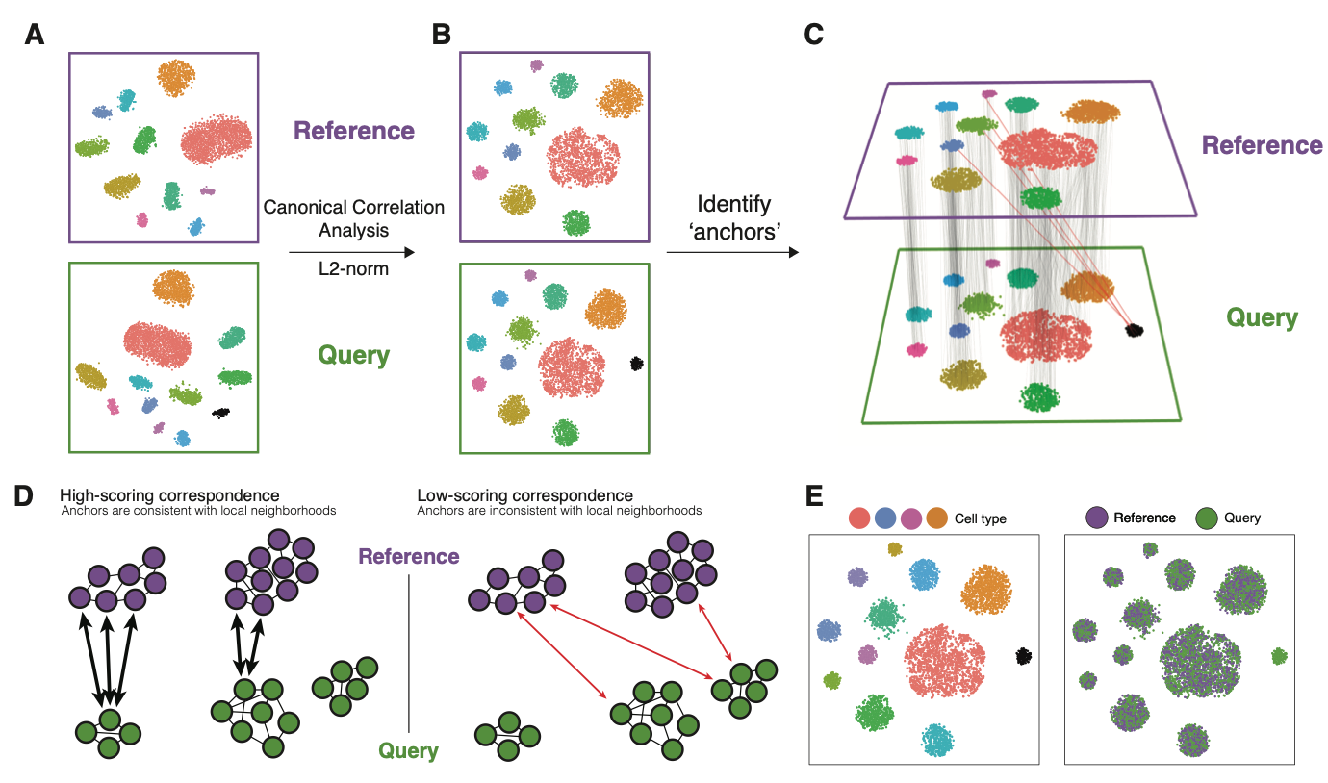
Seurat 3: IntegrateData
Notes:
Stuart et al 2018

Slide 39
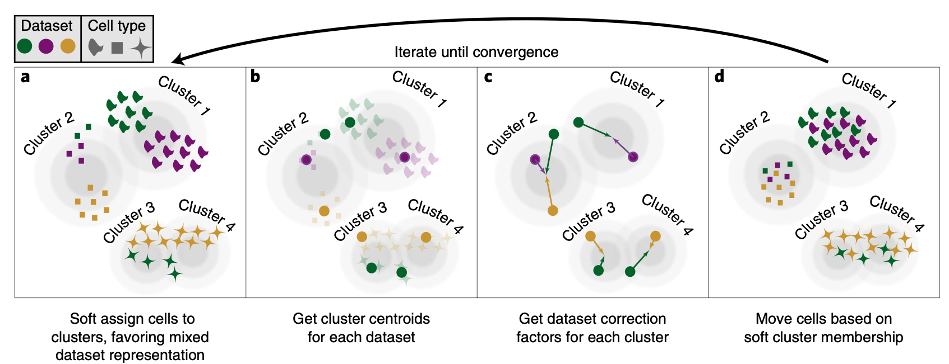
Harmony
Korunsky et al. 2019
Notes:
https://pubmed.ncbi.nlm.nih.gov/31740819/

Slide 40
Hands-on: Normalization, FindMarkers and Batch correction

Slide 41
Outline for this session
Main messages
Introduce the data and the research questions (5 min)
Primer on statistics (5 min)
Normalization (10 min)
Finding marker genes (5 min)
Batch correction (15 min)
  Hands-on
Multi-sample multi-condition comparison (30 min)
  Hands-on
Reiterate the main messages

Slide 42
Multi-sample-multi condition comparison
Replicate mice, human patients to be compared across multiple conditions
Order 1000s of cells per mouse, human patient
Inference should be at the level of mouse/human-patient and not individual cells
Would indicate reproducibility of detected associations
To replicate the study – one would sample a new set of mice or human patients
To replicate the study – there is really not an infinite pool of cells from which one can sample

Slide 43
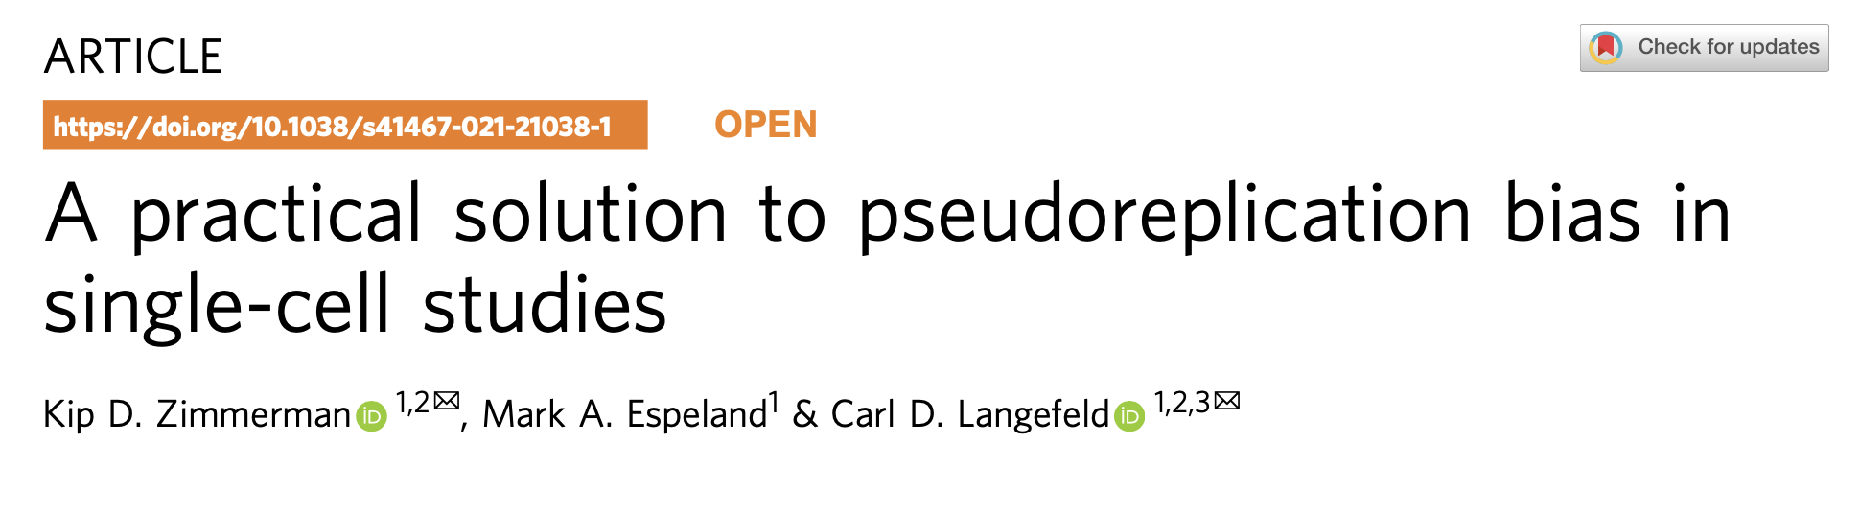
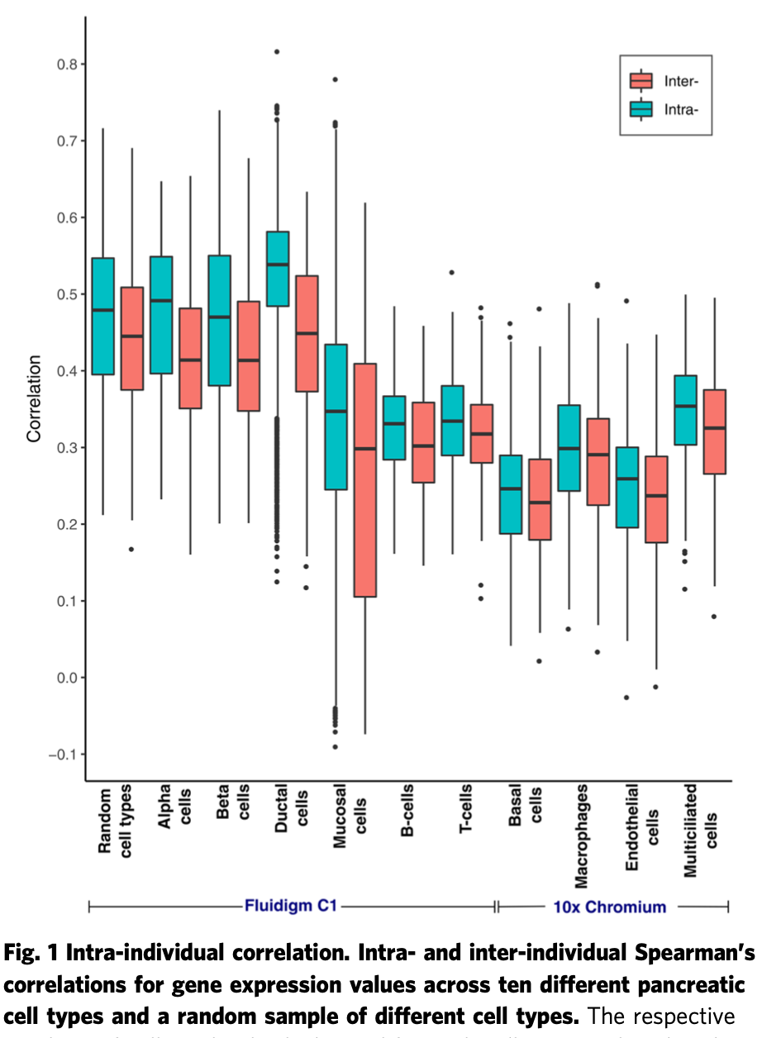
Gene expression is more correlated among cells within subjects

Slide 44
Multi-sample-multi condition comparison
Question 1 (Within-cluster): Find genes whose mean (across replicates) expression is different between condition within each cluster
Question 2 (Between-cluster): Find clusters with disproportionate number of cells between the two conditions

Slide 45
Within cluster:
Multi-sample-multi condition comparison
Within clusters, all cells are not independent of each other
Cells are dependent on the animal of origin
How does one model this dependence of reads across cells from the same animal?
Simple approach: Aggregate counts
More complex approach: Use linear mixed effects model

Slide 46
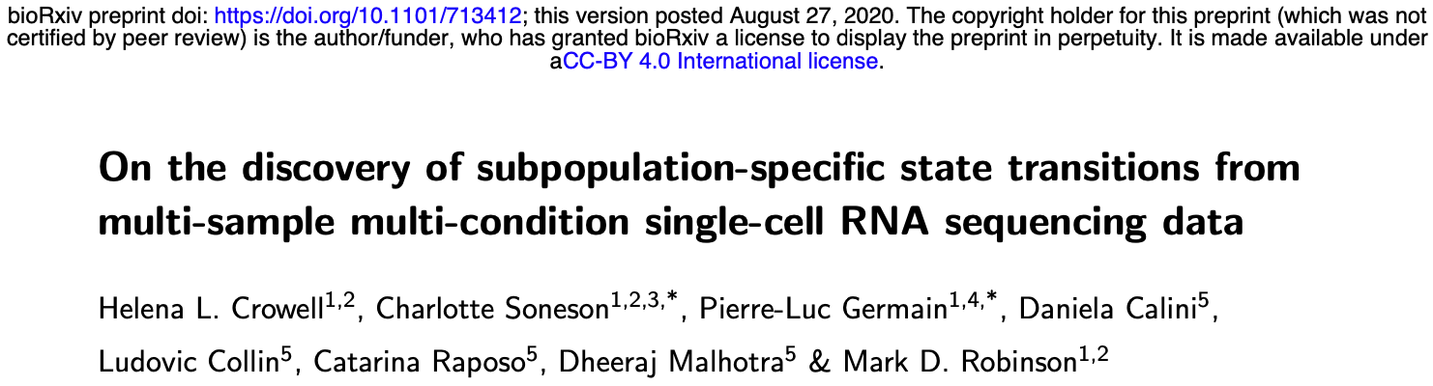
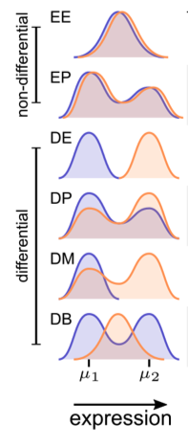
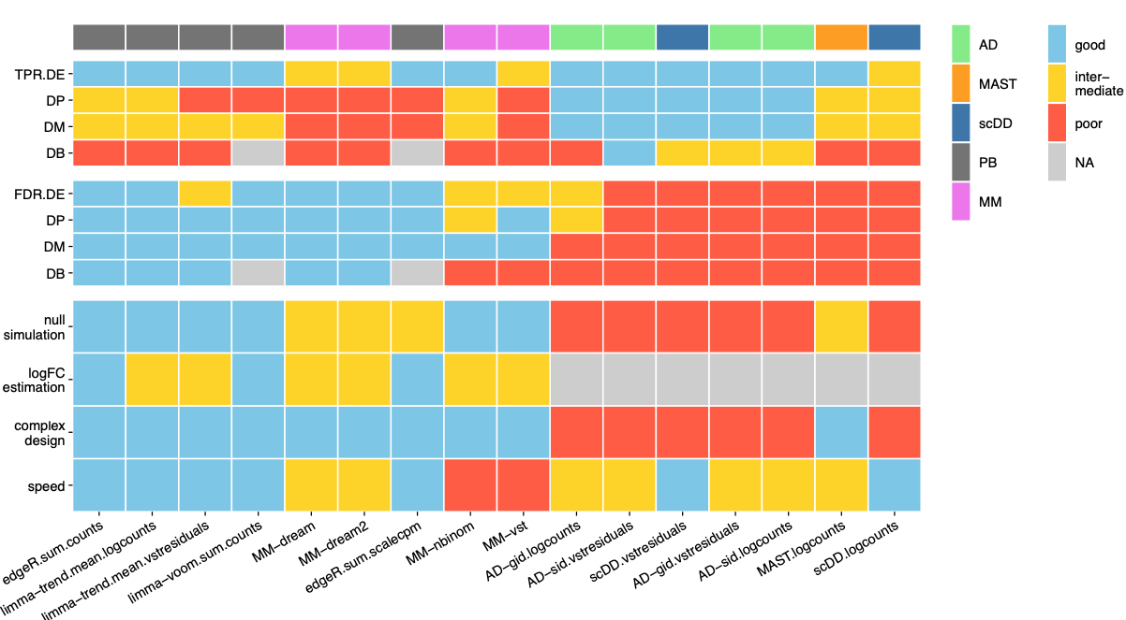
edgeR with aggregate counts (across cells from given individual) simple and most powerful!!

Slide 47
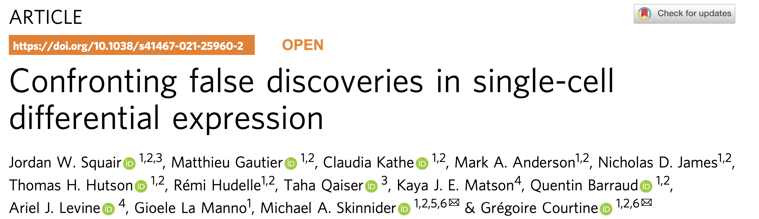
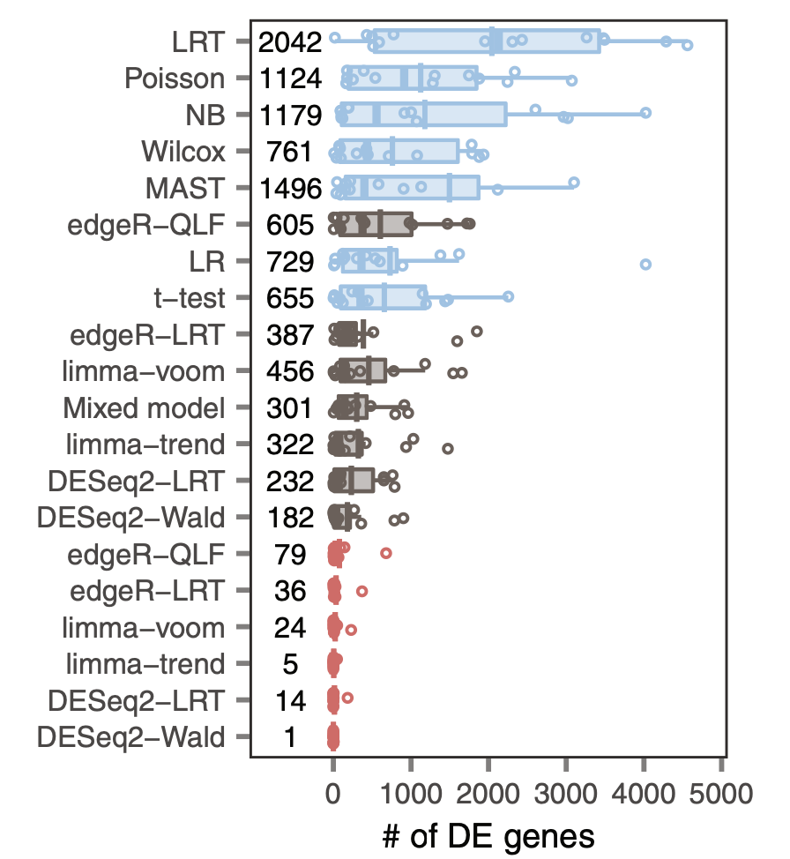
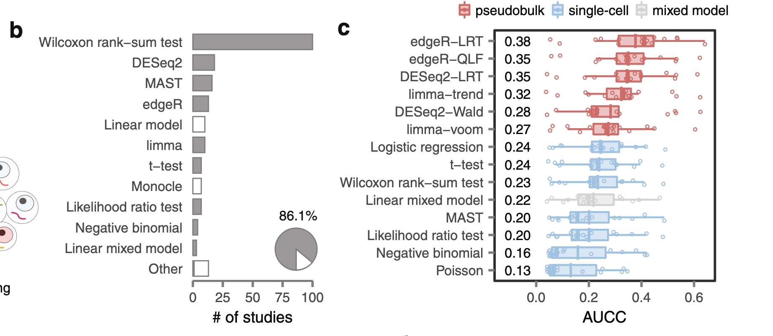
Assessment of True Positives
Assessment of False Positives

Slide 48
Between cluster:
Multi-sample-multi condition comparison
Cell-type (cluster) proportions from each subject may be associated with condition under study
We can model the change in the odds of cluster membership of cells from a given subject with change in condition
Use generalized linear mixed effects models

Slide 49
Hands on:
Multi-sample-multi condition comparison

Slide 50
Outline for this session
Main messages
Introduce the data and the research questions (5 min)
Primer on statistics (5 min)
Normalization (10 min)
Finding marker genes (5 min)
Batch correction (15 min)
  Hands-on
Multi-sample multi-condition comparison (30 min)
  Hands-on
Reiterate the main messages

Slide 51
Main points I want to convey
State of art of the design and statistical analyses of scRNAseq data is still in flux
  Benchmarks in different areas are being increasingly available
There are better designs
  Most important: Please include replicates drawn from the population you want to make a claim about
There are better statistics/ways to get “more” reproducible results.
  Normalization
  Identification of marker genes
  Multi-sample multi-condition comparison
  Batch correction
Notes:
Every scRNA-seq data may look similar to tools like Seurat/scNetViz.
But underlying the data is a story, a design
Whatever tests we perform to estimate p-values, should take into account this design.
Unless the variability and dependency implicit in the design is taken into account in estimating fold-changes, the associated p-values are incorrect. We are therefore not controlling the number false positives in any resulting list of genes. Our designs and associated analyses may then end up black lists created by John Ionidis.

Slide 52
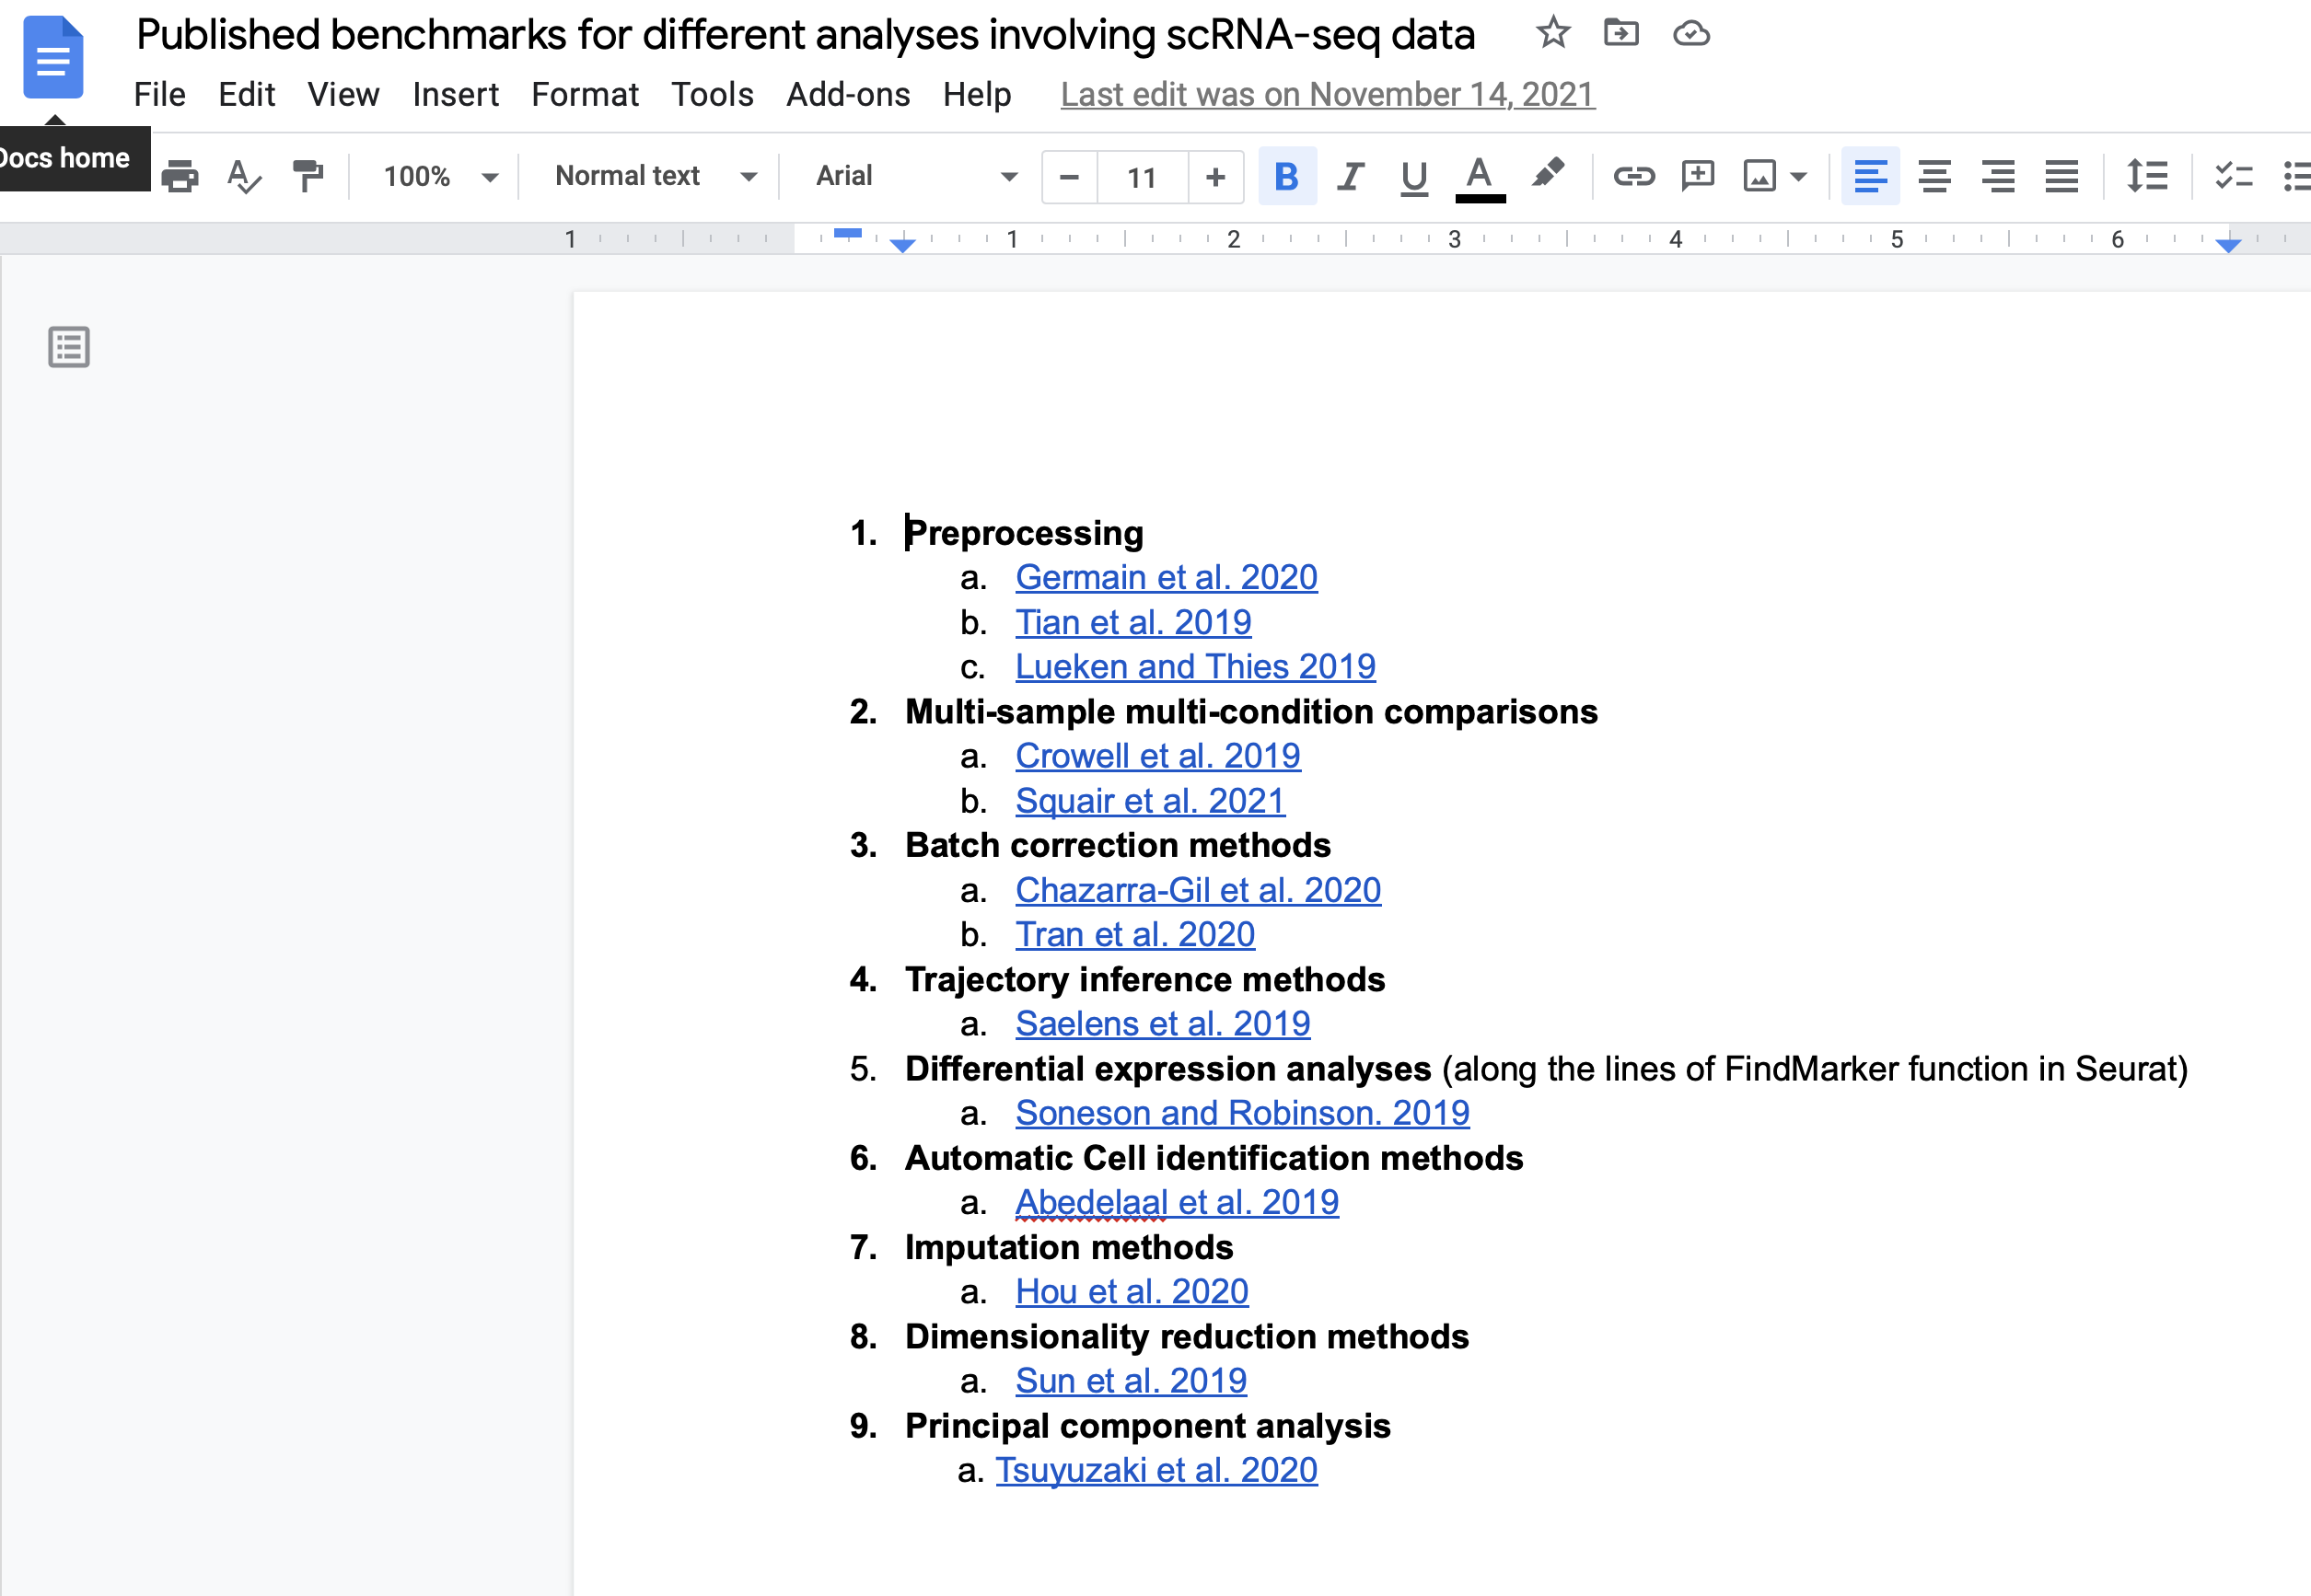
Benchmarks will help you narrow down your choice of right tools
Published benchmarks for different classes methods/analyses on single-cell RNA-seq data

Slide 53
Helpful resources
Wynton Slack channel
  ucsf-wynton.slack.com
Gladstone Bioinformatics Core slack channel
  https://gladstoneinstitutes.slack.com/archives/C0145F1L7QS
Wynton tutorials
  https://github.com/ucsf-wynton/tutorials/wiki

Slide 54
Your feedback is important to us!
https://www.surveymonkey.com/r/F75J6VZ
~3 min.

Slide 55
Thank you
Krishna Chaudhary, Bioinformatics Core
Alex Pico, Bioinformatics Core
Min-Gyoung Shin, Bioinformatics Core

Slide 57
Distribution of p-values across all genes (simulated data)

Slide 58
Scatter of fold-changes over repeated experiments (simulated data)
More left skewed p-value distribution, the more reproducible the results!

Slide 59
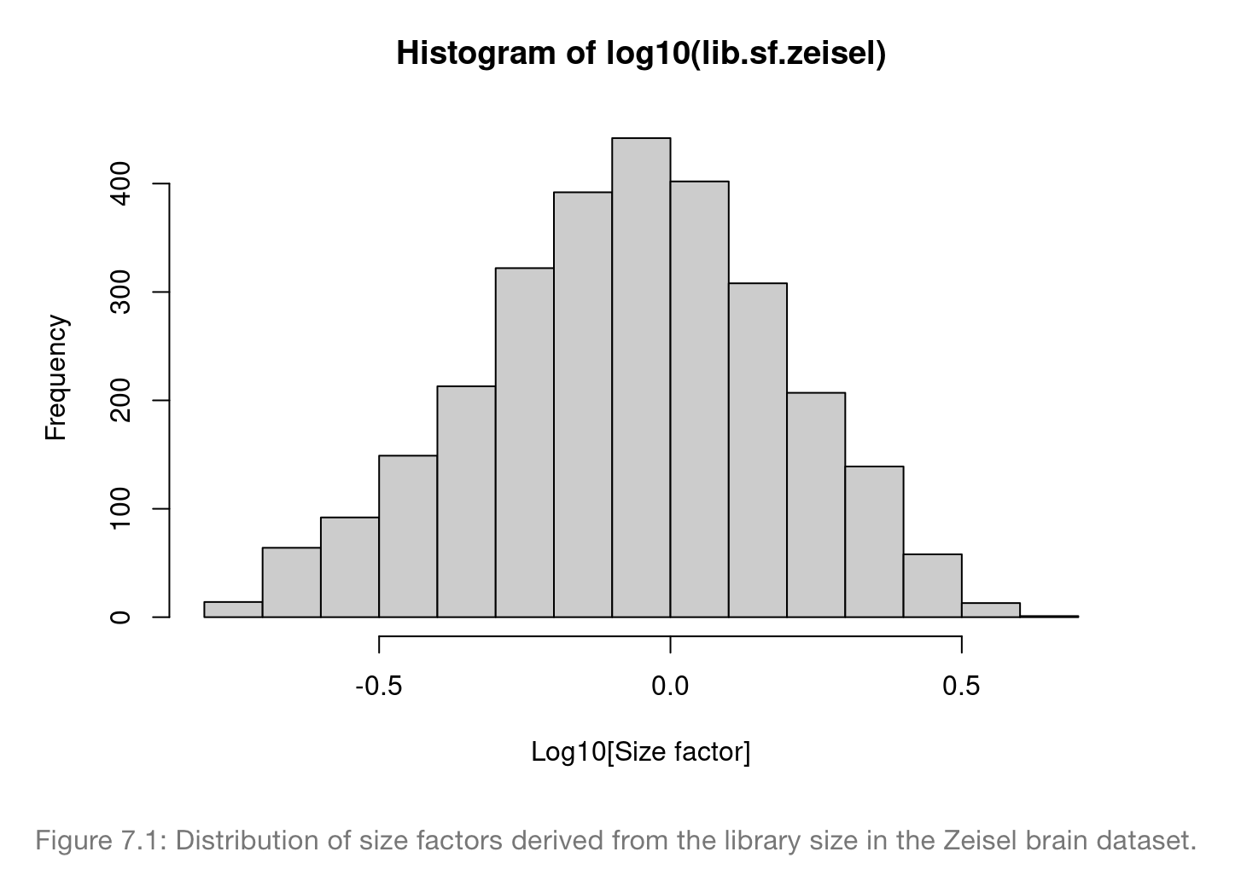
1. Library size normalization
E.g.: LogNormalize in Seurat
Assumption: No “imbalance” in the DE genes between any pair of cells
Advantages: Simple to understand, quick to implement
Disadvantages: Could introduce biases in clustering, low-dimensional reduction, differential expression
Method: Normalize reads by sequencing depth per cell
Notes:
http://bioconductor.org/books/release/OSCA/normalization.html#normalization-by-deconvolution

Slide 60
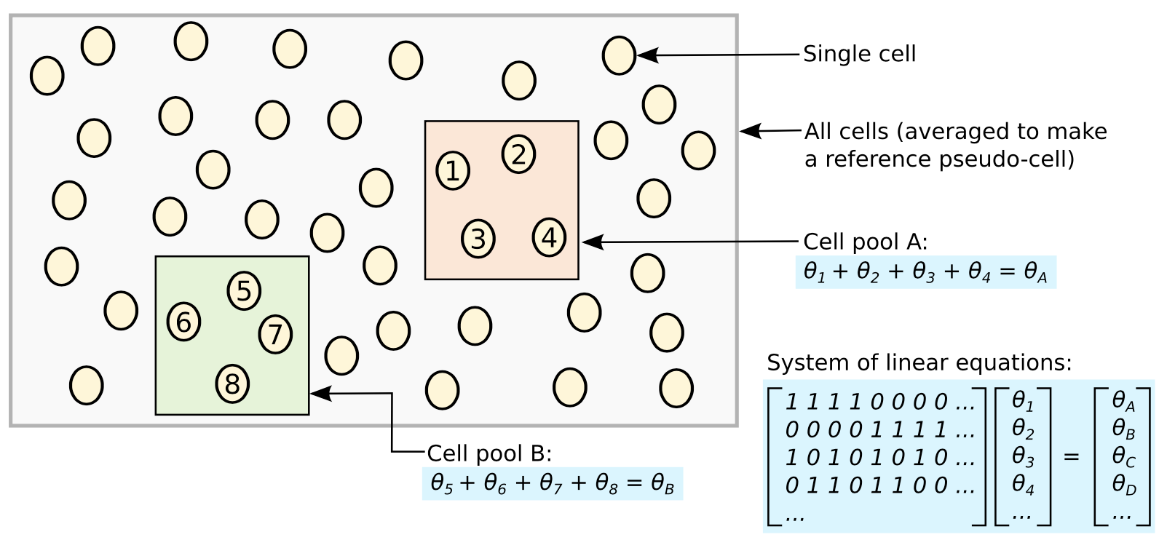
2. Deconvolution normalization
E.g.: scran, edgeR, DESeq2 in Bioconductor;
Assumption: input RNA quantity from non-diff expressed genes is the same across all cells. Most genes are not differentially expressed
Advantage: Treats data as counts unlike LogNormalize
Method: Compute size factors by pooling cells
Notes:
Lun et al. Genome Biology (2016) 17:75

Slide 61
3. Spike-in normalization
Assumption: Same amount of spike-in RNA in each cell
Cell differences in the coverage of the spike-in transcripts due to capture efficiency or sequencing depth
Advantage: Does not require the assumption of same amount of starting RNA material per cell
Advantage: Can treat data as count data
Method: Use differences in coverage of spike-in transcripts to normalize reads assigned to genes

Slide 62
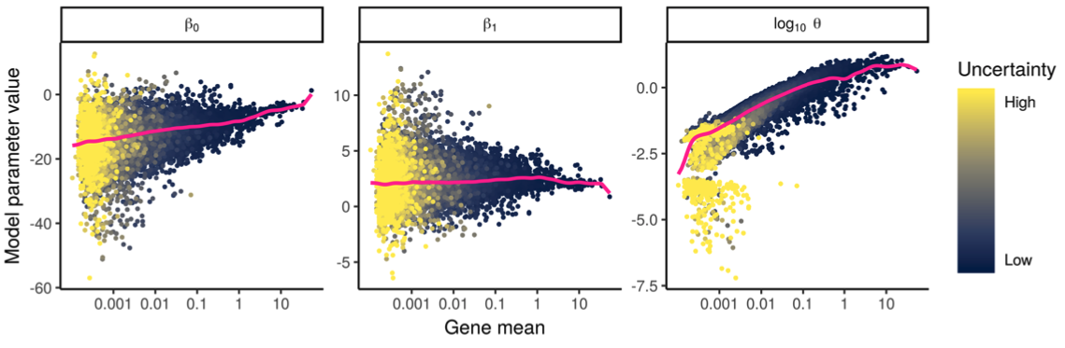

4. Variance-stabilizing transformation
SCTransfrom in Seurat, zinbwave in Bioconductor
Assumption: Most genes are not differentially expressed
Advantage: Treats data as counts unlike LogNormalize
Disadvantage: Can be computationally intensive
Method: “Regularized” dependence of count distribution parameters on gene abundance
Mean expression of
gene i
Sequencing depth

