Slide 1
Introduction to RNA-seq data analysis
Gladstone Institutes
Krishna Choudhary
Bioinformatics Core, GIDB
March, 2020

Slide 2
Overall goals
Demystifying RNA-Seq computational analysis.
Enable informed conversations with computational biologists.
Work with Galaxy.

Slide 3
Contents
Introduction
From sequencer output to differential analysis (Hands-on)
Conclusion

Slide 4
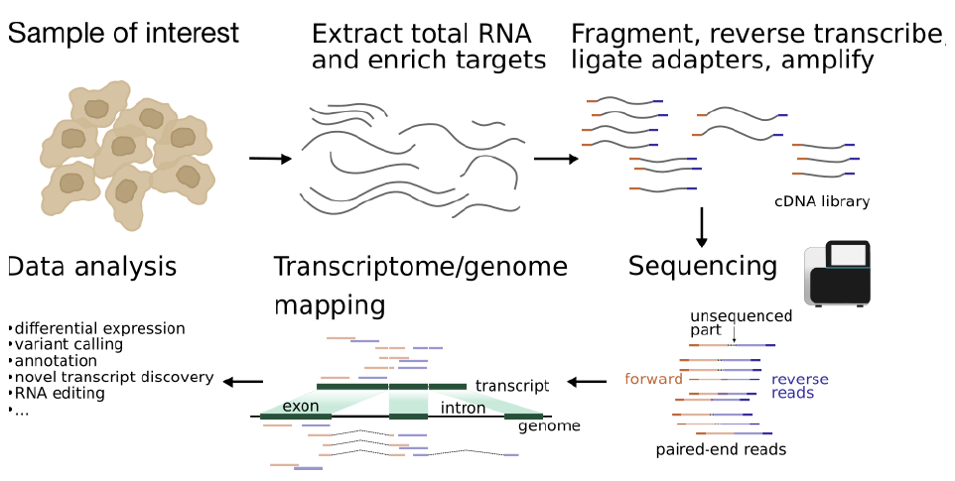
Typical protocol

Slide 5

Sequencer
FASTQ
Check quality
Trim adapters
Check quality
Map reads
Check quality
Tally counts
Check quality
DGE analysis

Slide 6
Experiment design influences data analysis. (should be planned to address relevant questions)
What is the biological question that we seek to answer?
How many tissue types and/or time points to compare?
How deep should we sequence?
Read length?
Which sequencing platform?
Single-end or paired-end?
Pooling?
Biological replicates?
Technical replicates?
Additional considerations?
Not the subject matter today!
Workshop on April 2 by Reuben Thomas:
Intro to statistics and experimental design.
Reading material in Dropbox:
RNA sequencing data : hitchhiker’s guide
to expression analysis by Berge et al., 2018

Slide 7
Dataset
Small dataset with 100k reads (for practice only).
FASTQ to tallying counts.
Real counts data (GSE49712).
Use this for DGE analysis.
5 replicates of two groups.
Group A: Strategene Universal Human Reference RNA
Group B: Ambion Human Brain Reference RNA
Notes:
https://www.ncbi.nlm.nih.gov/geo/query/acc.cgi?acc=GSE49712

Slide 8
Sequencing centers provide FASTQ files. (~15 min)
Section goal: Understanding origin and contents of FASTQ file type.

Slide 9
cDNA library is applied to a flow cell.
Notes:
https://bitesizebio.com/13546/sequencing-by-synthesis-explaining-the-illumina-sequencing-technology/

Slide 10
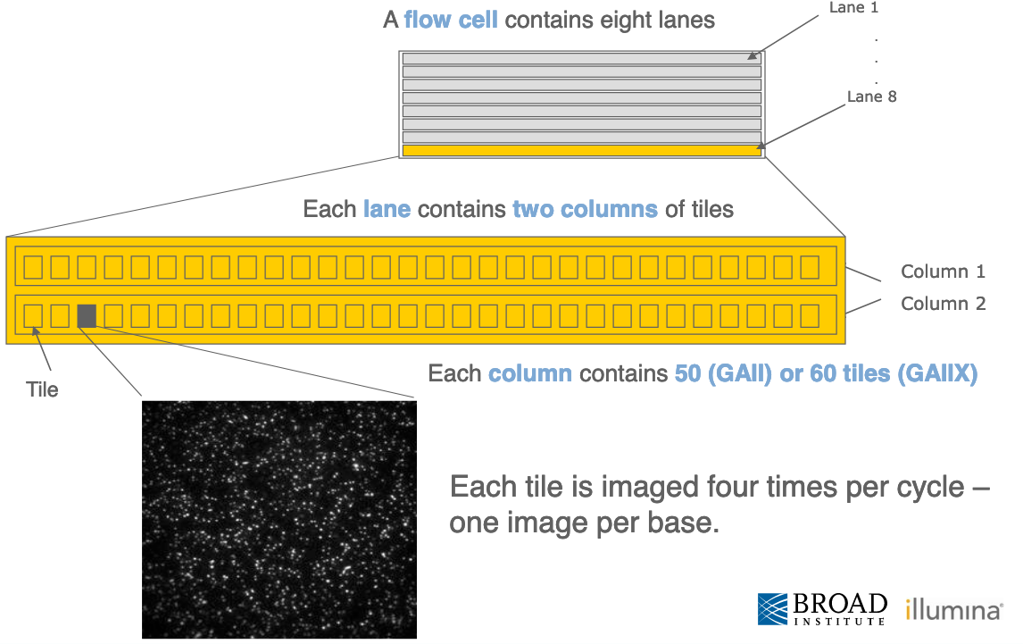
Flow cells are organized in lanes, columns and tiles.
Notes:
https://www.broadinstitute.org/files/shared/illuminavids/sequencingSlides.pdf

Slide 11
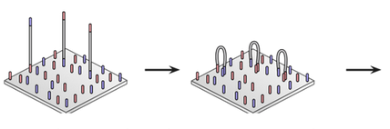
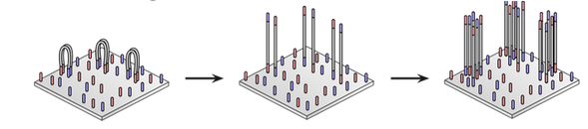
DNA fragments immobilized on flow cell & amplified into clonal clusters.
Synthesize complementary strand
Repeat steps =>
Clonal clusters
Immobilization
Bridging
Linearization
Fragments bend. Adapter on other end pairs with complementary sequence.
cDNA fragments stick to complementary sequences on flow cell.
Notes:
https://kscbioinformatics.wordpress.com/2017/02/13/illumina-sequencing-for-dummies-samples-are-sequenced/

Slide 12
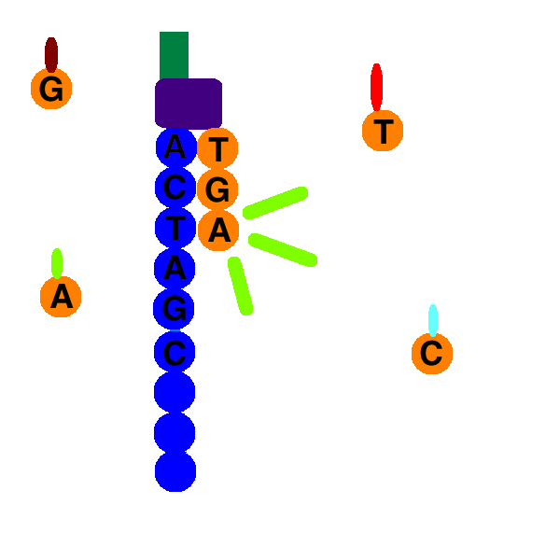
Sequencing by Synthesis
Adapters contain primer binding sites.
Nucleotide with reversible terminator & fluorophore added.
Image nucleotide added.
Remove terminator and fluorophore.
Repeat 2-4.
Notes:
Mention that one can read into adapter.

Slide 13
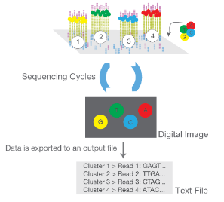
Strong signal from monoclonal clusters.

Slide 14
FASTQ files contain detailed information about each read.
Read sequence.
Instrument used, flow cell id, lane number, tile number, etc.
Quality of each base call.

Slide 15
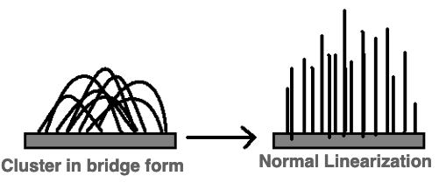
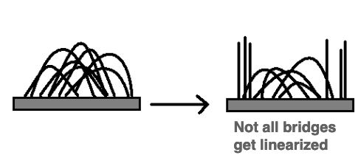
Base calling may not be accurate. Various possible causes: Example
Ideal world
Real world
Notes:
https://www.broadinstitute.org/files/shared/illuminavids/sequencingSlides.pdf

Slide 16
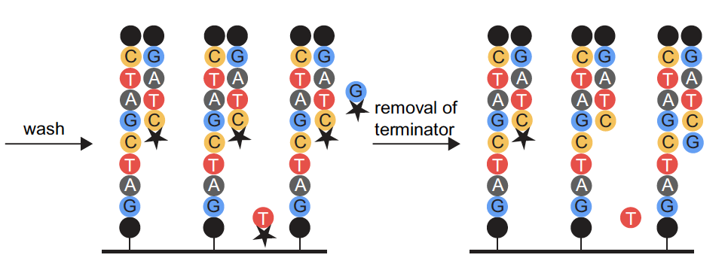
Base calling may not be accurate. Various possible causes: Example

Slide 17
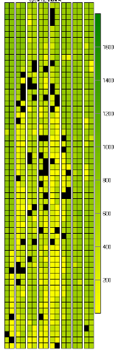
Base calling may not be accurate. Possible causes
Blocking of synthesis after one nucleotide addition may be inefficient.
Clusters might not be monoclonal.
A tile may be out of focus.
Oil, reagent, etc. on flow cell or imaging component, etc.
=> Need to record quality of each base call.
Notes:
https://www.broadinstitute.org/files/shared/illuminavids/sequencingSlides.pdf

Slide 18
Example FASTQ file with one read only.
Open Single_read.fastq

Slide 19
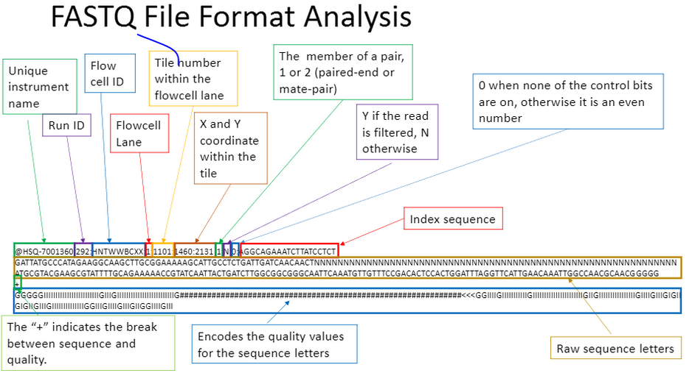
Four lines per read: 1. Read ID, 2. Sequence, 3. Space for optional info, 4. Quality.
Notes:
https://kscbioinformatics.wordpress.com/2017/02/13/illumina-sequencing-for-dummies-samples-are-sequenced/
https://help.basespace.illumina.com/articles/descriptive/fastq-files/

Slide 20
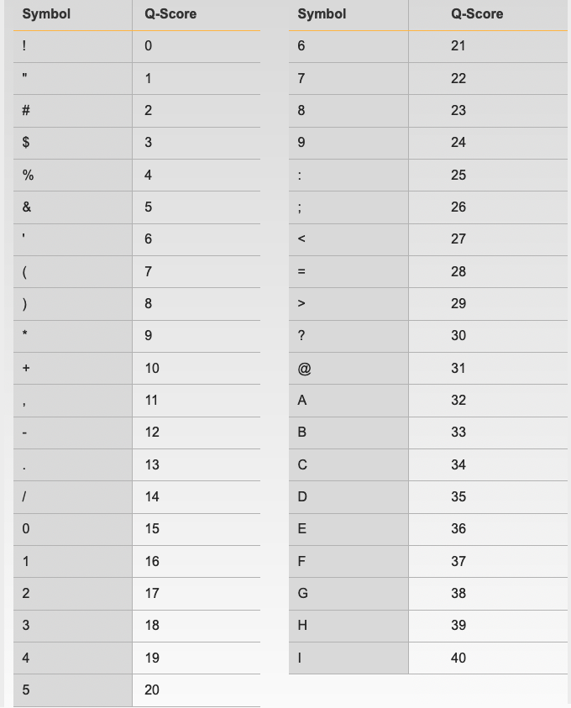
Quality is encoded as symbols.
Quality measured in terms of Phred scores.
Link for Illumina encoding of scores in description.
Notes:
https://www.broadinstitute.org/files/shared/mpg/nextgen2010/nextgen_poplin.pdf
https://support.illumina.com/help/BaseSpace_OLH_009008/Content/Source/Informatics/BS/QualityScoreEncoding_swBS.htm

Slide 21
Adapters, primers, contaminants, target sequences, etc. represented in FASTQ files.
Open Bacteria_GATTACA_L001_R1_001.fastq.

Slide 22
Length of insert < Length of reads ordered => Adapters included in reads.
Notes:
Mention that one can read into adapter.

Slide 23
Naming conventions for fastq files.
File names often follow a format.
SampleName_Barcode_LaneNumber_ReadNumber_SetNumber.fastq
Ex – Bacteria_GATTACA_L001_R1_001.fastq
Paired-end reads named with R1 and R2 in file name.
Ex – Bacteria_GATTACA_L001_R1_001.fastq and Bacteria_GATTACA_L001_R2_001.fastq
File extensions may be .fq or even .txt.
Often compressed using gzip.
gzip is free and open-source.
Resulting file names have .gz added. Example – .fq.gz.
Notes:
https://support.illumina.com/content/dam/illumina-support/documents/documentation/software_documentation/bcl2fastq/bcl2fastq_letterbooklet_15038058brpmi.pdf

Slide 24
Quality control of sequencing files. (~ 30 mins)
Section goal: Running FastQC and interpreting results.

Slide 25
FastQC: Tool for quality control of sequencing data
Summarizes quality of base calls.
Checks for presence of know adapters.
Any sequences more frequently observed than typical?
Any sequence biases?
Any GC biases?
…
Notes:
https://rtsf.natsci.msu.edu/genomics/tech-notes/fastqc-tutorial-and-faq/
https://www.bioinformatics.babraham.ac.uk/projects/fast
https://dnacore.missouri.edu/PDF/FastQC_Manual.pdfqc/

Slide 26
Galaxy: Open source, web-based platform that integrates many tools.
Free, public, internet accessible resource.
https://usegalaxy.org/
Data transfer and data storage are not encrypted.
DO NOT UPLOAD PROTECTED DATA!!!
For protected or large data:
Setup local galaxy instance.
Run Galaxy on the cloud.
Notes:
https://galaxyproject.github.io/training-material/topics/introduction/slides/introduction.html#25
https://galaxyproject.github.io/training-material/topics/introduction/

Slide 27
What if QC gives warn/fail flag?
Non-normal GC content per read?
Normal expected for whole-genome shotgun sequencing.
RNA-seq might give different distributions.
Non-uniform sequence content per nucleotide?
First 10-15 nt in RNA-seq often non-uniform.
High duplication levels or over-represented sequences?
Are they contaminants, e,g. adapers or PCR duplicates?
If so, clean up contaminants.
Could be attributed to highly abundant transcripts.
Are sequence biases expected?
For more: https://rtsf.natsci.msu.edu/genomics/tech-notes/fastqc-tutorial-and-faq/
Notes:
QC goal: Getting a feel of the data. What am I dealing with?

Slide 28
Examples of FastQC reports
Good Illumina data: https://www.bioinformatics.babraham.ac.uk/projects/fastqc/good_sequence_short_fastqc.html
Bad Illumina data: https://www.bioinformatics.babraham.ac.uk/projects/fastqc/bad_sequence_fastqc.html

Slide 29
✔️
Sequencer
FASTQ
✔️
Check quality
Trim adapters
Check quality
Map reads
Check quality
Tally counts
Check quality
DGE analysis

Slide 30
Cleaning up contaminants (20 mins)
Section goal: Run cutadapt on fastq files to remove adapters.

Slide 31

cutadapt removes adapters.
Search for adapter sequence in read.
Allow for mismatches in sequence.
If significant alignment, cut.
Notes:
Cutadapt: http://journal.embnet.org/index.php/embnetjournal/article/view/200
Trimmomatic: https://academic.oup.com/bioinformatics/article/30/15/2114/2390096

Slide 32

Alternative approach: Trimmomatic
Say adapter sequence in read is very short.
Can we still identify it?
Yes for paired-end reads.
Primer binding
Adapter
Notes:
Trimmomatic: https://academic.oup.com/bioinformatics/article/30/15/2114/2390096

Slide 33
What else to clean?
PCR primers?
Unique molecular identifiers?
Poor quality base calls?
…

Slide 34
Redo QC to ensure satisfactory quality.
Run FastQC.
Are over-represented sequences gone?

Slide 35
✔️
✔️
Sequencer
FASTQ
✔️
Check quality
Trim adapters
✔️
✔️
Check quality
Map reads
Check quality
Tally counts
Check quality
DGE analysis

Slide 36
Mapping reads (20 mins)
Section goal: Understand alignment method

Slide 37
Mapping := Aligning reads to regions of reference DNA.
After cleaning, reads from real sample only. (Assumption)
Mapping := Aligning reads to regions of reference DNA.
Challenges:
Reference sequences can be very long (~3 billion bp for humans).
Order of 100 million reads to be mapped.
Sometimes, need to account for splicing.
Allow for PCR artifacts/sequencing errors.

Slide 38
Inputs needed.
Reads to align.
FASTQ file after cleaning.
Reference sequence to align to.
Example – “rDNA_sequence.fasta”
FASTA format. Two lines per sequence.
Starting with “>”, followed by sequence name/identifier.
Sequence.
File extensions: .fasta, .fa, .txt.

Slide 39
Indexing reference sequence speeds up mapping.
Use bowtie2 to build index.
Use cleaned reads and index of reference sequence to map.

Slide 40
Output => 1. Alignments in SAM format, 2. Summary of mapping statistics.
SAM format:
For each read, mapped where, in what orientation?
Summary statistics:
How many reads mapped?
How many unmapped?
…

Slide 41
Binary Alignment/Map (BAM) format
Alignment reports often very large files.
BAM extension used for compressed SAM files.

Slide 42
Sequence Alignment/Map (SAM) format
Open with Excel.
First few lines contain metadata about alignments.
These lines start with “@”.
Example – version of file format, sorting order of alignments, grouping, etc.
After header, a table of alignments.
Notes:
https://samtools.github.io/hts-specs/SAMv1.pdf

Slide 43
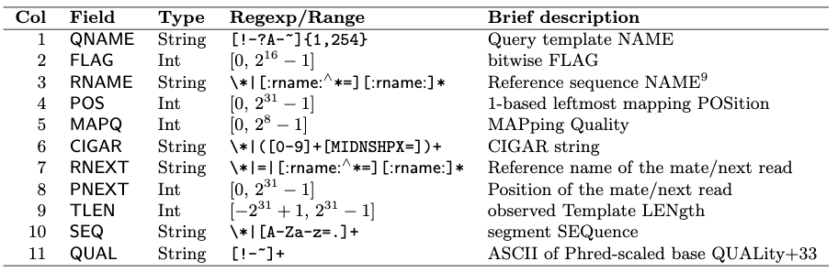
11 fields for each alignment (per row).
Notes:
https://samtools.github.io/hts-specs/SAMv1.pdf
https://broadinstitute.github.io/picard/explain-flags.html

Slide 44
Alternatives
Several. Example – bowtie2, BWA, subread, etc.
Differences in speed and memory requirement.
Pros and cons of each:
Example: Some handle spliced alignment, others do not.
…
Notes:
https://www.ncbi.nlm.nih.gov/pmc/articles/PMC3322381/pdf/nihms-366740.pdf

Slide 45
Online resources for sequencing data analysis
http://seqanswers.com/forums/
https://www.biostars.org/
https://www.rna-seqblog.com/
…

Slide 46
Tools to manipulate files are available.
Need to sort alignment report?
samtools
Need to convert FASTQ to FASTA?
fastx-toolkit
…
Google!

Slide 47
✔️
✔️
Sequencer
FASTQ
✔️
Check quality
Trim adapters
✔️
✔️
Check quality
✔️
Map reads
Check quality
✔️
Tally counts
Check quality
DGE analysis

Slide 48
Tally counts (~15 mins)

Slide 49
How many reads overlap annotated regions?
Need annotation information.
Need alignment information.
Use featureCounts.

Slide 50
✔️
✔️
Sequencer
FASTQ
✔️
Check quality
Trim adapters
✔️
✔️
Check quality
✔️
Map reads
Check quality
✔️
✔️
Tally counts
Check quality
DGE analysis

Slide 51
Downstream analysis (~15 mins)
No. 1: Differential gene expression analysis.

Slide 52
Gene-wise counts should be normalized before comparing between samples.
Counts can differ because of different library sizes.
Mapping statistics might be different for samples.
Real change in expression level of a gene.
…
Need to factor out differences due to non-biological reasons.

Slide 53
Counts may differ due to inherent noisiness of biological systems.
Identical individuals may give different counts.
Inherent variation used as benchmark to call out interesting variation.
Need to estimate inherent variation or dispersion.

Slide 54
✔️
✔️
Sequencer
FASTQ
✔️
Check quality
Trim adapters
✔️
✔️
Check quality
✔️
Map reads
Check quality
✔️
Tally counts
✔️
✔️
Check quality
✔️
DGE analysis

Slide 55
Your feedback is important to us!
https://bioinformatics-course-feedback.questionpro.com/
~5 min.

Slide 56
Conclusions (~5 min)

Slide 57
Topics covered
Steps of analysis.
Common tools, e.g., cutadapt, fastqc, bowtie2, edgeR, etc.
Common file formats, e.g., FASTQ, FASTA, SAM, GFF, etc.
Analysis with Galaxy.

Slide 58
Additional information: Sources of data
Sequence read archive
https://www.ncbi.nlm.nih.gov/sra
Download and install SRA toolkit
Step-by-step guide:
https://www.ncbi.nlm.nih.gov/sra/docs/sradownload/#download-sequence-data-files-usi

Slide 59
More tools
Quality control: RSeQC, MultiQC, etc.
Mapping: STAR, BWA, etc.
File manipulation: bedtools, samtools, fastx-toolkit, etc.
Visualization: UCSC Genome Browser
…

Slide 60
Upcoming Workshops
Intermediate RNA-Seq analysis
April 17
Single cell analysis (Symposium)
May 14
Pathway analysis
Oct 7

Slide 61
Thank you!

Slide 62
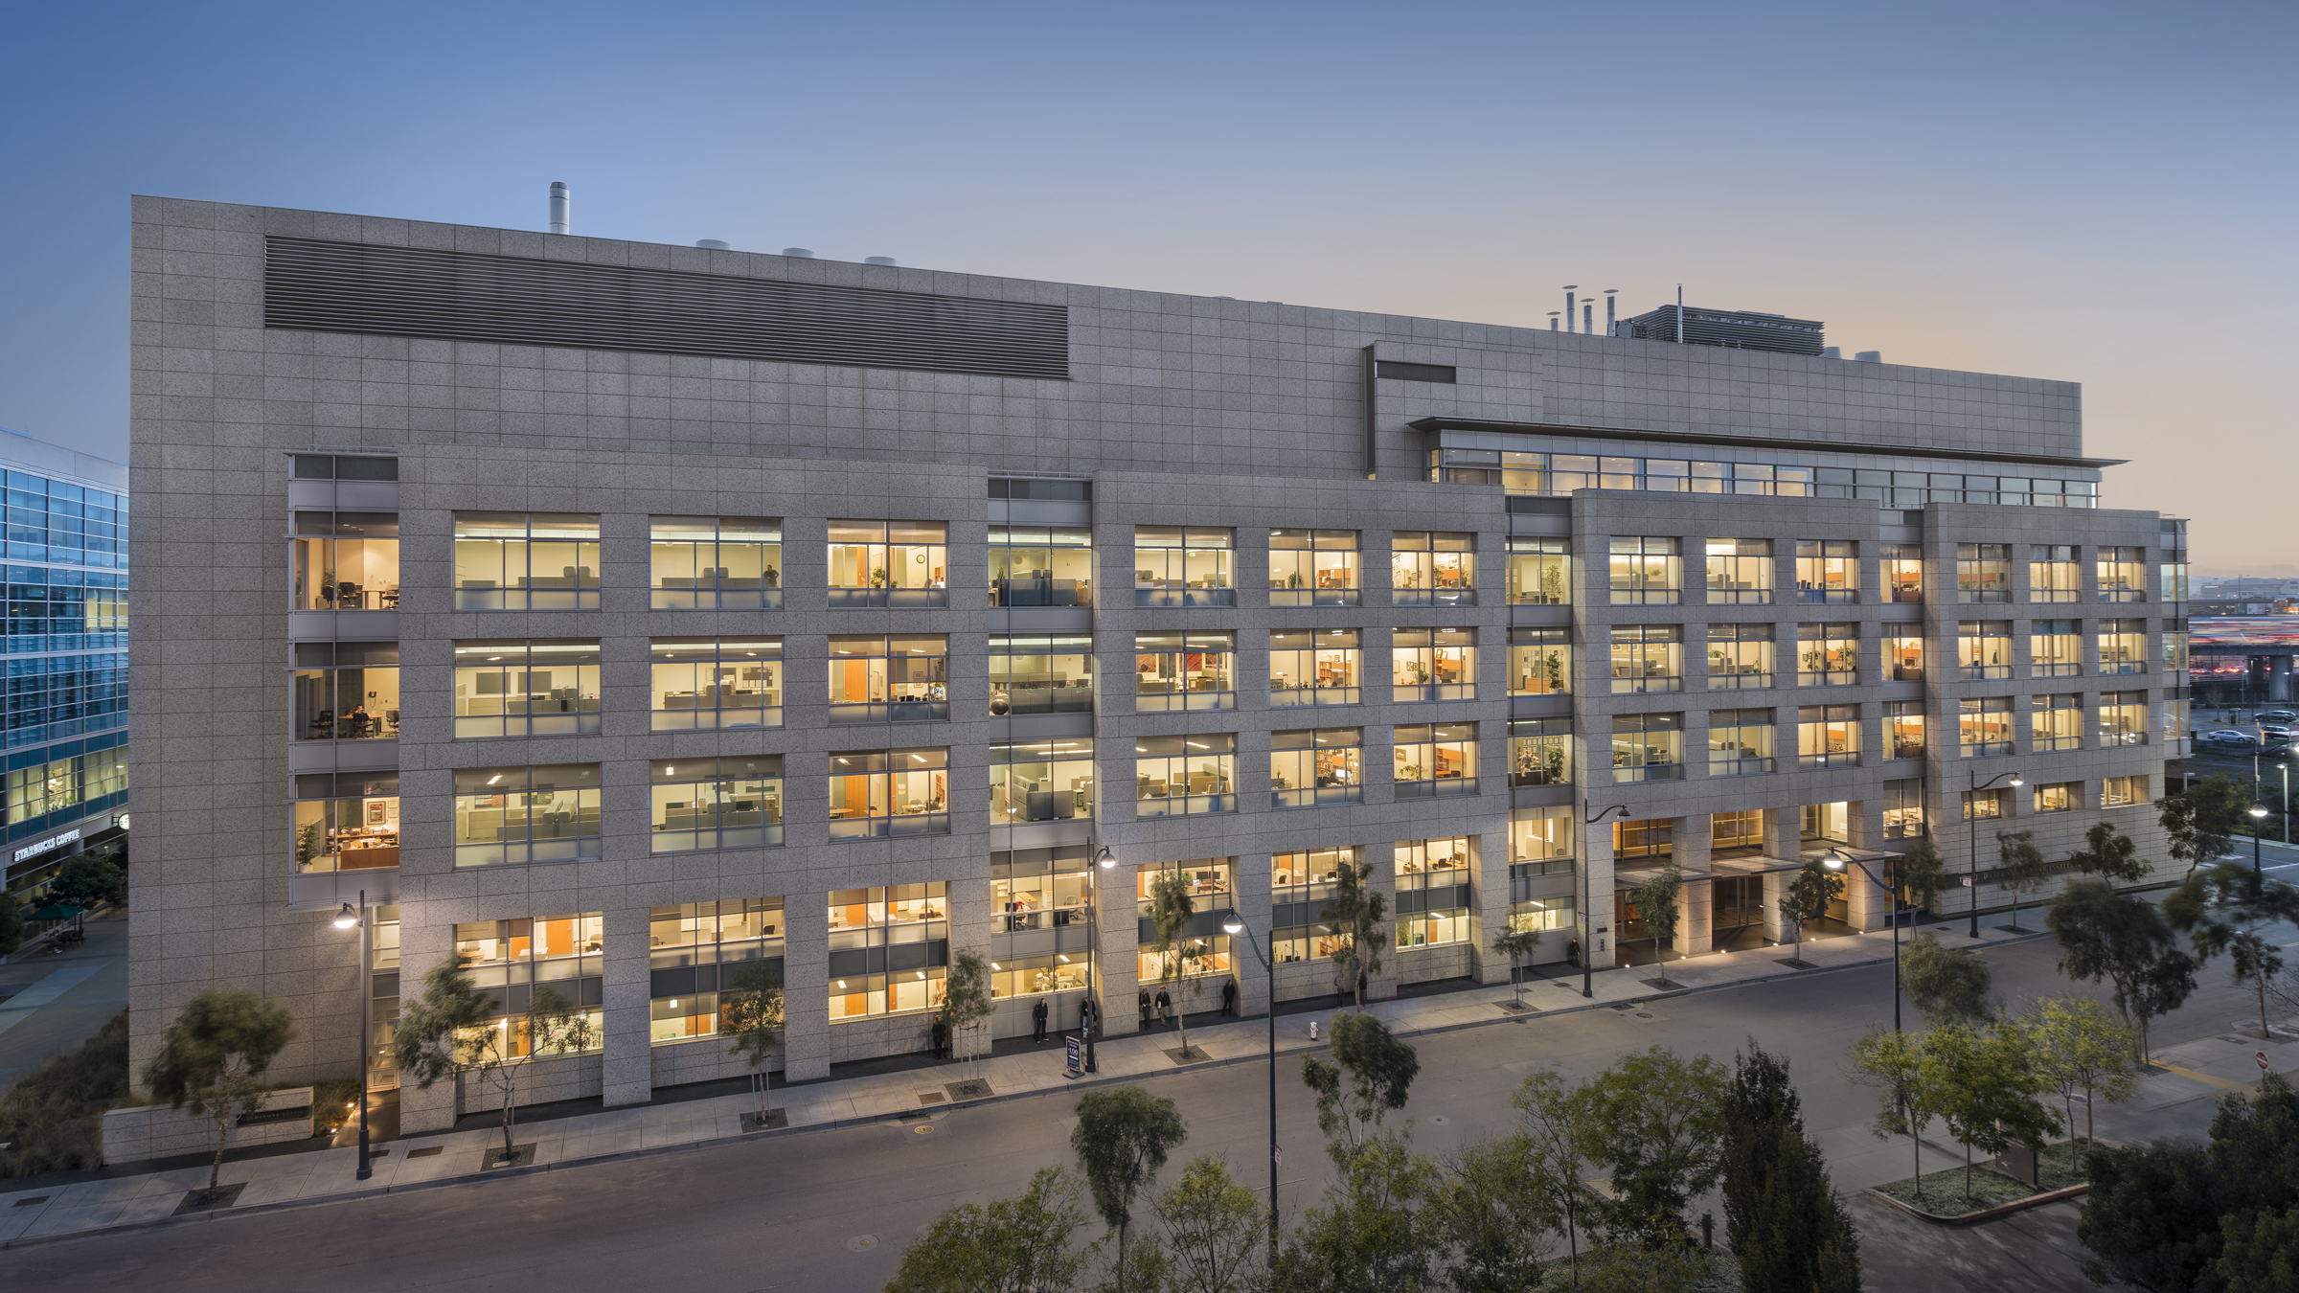
Notes:
This is Gladstone – We were founded 40 years ago and we are a basic biomedical

Slide 64
Applications
Genome annotation
Gene regulation
Clinical applications, e.g., molecular sub-classification of cancer
Meta-transcriptomics
Spatial transcriptomics
…

