Slide 1
RNA-seq data analysis:
From counts to differentially expressed genes using edgeR-quasi
Gladstone Institutes
Krishna Choudhary
Bioinformatics Core, GIDB
2020

Slide 2
Assumed background
Familiarity with R and RStudio
Familiarity with RNA-seq protocol
Familiarity with basic concepts of hypothesis testing

Slide 3
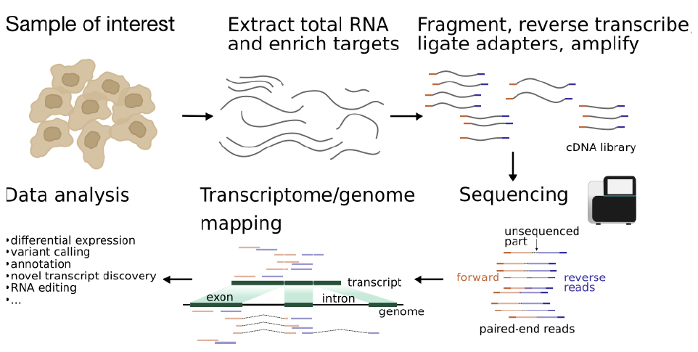
Typical protocol

Slide 4
Experiment design influences data analysis.
(should be planned to address relevant questions)
What is the biological question that we seek to answer?
How many tissue types and/or time points to compare?
How deep should we sequence?
Read length?
Which sequencing platform?
Single-end or paired-end?
Pooling?
Biological replicates?
Technical replicates?
Additional considerations?
Not the subject matter today!
Workshop by Reuben Thomas:
Intro to statistics and experimental design.
Reading material in Dropbox:
RNA sequencing data : hitchhiker’s guide
to expression analysis by Berge et al., 2018

Slide 5


Sequencing center
FASTQ
Check quality
Trim adapters
Check quality
Map reads
Check quality
Tally counts
(See link in description for a detailed slide deck on pre-processing.)
Check quality
DGE analysis
The subject matter for today.
Notes:
See Intro to RNA-seq workshop materials at https://github.com/gladstone-institutes/Bioinformatics-Workshops/wiki/Introduction-to-RNA-Seq-Analysis

Slide 6
Outline
Load and reformat the data
Exploratory visualization : MA plot
Create DGElist object and retrieve gene symbols
Filter genes with inadequate information
Normalize counts : What’s under the hood?
Exploratory visualization : MDS and PCA plots
Define and fit a model
Hypothesis testing (four example hypotheses)
Save results as a table and explore in Excel

Slide 7
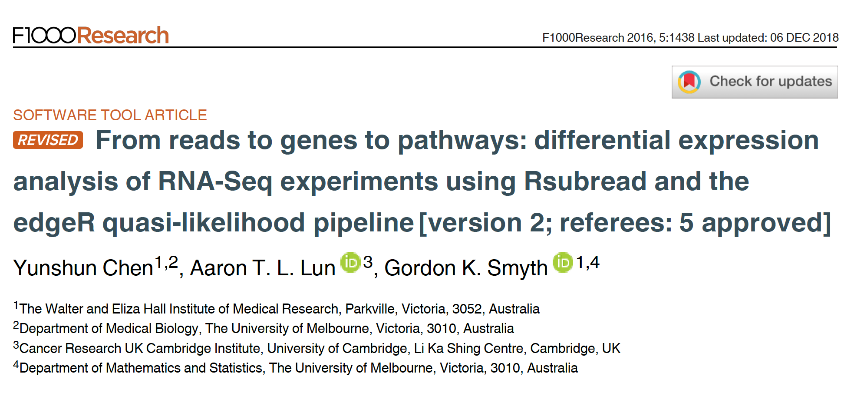
Reference for the workshop
Notes:
Relevant reading for theory:
1. Chen, Yunshun, Aaron TL Lun, and Gordon K. Smyth. "Differential expression analysis of complex RNA-seq experiments using edgeR." Statistical analysis of next generation sequencing data. Springer, Cham, 2014. 51-74.

Slide 8
Dataset
GEO accession: GSE60450
Tissue of origin: Mammary glands of mouse
Cell types: Basal stem-cell enriched cells (B) and committed luminal cells (L)
Biological conditions: Virgin, Lactating and Pregnant
# of groups: 2 cell types x 3 conditions = 6 groups
# of replicates: 2 of each group

Slide 9
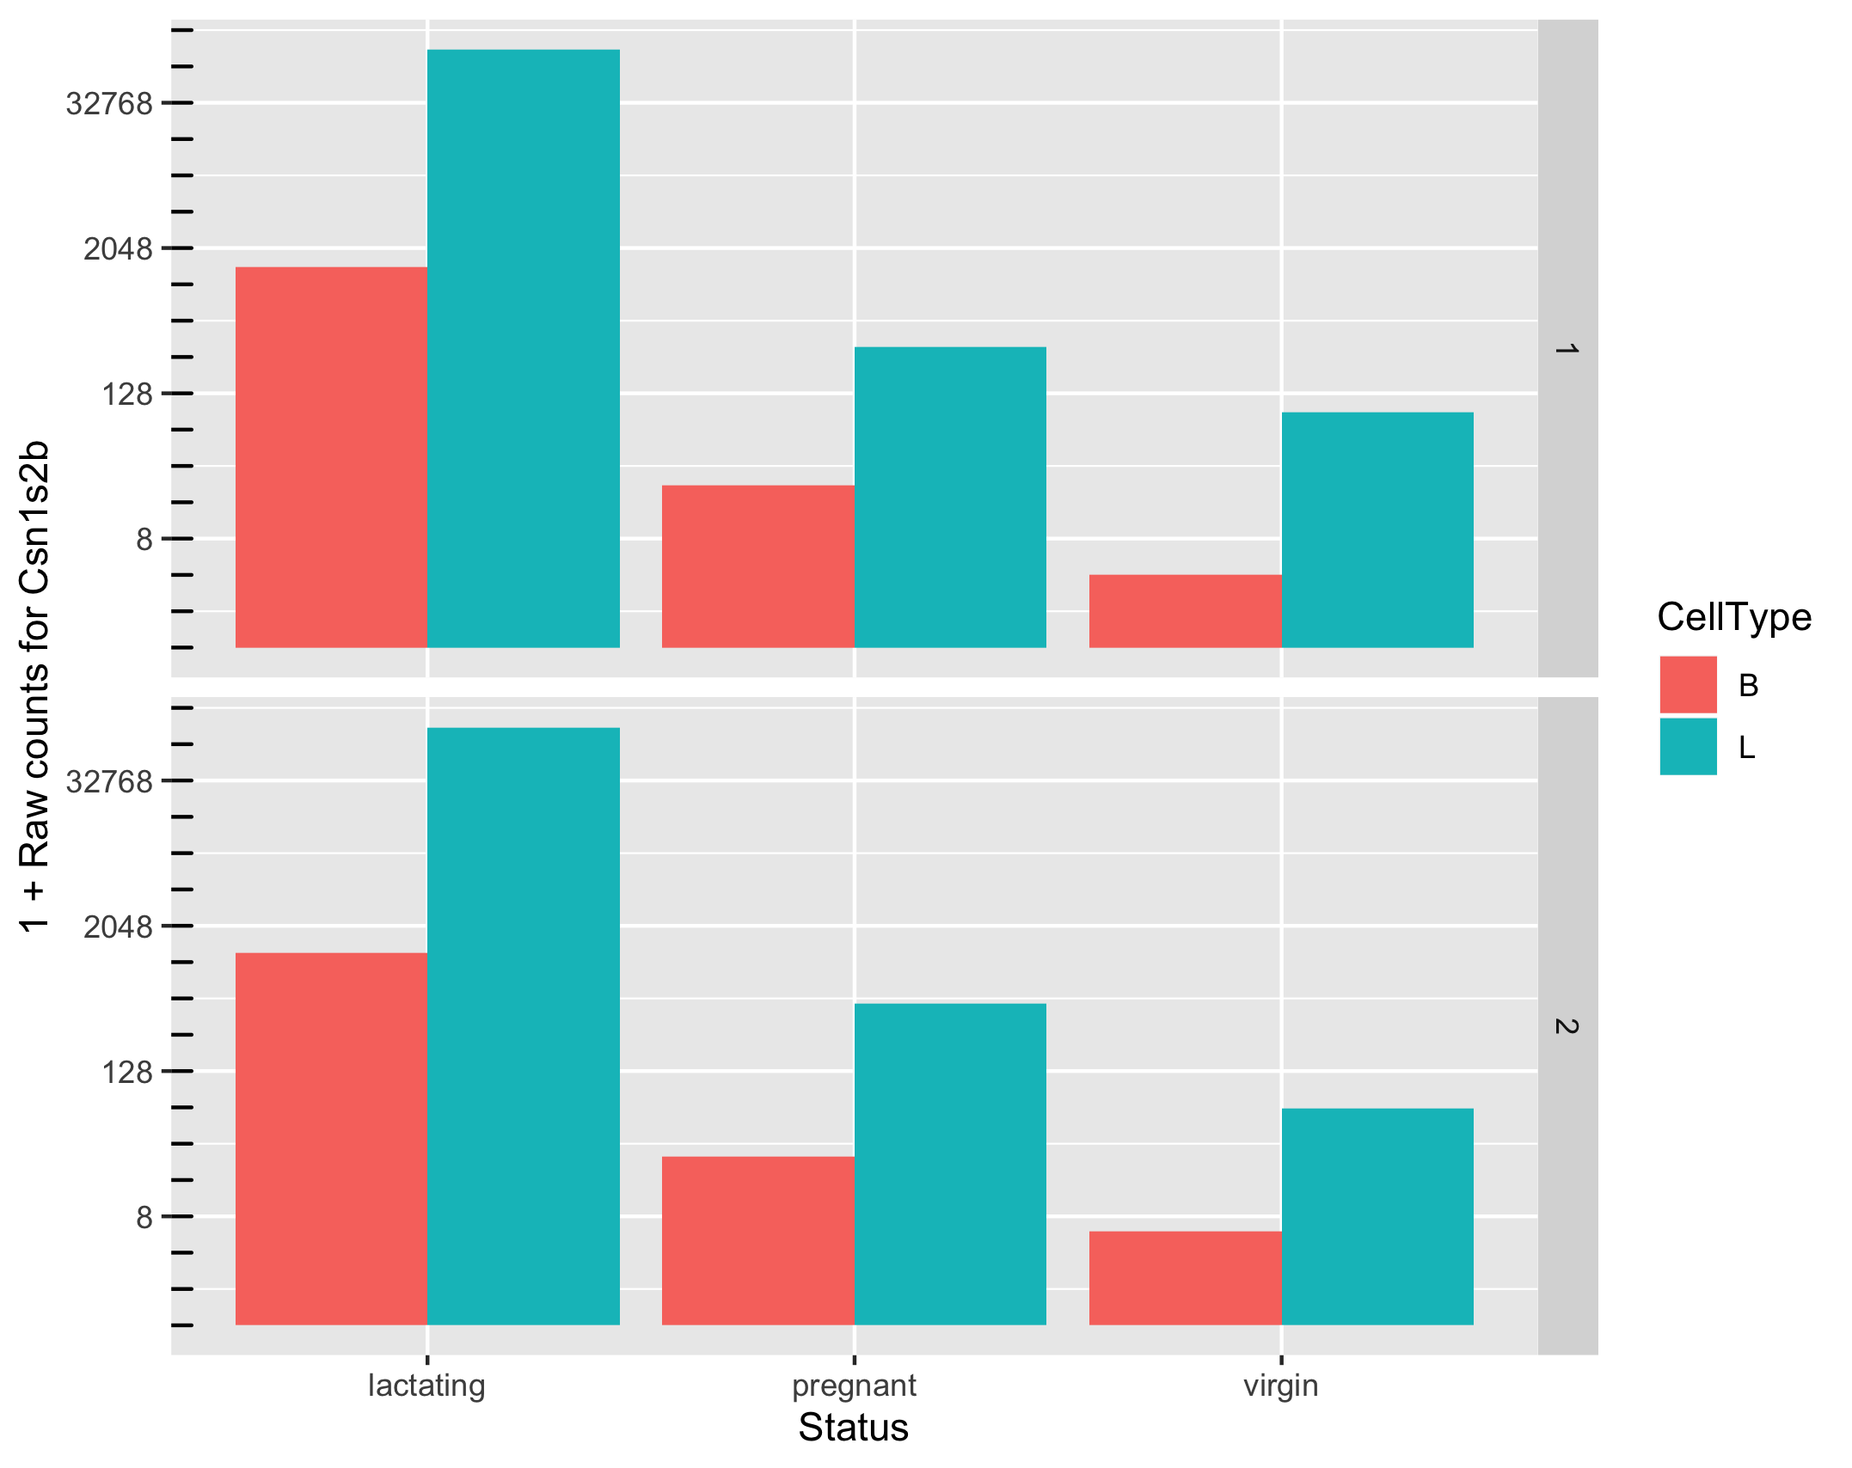
Goal: To identify a set of genes that are differentially expressed
Which comparisons are we interested in?
Example:
B vs L,
B.lactating vs L.pregnant,
...
All of them

Slide 10
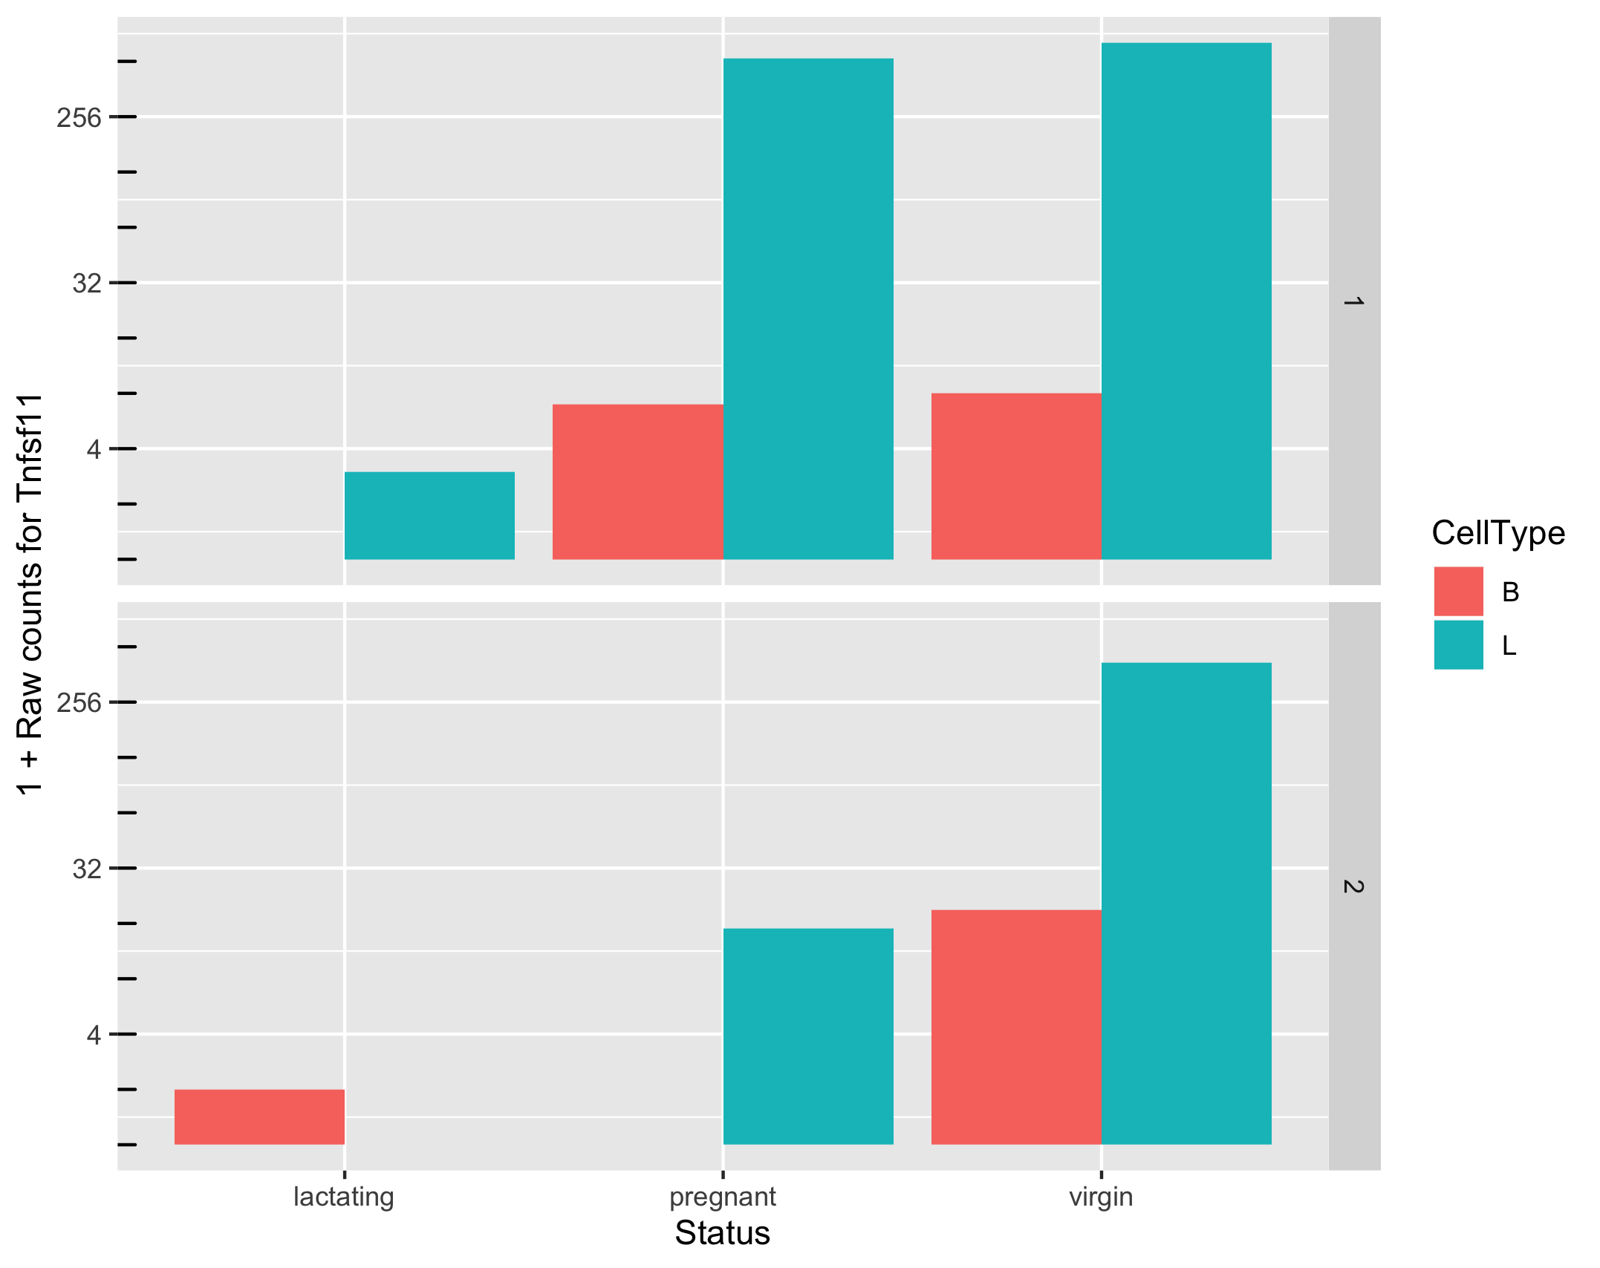
Goal: To identify a set of genes that are differentially expressed
How do we ensure high power for detection and high specificity when faced with noise?
Can we make reliable inferences for genes with very low counts? What should we consider “very low”?

Slide 11
Factors other than differential gene expression that cause variation in counts
Variation in sequencing depths => Need to normalize counts
Group | Total counts
B.virgin | 23085177
B.virgin | 21628857
B.pregnant | 23919152
B.pregnant | 22490570
B.lactating | 21382233
B.lactating | 19884434
Group | Total counts
L.virgin | 20213223
L.virgin | 21509988
L.pregnant | 22073815
L.pregnant | 21837341
L.lactating | 24638939
L.lactating | 24581591

Slide 12
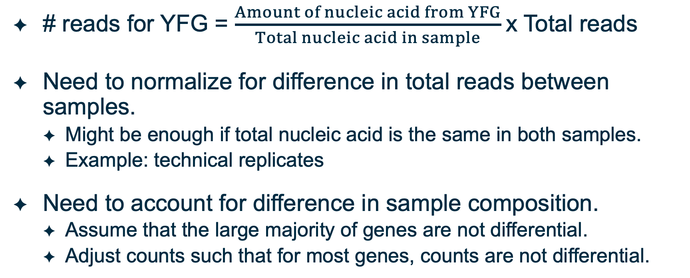
Observed counts depend on total reads sequenced and sample composition
# reads for YFG = $\frac{Amount of nucleic acid from YFG}{Total nucleic acid in sample}$x Total reads
Need to normalize for difference in total reads between samples.
  Might be enough if total nucleic acid is the same in both samples.
  Example: technical replicates
Need to account for difference in sample composition.
  Assume that the large majority of genes are not differential.
  Adjust counts such that for most genes, counts are not differential.

Slide 13
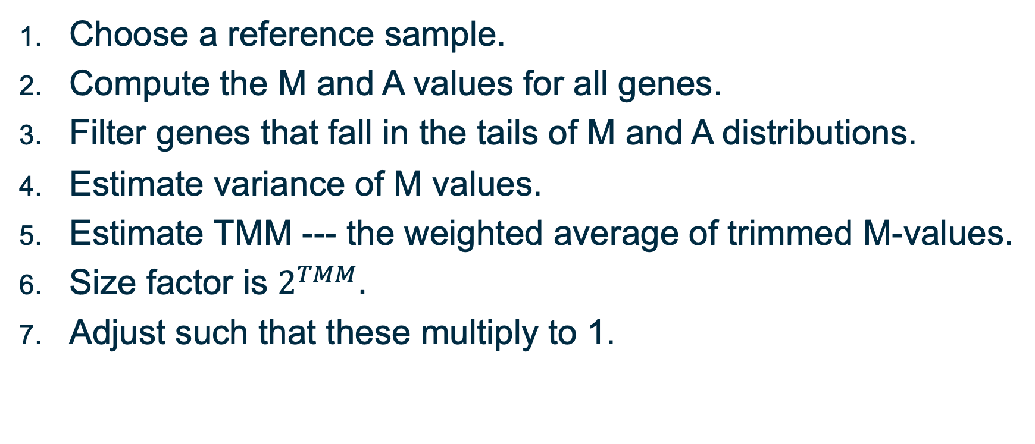
Normalization: Trimmed Mean of M-values
Choose a reference sample.
Compute the M and A values for all genes.
Filter genes that fall in the tails of M and A distributions.
Estimate variance of M values.
Estimate TMM --- the weighted average of trimmed M-values.
Size factor is $2^{TMM}.$
Adjust such that these multiply to 1.

Slide 14
Other approaches to normalization
RLE approach by Anders and Huber (2010)
  Reference: geometric mean of all samples
  Normalization factor: median ratio of each sample to the reference
  Identical to TMM approach
  See link in description for complete reference
Upper quartile normalization by Bullard et al (2010)
  Normalization factor: 75% quantile of the counts for each sample
  Not recommended in general
  See link in description for complete reference
Notes:
Anders, S, Huber, W (2010). Differential expression analysis for sequence count data. Genome Biology 11, R106.
Bullard JH, Purdom E, Hansen KD, Dudoit S. (2010) Evaluation of statistical methods for normalization and differential expression in mRNA-Seq experiments. BMC Bioinformatics 11, 94.

Slide 15
Empirical Bayes estimates of dispersion parameters: Learning from the experience of others
For an intuitive explanation by Bradley Efron, see link in description
Original paper: Robbins, Herbert. An Empirical Bayes Approach to Statistics. (see description for complete reference)
Notes:
https://smartech.gatech.edu/bitstream/handle/1853/35125/efron_videostream.html?sequence=8&isAllowed=y
Robbins, Herbert. An Empirical Bayes Approach to Statistics. Proceedings of the Third Berkeley Symposium on Mathematical Statistics and Probability, Volume 1: Contributions to the Theory of Statistics, 157--163, University of California Press, Berkeley, Calif., 1956. https://projecteuclid.org/euclid.bsmsp/1200501653

Slide 16
Your feedback is important to us!
https://bioinformatics-course-feedback.questionpro.com/
~5 min.

Slide 17
Thank you.

