Slide 1
Introduction to Statistics:
Hypothesis Testing & Experimental Design
Gladstone Institutes
Reuben Thomas & Michela Traglia
04/10/2024

Slide 2
Leading the discussion …
Reuben Thomas – Associate Core Director
Michela Traglia– Senior Statistician

Slide 3
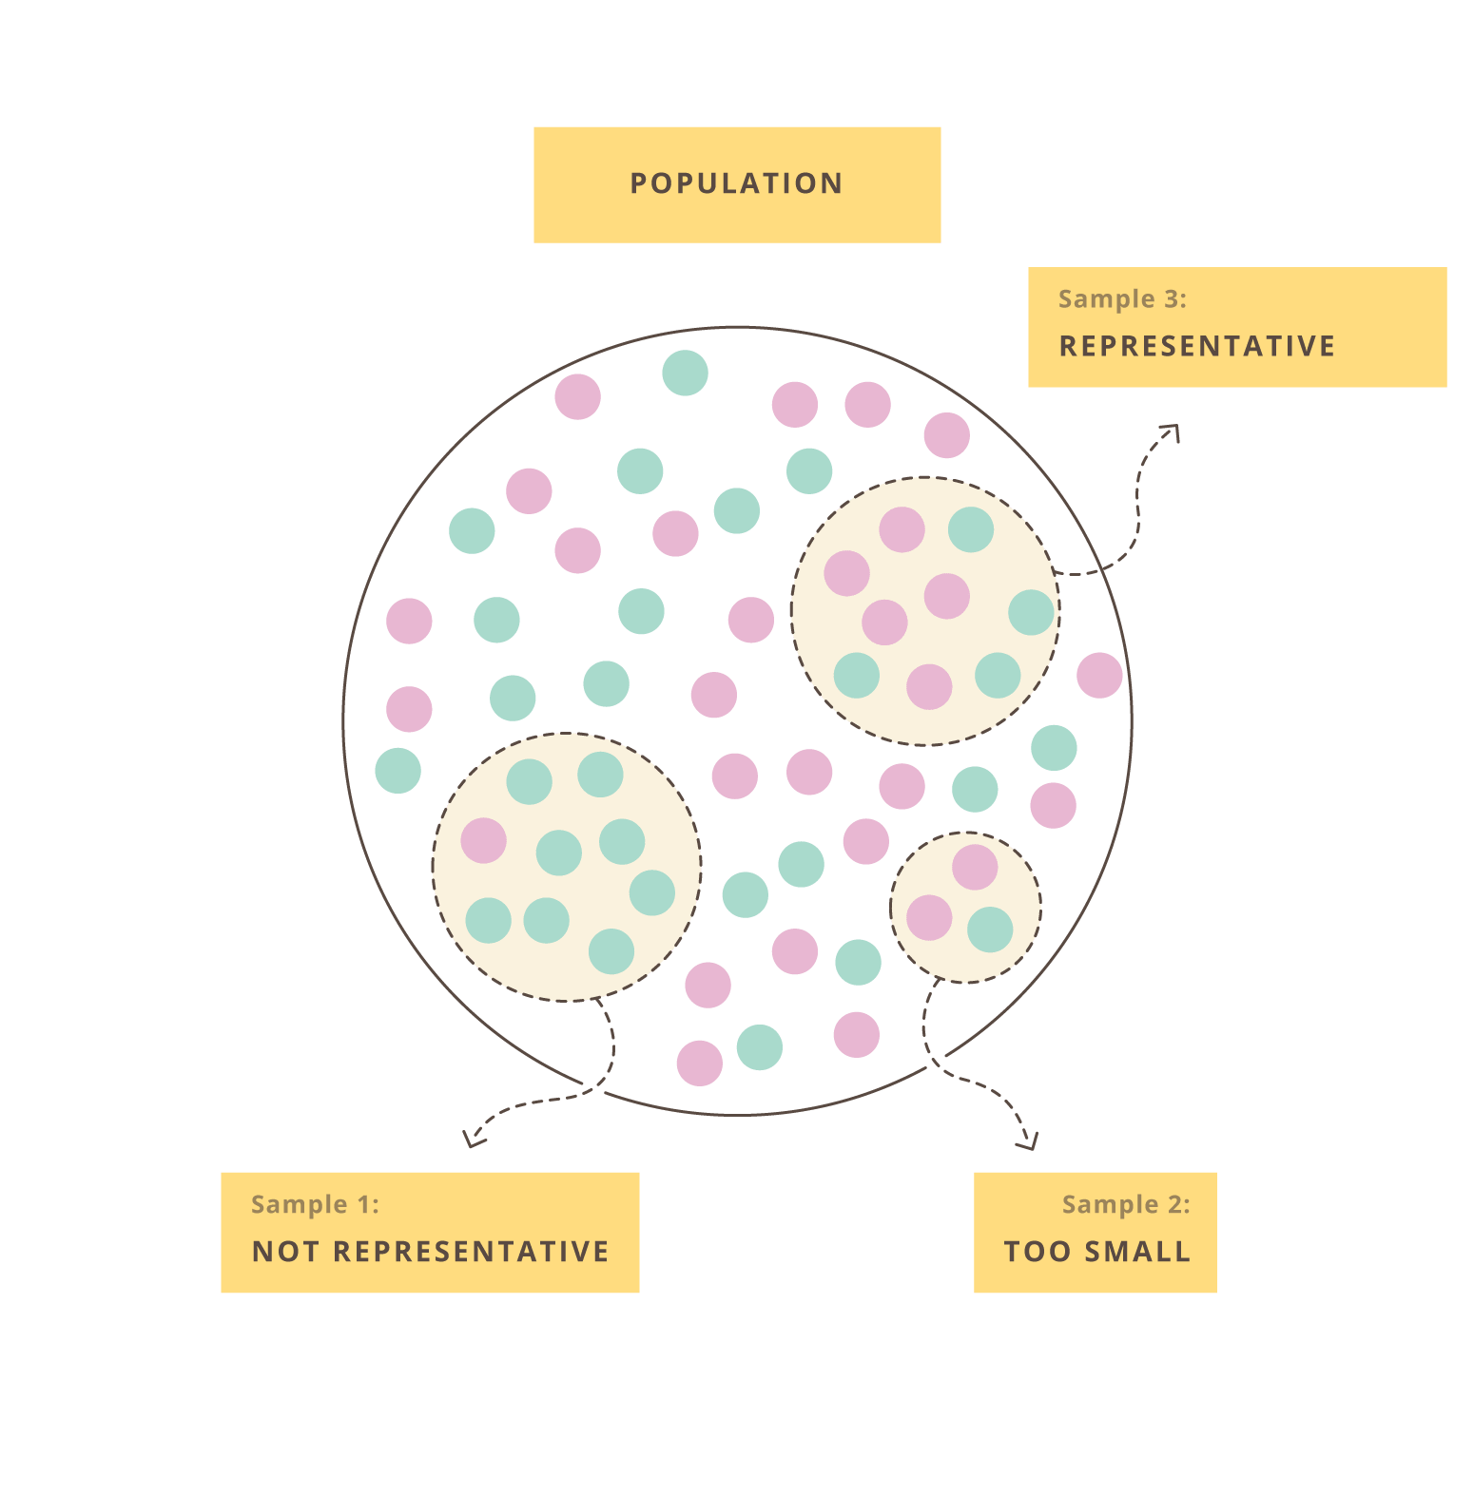
Statistics helps assess reproducible and generalizable claims using empirical/noisy data

Slide 4
Statistics helps assess reproducible and generalizable claims using empirical/noisy data
How to collect data appropriately?
How to test claim?
Experimental Design!
Hypothesis Testing!

Slide 5
Statistics helps assess reproducible and generalizable claims using empirical/noisy data
Uncover scientific knowledge using noisy data with limited resources
Testing claims OR Estimating associations
  Dependent (Outcome) Variable ~ Independent (Predictor) variable
Hypothesis testing: tools for estimating associations of interest using collected or observed data
Experimental design: ideas or principles to make sure we collect data in appropriate ways

Slide 6
Introduction to Statistics: Hypothesis testing and experimental design
Very basic introduction to the concepts and terminology of hypothesis testing and experimental design
Some guidance on choosing tests in relatively simple situations
Hands-on training on implementing statistical tests in R, requires some basic familiarity in working with R/Rstudio
Two days: 9/10 (1PM), 9/12 (1PM) for 2 hours
Tues: Hypothesis Testing & Experimental Design Concepts
Thurs: Mostly hands-on plus some Exp. Design concepts

Slide 7
Poll: Why do we perform statistical hypothesis testing?
It allows us to make claims claims that are reproducible and generalizable with limited resources

Slide 8
Poll: What hypothesis tests have you used?

Slide 9
Terms one commonly encounters in hypothesis testing
Null hypothesis versus Alternative hypothesis
P-values
Two-sided test versus One-sided test
Test statistic
Sampling distribution
Type I and Type II errors (Power)
Multiple testing
Assumptions of different tests
Linear models
ANOVA

Slide 10
Typical scenario
Setting: I have generated data from very cool experiment that I hope would resolve a long standing question
Problem: I don’t know how to use my data to conclude in a convincing manner one way or other
Possible solution: Pose the problem as a statistical association problem
  Changing something has a consequence on something else of biological relevance
  E.g.: Change dose of drug treatment and phenotype changes

Slide 11
Outline
Introduction to hypothesis testing
Define variables
Choosing the right test
Basic concepts in hypothesis testing
Multiple testing
Simple Hypothesis tests
Hands-on

Slide 12
Introduction to Hypothesis Testing
We would like to make generalizable claims about an entire target population with data from only a random subset of this population.
Random sampling, appropriate experimental design and Central Limit Theorem allows us to make generalizable claims
Hypothesis testing rests on assuming the skeptical point of view and testing for deviations from this assumption – Null versus Alternative Assumption
Equally relevant to Hypothesis Testing is the idea of measuring the strength of association/effect size

Slide 13
Outline
Introduction to hypothesis testing
Define variables
Choosing the right test
Basic concepts in hypothesis testing
Multiple testing
Simple Hypothesis tests
Hands-on

Slide 14
Variables
Response: Autism in kid, Gene expression, Chicken weight
Predictor: Maternal blood pollutant, Genotype, treatment, chicken feed
Types: Categorical or Continuous
  Categorical – genotype (mutant versus wild-type), disease vs normal
  Continuous – age, dose of drug treatment

Slide 15
Outline
Introduction to hypothesis testing
Define variables
Choosing the right test
Basic concepts in hypothesis testing
Multiple testing
Simple Hypothesis tests
Hands-on

Slide 16
How do I choose which statistical test to use?
Response variable
Categorical
X
X
Continuous
X
X
Continuous
Categorical/Factor
Predictor variable

Slide 17
Response:Continuous
Predictor: Continuous
Linear regression
Parameter/effect size: slope

Slide 18
How do I choose which statistical test to use?
Response variable
Categorical
X
X
Continuous
X
Continuous
Categorical
Predictor variable

Slide 19
Response:Continuous
Predictor: Categorical
T-tests, ANOVA
Parameter/effect size: difference of
means

Slide 20
How do I choose which statistical test to use?
Response variable
Categorical
X
X
Continuous
Continuous
Categorical
Predictor variable

Slide 21
Response:Categorical
Predictor: Categorical
Fisher’s test, Chiq-square test, 2x2 tables
Parameter/effect size: odds ratio

Slide 22
How do I choose which statistical test to use?
Response variable
Categorical
X
Continuous
Continuous
Categorical
Predictor variable

Slide 23
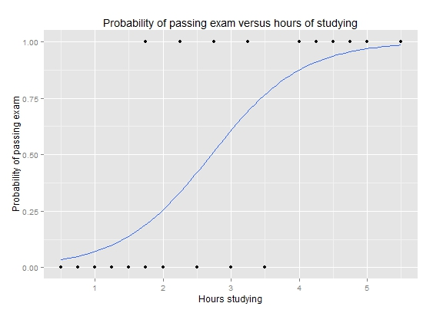
Response:Categorical
Predictor: Continuous
Logistic regression
Parameter/effect size: odds ratio
https://upload.wikimedia.org/wikipedia/commons/6/6d/Exam_pass_logistic_curve.jpeg

Slide 24
How do I choose which statistical test to use?
Response variable
Categorical
Continuous
Continuous
Categorical
Predictor variable

Slide 25
Outline
Introduction to hypothesis testing
Define variables
Choosing the right test
Basic concepts in hypothesis testing
Multiple testing
Simple Hypothesis tests
Hands-on

Slide 26
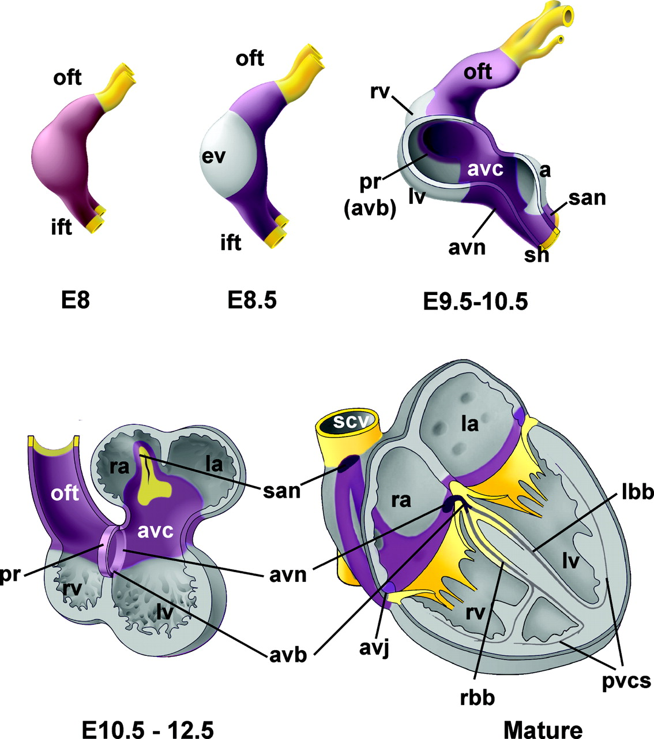
Research question 1
Gene controlling developing heart
https://www.ahajournals.org/doi/epub/10.1161/CIRCEP.108.829341

Slide 27
Is gene differentially expressed between the two developmental time-points?
Random sampling
Target population?
Data noisy
Compare means

Slide 28
Convince a skeptic: Repeat this experiment 1000 times
Lot of work, time, money!

Slide 29
Central limit theorem allows us to estimate the variation of the location of the distribution
…if you correctly followed the prescriptions for correct experimental design!
- random sampling

Slide 30

We tend to be skeptics as scientists
Notes:
https://cdn4.vectorstock.com/i/1000x1000/77/78/skeptic-man-cartoon-vector-1437778.jpg
https://media.npr.org/assets/img/2020/10/22/gettyimages-465200830_wide-1906e6f55de19e48406b0a0e15b8b1f4c8e3a1bd.jpg

Slide 31
In reality…
We will take the skeptical viewpoint
  What would the difference of mean expressions be if there were no differences between the embryonic stages?
We will use the CLT to attempt to demonstrate that the skeptical viewpoint is unlikely
Skeptical viewpoint: Null Hypothesis (H0)
Interesting viewpoint: Alternate Hypothesis (H1)
We need decision points to make the transition from the skeptical to interesting viewpoints – enter Type I error, p-value

Slide 32
Theoretical sampling distribution of difference in means under Null (uninteresting, no-change) Hypothesis
Observed difference
Type I error and p-value

Slide 33
Alter underlying variation
sd=14
sd=24
sd=4

Slide 34
Alter the number of replicates
n=4
n=3
n=15

Slide 35
Power to detect a difference of means of -15
You are willing to be mistaken that there is a true difference Type I error fraction of time you repeat this experiment
You are mistaken that there is no difference Type II error fraction of time you repeat this experiment
Power = 1 – Type II error
You correctly say that there is a difference Power fraction of time you repeat this experiment
Type I and Type II error

Slide 36
Poll: What are the factors that affect Power or the fraction of time you claim that there is a real difference when there is actually a difference?

Slide 37
Power to detect varying levels of difference in mean differences
Mean diff = -15
Mean diff = -25
Mean diff = -5
Type II error smaller for larger effect sizes
Larger effect sizes are easier to estimate compared to smaller effect sizes

Slide 38
Poll: If Type II error for a given hypothesis test is zero then what is its statistical power?

Slide 39
Outline
Introduction to hypothesis testing
Define variables
Choosing the right test
Basic concepts in hypothesis testing
Multiple testing
Simple Hypothesis tests
Hands-on

Slide 40
Multiple tests

Slide 41
Multiple testing correction
Scenario: You are testing not one but multiple different hypotheses at the same time.
  Assume you test 1000 independent hypotheses
  Type I error is set at 0.05
  50 = 1000 x 0.05 of the 1000 hypotheses would result in you saying that there is a real effect when in fact there isn’t one
  Not good with this whole reproducibility thing!
Enter multiple testing correction methods

Slide 42
Comparing every feed to every other one
There are 15 possible comparisons

Slide 43
Why do we need multiple testing?
We have 15 possible comparisons between feeds
Assume no. of true associations = 8
We set Type I error = 0.05
Assume statistical power to detect differences = 0.8
We will detect 8x0.8 ~ 6 true differences
#false positives = 15x0.05~1
False Discovery Rate = #false positives/(# false positives + #true positives) = 1/(1+6) ~ 14% - pretty high!

Slide 44
Outline
Introduction to hypothesis testing
Define variables
Choosing the right test
Basic concepts in hypothesis testing
Multiple testing
Simple Hypothesis tests
Hands-on

Slide 45
Every hypothesis test requires…
Test statistic
Sampling distribution of test statistic under the null hypothesis
A Type I error that will be allowable – fraction of times you are willing to accept a false-positive as a real result
Note: Use of test statistic and associated sampling distribution depends on your data meeting certain assumptions
A Type II error given the effect size of the association you are expect to estimate

Slide 46
Z/T-statistic (Two-sample t-test)

Slide 47
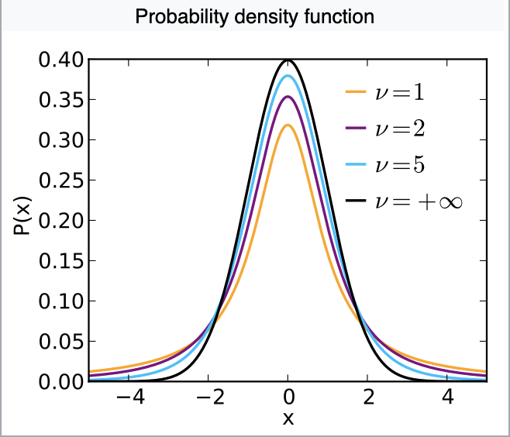
Sampling distribution of T-statistic under the Null hypothesis
Notes:
https://en.wikipedia.org/wiki/Student%27s_t-distribution

Slide 48
T-tests requires assumptions of…
Normality of the responses
Equal variance of the two groups being compared

Slide 49
Parametric versus non-parametric tests
Parametric tests make distributional assumptions about the response variables (Example: Normal probability distribution for the t-test)
Non-parametric tests do not make such assumptions (Example: Mann-Whitney test (next))

Slide 50

U-statistic (Mann Whitney test, two sample test)
Two groups
Rank all observations across both groups, smallest observation given rank 1.
The sum of ranks of observations within group 1 with n1 observations is R1

Slide 51
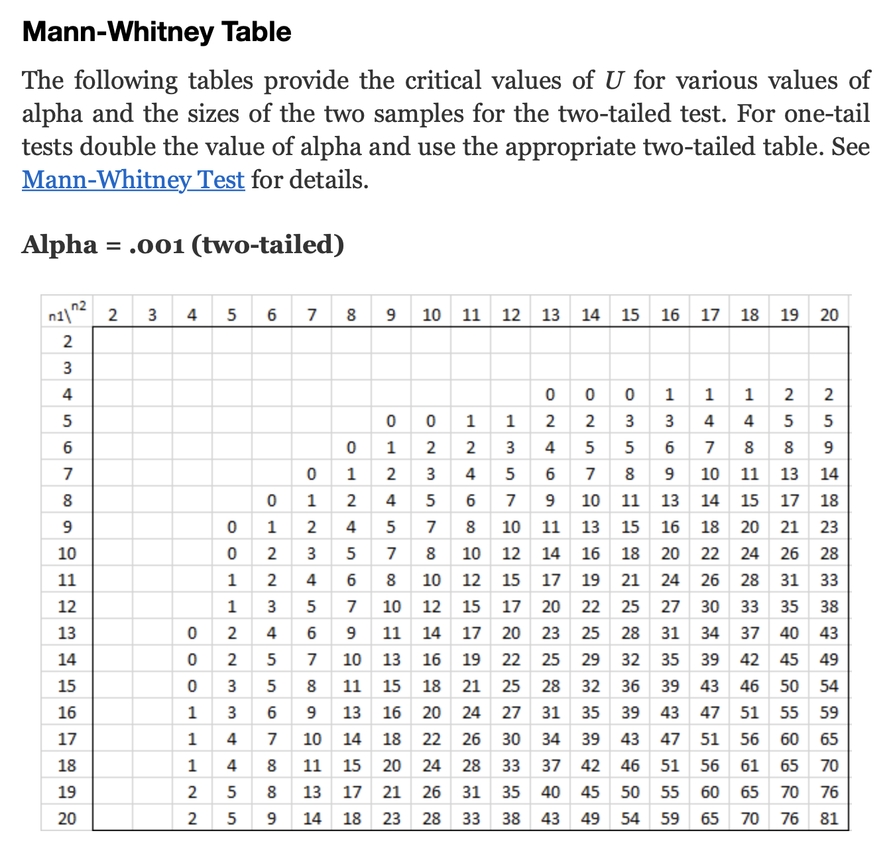
U-statistic sampling distribution in terms of tables
Critical value of statistic
Area of red shaded part=0.001
Notes:
http://www.real-statistics.com/statistics-tables/mann-whitney-table/

Slide 52
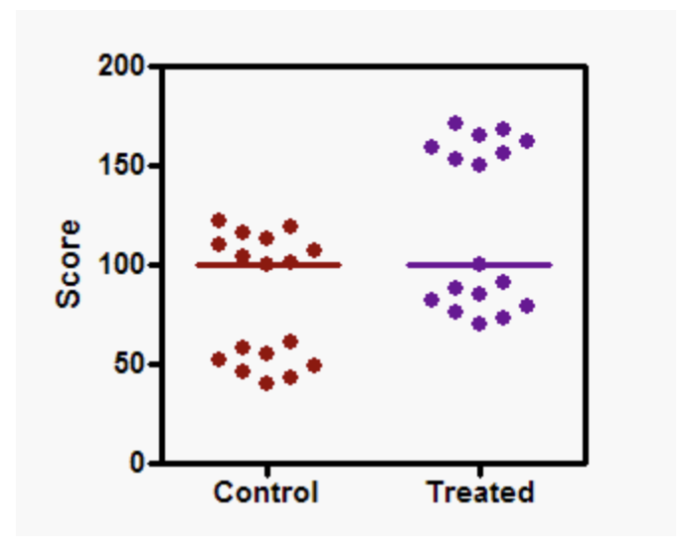
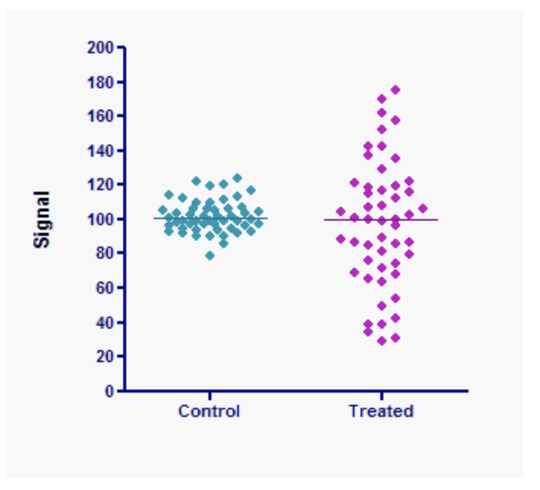
Mann-Whitney test valid as a comparison of location only if…
The two distributions have the same underlying shape, variance
Same location, significant p-value
Same location, non-significant p-value
Notes:
https://www.tandfonline.com/doi/pdf/10.1080/00031305.2017.1305291?needAccess=true
https://www.graphpad.com/guides/prism/5/user-guide/prism5help.html?stat_nonparametric_tests_dont_compa.htm

Slide 53

F-statistic (ANOVA)

Slide 54
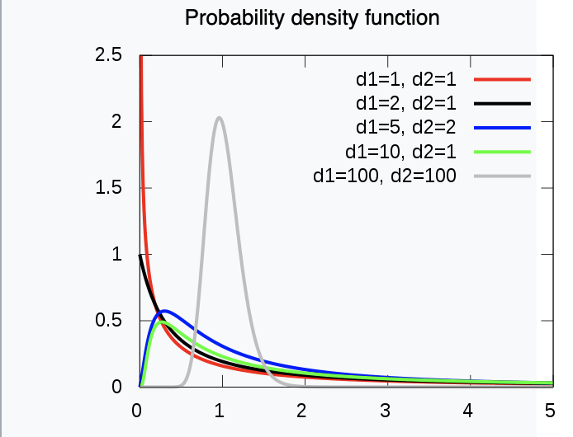
Sampling distribution of the F-statistic
Notes:
https://en.wikipedia.org/wiki/F-distribution

Slide 55
1-way ANOVA requires assumptions of…
Normality of the responses
Equal variance of the responses with each of the groups being compared

Slide 56
Poll: Are you aware of the difference between the t-test, Welch t-test, Mann-Whitney test?

Slide 57
Why do we have so many different tests?
Sampling distribution derived via Central Limit Theorem only valid only if certain assumptions met with underlying data
E.g. of assumptions could be Normality, Equality of variances etc.

Slide 58
Every hypothesis test requires…
Test statistic
Sampling distribution of test statistic under the null hypothesis
A Type I error that will be allowable – fraction of times you are willing to accept a false-positive as a real result
Note: Use of test statistic and associated sampling distribution depends on your data meeting certain assumptions
A Type II error given the effect size of the association you are expect to estimate

Slide 59
Outline
Introduction to hypothesis testing
Define variables
Choosing the right test
Basic concepts in hypothesis testing
Multiple testing
Simple Hypothesis tests
Hands-on

Slide 60
Please fill-out survey
https://www.surveymonkey.com/r/F75J6VZ
~ 3min

Slide 61
EXTRA SLIDES

Slide 62
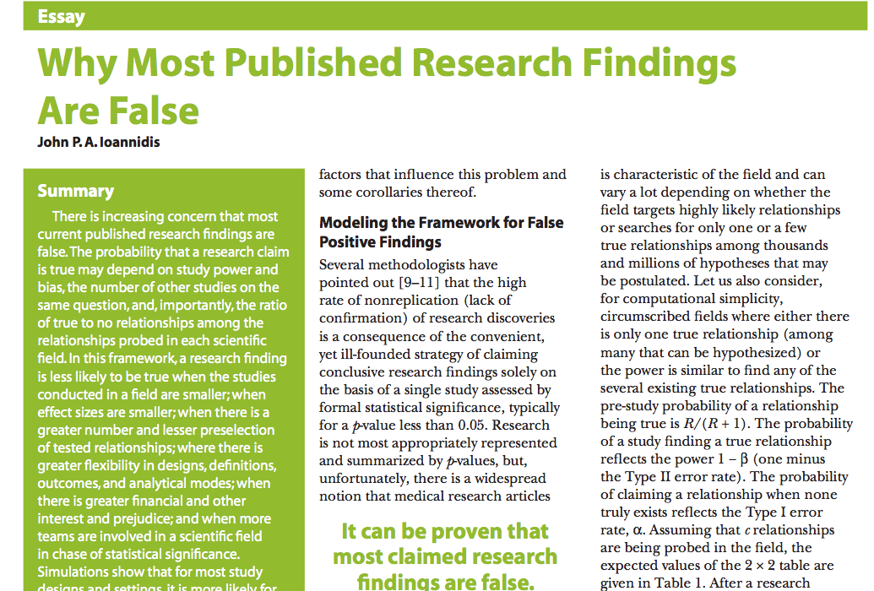


Slide 63
P0, pre-experiment probability of finding a true association among all possible testable associations
Depends on the field of study
An -omics study on a given disease typically involves 100s of 1000s of associations tested
One would expect only a small fraction of these associations to be true, P0 would be small

Slide 64
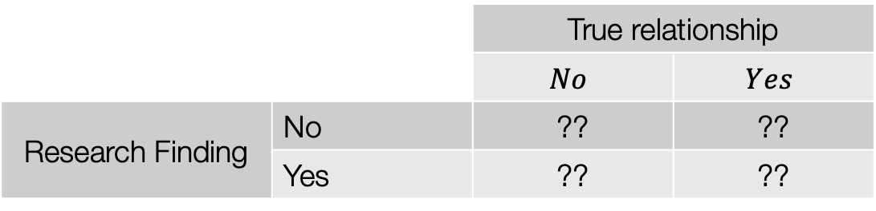
Assume that we test c associations in all …
 |  | True relationship
 |  | $$No$$ | $$Yes$$
Research Finding | No | ?? | ??
 | Yes | ?? | ??
Poll: How many of the c associations tested would we claim as a research finding when in fact they are not true associations?
Assume c = 100,000
P0 = 0.0001
Type I error, α = 0.05
Type II error, β = 0.3
Ioannidis 2005

Slide 65
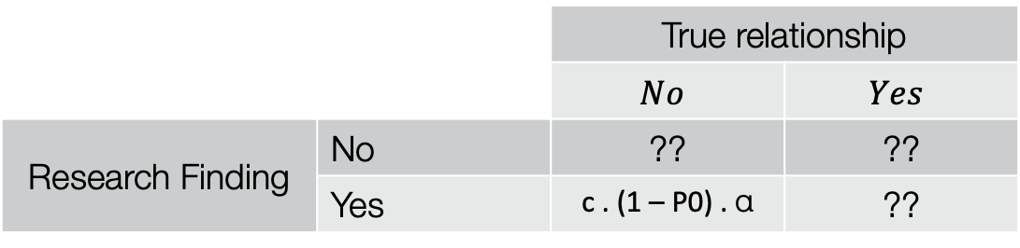
Assume that we test c associations in all …
 |  | True relationship
 |  | $$No$$ | $$Yes$$
Research Finding | No | ?? | ??
 | Yes | c . (1 – P0) . α | ??
Poll: How many of the c associations tested would we claim as a research finding when
in fact they are not true associations?
The number of true relationships = c x P0 = 100,000 x 1e-4 =10
The number of false relationships = c x (1 – P0) = 99990
The number of false relationships claimed as a research finding = c x (1 – P0) x α = 5000
Ioannidis 2005

Slide 66
Assume that we test c associations in all …
 |  | True relationship
 |  | $$No$$ | $$Yes$$
Research Finding | No | ?? | ??
 | Yes | c . (1 – P0) . α | ??
Poll: How many of the c associations tested would we claim as a research finding when
in fact they are true associations?
The number of true relationships = c x P0 = 100,000 x 1e-4 =10
The number of true relationships claimed as a research finding = c x P0 x (1 – β) = 7
Ioannidis 2005

Slide 67
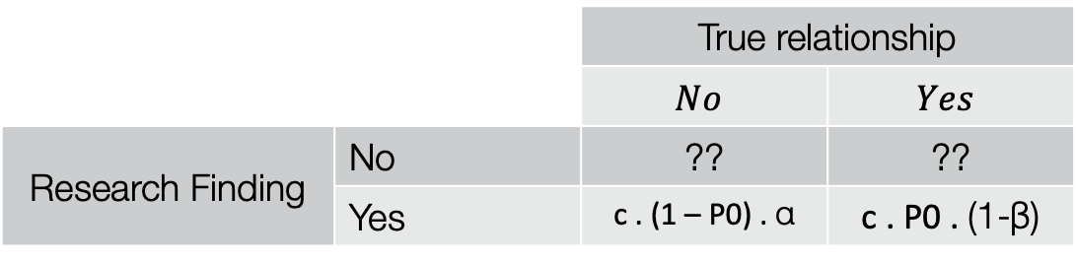
Only a very tiny fraction (0.1%) of your research findings would be true findings!!
 |  | True relationship
 |  | $$No$$ | $$Yes$$
Research Finding | No | ?? | ??
 | Yes | c . (1 – P0) . α | c . P0 . (1-β)
Poll: How many of the c associations tested would we claim as a research finding when
in fact they are true associations?
Pre-study probability of finding a true relationships = P0 = 1e-4
Post-study probability of finding a true relationships = $\frac{c.P0.(1−β)}{c.P0.\left(1−β\right)+c.P0.α}=\frac{7}{7+5000}=0.0014$
Ioannidis 2005

Slide 68
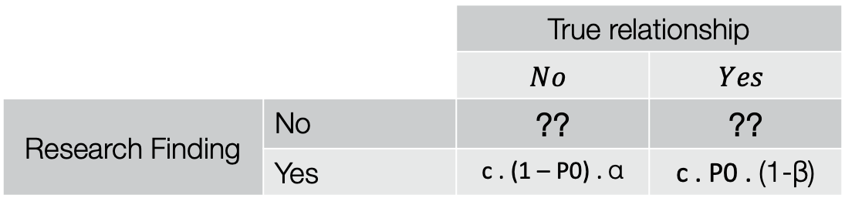
 |  | True relationship
 |  | $$No$$ | $$Yes$$
Research Finding | No | ?? | ??
 | Yes | c . (1 – P0) . α | c . P0 . (1-β)
Poll: How many of the c associations tested would we not claim as a research finding when
in fact they are true associations?
Poll: How many of the c associations tested would we correctly not claim as a research
finding?
Ioannidis 2005

Slide 69
Repeated measures experimental design
Designs where multiple responses from the same biological unit are assessed
  Examples include measuring changes in biomarker levels (e.g. CD4 counts) in subjects over time

Slide 70
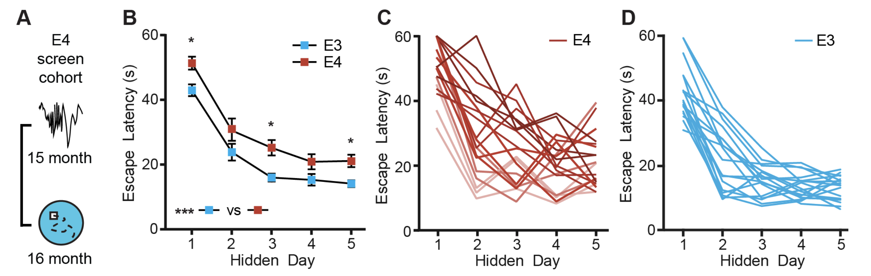
Learning in Alzheimer’s Disease mice assayed in the Morris-Water Maze
Jones et al. 2019

Slide 71
Comparing every feed to every other one
There are 15 possible comparisons

Slide 72
Interpret parameters from linear model to estimate slope
Slope ~ 20/5 = 4
20
5

Slide 73

Interpret parameters from linear model implementation of one-way ANOVA
330
50
100
160

Slide 74



Interpret parameters from linear model implementation of two-way ANOVA

Slide 75

Interpret the main effect

Slide 76

Interpret the interaction term

