Slide 1
Introduction to Data Analysis With R
Gladstone Institutes
Krishna Choudhary
Bioinformatics Core, GIDB
June, 2020

Slide 2
Contents
Motivation
Hands-on work in RStudio
Exercises
Conclusions
Notes:
Questions: How many have experience with programming?
How many have experience with R?
How many feel the need for data analytic tools?

Slide 3
R topics covered
RStudio interface.
Addition, subtraction, basic math operations.
Assigning values to variables.
Commenting in a script.
Logical operators.
Intro to functions and libraries.
Reading data.
Troubleshooting error messages.
Exploring data. (Basic summaries such as mean, median, etc.)
Selecting subsets of data.
Plotting data.
Data structures available in R.
Notes:
For the absolute beginner.

Slide 4
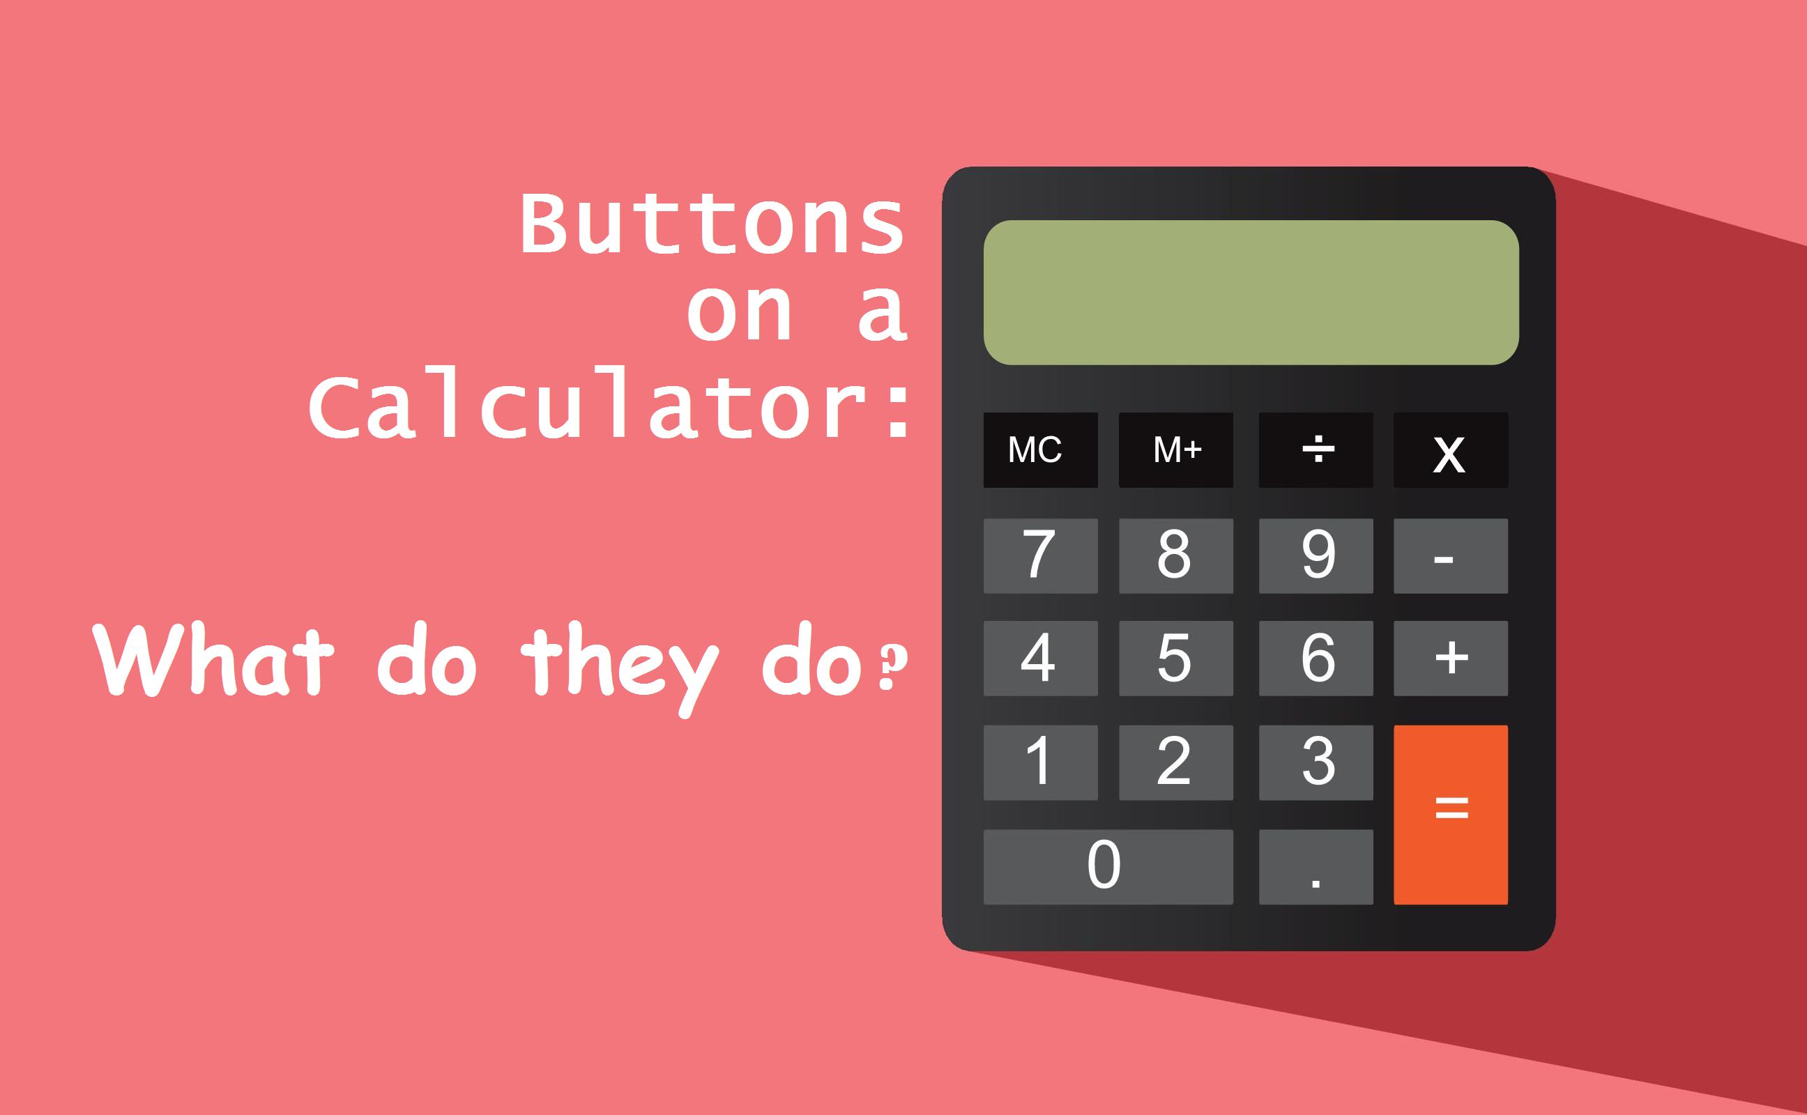
R:= A calculator with more “buttons” than you will ever use.
R can do all that a calculator can.
  Open R.
  Try 2+3.
  Try 2*3.
  Try (2+3)/5.
Conclusion: Off with the calculators!

Slide 5
What is R?
Collection of “buttons” that will perform mathematical calculations when pressed
  The way to press “buttons” in R is by writing a command. Examples:
    sum(2, 3)
    prod(2,3)
    sqrt(4)
Links for useful R commands:
  https://www.calvin.edu/~scofield/courses/m143/materials/RcmdsFromClass.pdf
  https://www.personality-project.org/r/r.commands.html
  https://www.rstudio.com/wp-content/uploads/2016/10/r-cheat-sheet-3.pdf

Slide 6
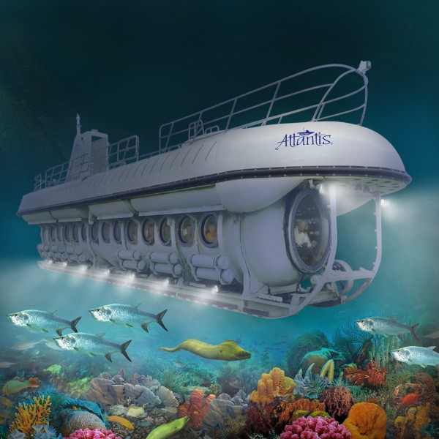

Excel: A boat to explore the surface of “Data-lantic ocean”.
R: A submarine for deep exploration.
Excel
R

Slide 7
R offers a lot more than Excel.
Excel
R
Familiarity.
Simple visualizations only.
Simple statistics only. Limited support for advanced needs.
You know it’s falling short. That’s why you’re here.
Pay for an inferior option. Why?
Unknown territory.
Visualization heaven.
If there is a statistical method out there, you’ll likely find it in R. All you need is to “hit a button”.
You will need it ever more.
Free of cost.

Slide 8
R: designed specifically to support variety of biological data analysis.
Bioconductor: Software for all kinds of biological data.
  Understands file formats commonly used in biology.
  Vetted by large community of users.
  Frequently updated.
  https://www.bioconductor.org/

Slide 9
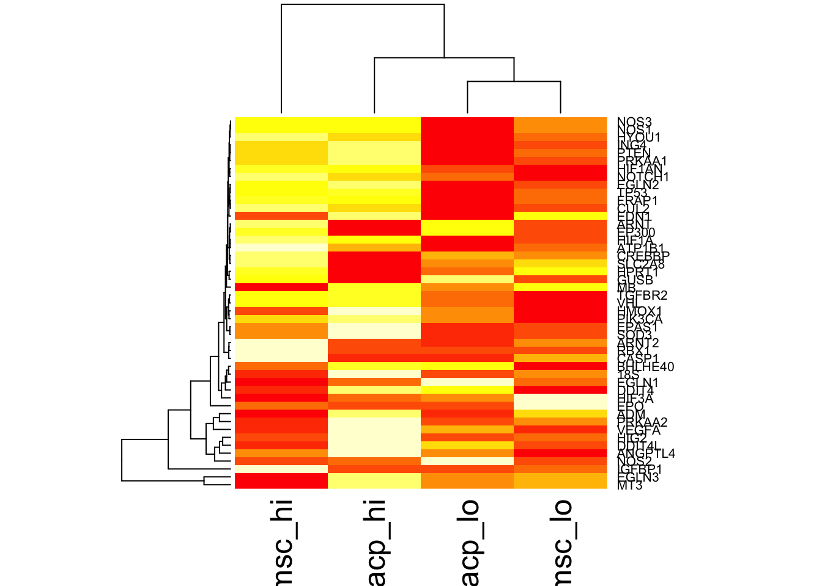
R: easy visualization of biological data. Supports interactive visualization.

Slide 10
R: Increasingly becoming more central to biology.
Biological software tools are being integrated with R.
Upcoming training workshops may require R.

Slide 11
R vs Python: depends on what we need
https://www.datacamp.com/community/tutorials/r-or-python-for-data-analysis
  R is used by statisticians, engineers and scientists.
  Python is popular among developers and programmers because it is faster.
  R is primarily used in academics and research. Also common in industry for bioinformatics.
  Unique attractions of R: ggplot2 for data visualization, Bioconductor
Notes:
For more information on execution of R code, see:
https://subscription.packtpub.com/book/application_development/9781783989263/1/ch01lvl1sec09/r-is-interpreted-on-the-fly

Slide 12
RStudio and basic arithmetic.

Slide 13
R is a console application.
Text only interface. Inputs and outputs can be images.
RStudio: Brings more Graphical User Interface (GUI) features to R.
  RStudio is to R as Microsoft Word is to Notepad in Windows or TextEdit in Mac. (~kinda)
Launch RStudio.
Try from these:
  sum(2,3)
  prod(2,3)
  sqrt(5.5)
Notes:
Four panes in Rstudio. Describe the panes.
Interactive console. Try basic math operations here.
Source code. Try writing the same operations here and go Cmd-A and Cmd-Enter. Also save the script. Run it.

Slide 14
Commenting inside a source script
Looking at an old script, or someone else’s script can be scary.
Speak to machine in code.
Leave comments in natural language (e.g., English).
  Anything written after # is interpreted by R as a comment for humans.
Notes:
Show them how to leave comments.

Slide 15
Assignment operators in R
Results of one calculation may be input to another.
Save intermediate results by assigning them to variables.
a <- sum(2,3)
a = sum(2,3)
  Variables store values.
  Called so because they can be assigned any value.
Both work but prefer to use ‘<-’ for now.
Change ‘=’ to ‘<-’ in the script and rerun.
Notes:
Caclulate sum(2,3) and assign it to variable a.
Calculate prod(2,3) and assign it to variable b.
Calculate a-b and assign it to variable c.
Is c == 0?
Conclusion: summing numbers is not the same as multiplying them.

Slide 16
Rules for naming variables
Names can be a combination of letters, digits, period (.) and underscore (_).
It must start with a letter or a period. If it starts with a period, it cannot be followed by a digit.
Reserved words in R must not be used as variable names.
Notes:
Caclulate sum(2,3) and assign it to variable a.
Calculate prod(2,3) and assign it to variable b.
Calculate a-b and assign it to variable c.
Is c == 0?
Conclusion: summing numbers is not the same as multiplying them.

Slide 17

Empty workspace/environment

Slide 18
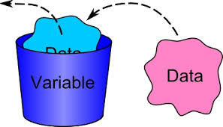
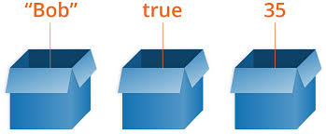

Data analysis creates objects that store data.
(top-right pane in RStudio)

Slide 19
Scientific calculations may require checking criteria.
Is p-value less than 0.05?
Is organism named Homo sapiens?
What percent of patients have heart rate greater than 130 bpm?

Slide 20
Scientific calculations may require checking criteria.
Is p-value less than or equal to 0.05?
  p <= 0.05
Is organism named Homo sapiens?
  name == “Homo sapiens”
What percent of patients have heart rate greater than 130 bpm?
  bpm > 130

Slide 21
Might need to check multiple criteria simultaneously.
p <= 0.05 & bpm > 130
bpm == 120 & name == “Homo sapiens”

Slide 22
Useful operators in R
! means ‘NOT’
!= means ‘NOT EQUAL’
== means ‘EQUAL’
& means ‘AND’
| means ‘OR’

Slide 23
Thus far…
R console
Source scripts
Commenting
Environment
Simple calculations
Variables

Slide 24
Coming up…
Intro to functions and libraries.
Reading data.
Troubleshooting error messages.
Exploring data. (Basic summaries such as mean, median, etc.)
Selecting subsets of data.
Plotting data.
Data structures available in R.

Slide 25
Functions

Slide 26
Working with buttons for modern scientific calculations?
The best of calculators => 10s of buttons for specific tasks.
Modern science needs many times more than 10s.

Slide 27
Functions are to R what buttons are to calculators.
R can perform 100s of 1000s of tasks.
Tasks are performed by using functions.
  Examples: sum(), prod(), mean(), t.test().
Result1
DatasetA
function()
DatasetB
Result2
DatasetC
Result3

Slide 28
There are functions for all sorts of things.
Example to read a table saved in a file:
  read.table()
  Usage: read.table(“filename”)
read.table()
Data is displayed in R.
File name

Slide 29
There are functions for all sorts of things.
Example to find complementary DNA sequence.
  complement()
  Usage: complement(sequence)
complement()
TGCA
ACGT

Slide 30
Directing output of one function as input to another.
read.table()
edgeR()
List of differentially expressed genes.
Data is displayed in R.
File name

Slide 31
Library is a collection of functions.
R works with > 100000 functions.
More being added everyday.
If the software were to load (i.e., make available) all of them at startup, it will take a while to launch.
Solution: Bundle related functions together in a library.
    Example: edgeR.
Load functions only when needed. (:= Install apps on smartphone as needed)

Slide 32
Functions may need lots of information
Calculators may take only numbers.
R functions take variety of things. Numbers, characters, etc.
Example:
  Reading a file. Inputs required: File name and address on computer, formatting of file, type of file, etc.
  Writing a file. Inputs required:
    what to write?
    where to write?
    how to format the file?
    Include column names, row names?
    separate with comma?

Slide 33
Reading a data file.

Slide 34
There are functions for all sorts of things.
Functions to read files:
  read.csv()
  read.table()
  read.xlsx()
Try reading a file called “iris.csv”
  read.table(file = “iris.csv”)

Slide 35

Error!!!

Slide 36
How to find help?
Execute a command name with the question mark before it. Example:
  ?read.table
Read the error message!
  Often, no need to understand every word.
  Look for key words in error message.
Copy-paste the error message verbatim in Google!

Slide 37
We need to set directory to where the file is.
The function for this is:
  setwd()
Can also do it interactively using the menu bar.
  In RStudio: Session -> Set Working Directory -> Choose Working Directory.
Verify using
  getwd()

Slide 38
Working with a dataset
(Read, Subset, Visualize)

Slide 39
Reading a dataset
Function we will use: read.table().
Dataset used: Iris dataset.
  Iris is a plant genus.
  Species of this genus may be identified based on the dimensions of petals and sepals of its flowers.
Try read.table(“iris.csv”).
  dat <- read.table(“iris.csv”)

Slide 40
Explore the current data
View(dat) #Shows the data in a tabular format.
dim(dat) #Shows the dimensions of the table, i.e. rows and columns.
colnames(dat) #Shows the names of columns, if any.
summary(dat) #Outputs summary statistics of data. Ex- minimum, max, median, etc.
head(dat) #Displays first 6 rows of data.
tail(dat) #Displays last 6 rows of data.

Slide 41
Extracting parts of data in another variable.
spl_len <- dat$Sepal.Length
  $ is used to refer to a feature in the data.
  Check what spl_len is.
  class(spl_len)
It contains numbers, makes sense to call it “numeric”.
spl_len is an ordered series of numeric values.
  Ordered series of values are called vectors in R. (More on that later)

Slide 42
Another data type: Factor
spcs <- dat$Species
  Check what spcs is.
  Factor variable.
  spcs <- as.character(spcs)
  spcs <- unique(spcs)
  How to check if spcs includes sapiens?
    “sapiens” %in% spcs
Factors are used to represent categorical variables.
spcs is now a character vector.

Slide 43
Goal: To extract subset of data for Iris setosa.
which_setosa <- dat$Species == “setosa”
  dat$Species == “setosa” compares each value in dat$Species with character “setosa”.
  If a value equals “setosa”, output is TRUE.
  Check what which_setosa is. (a logical vector)
To extract the subset for Iris setosa:
  dat_setosa <- dat[which_setosa, ]

Slide 44
Goal: To extract subset of data for Iris setosa.
Alternatively
  dat_setosa <- subset(dat, Species == “setosa”)
  If only I had googled!!
Wishing you could just hit enter?
Feeling like a lot of people would want it?
Google!
TRUE for most anything at a beginner level.
If you get an error, someone else would have got it too. Google!

Slide 45
Basic statistics.
Mean
  mean(dat$Sepal.Length)
Median
  median(dat$Petal.Length)
Standard deviation
  sd(dat$Petal.Width)
Histogram
  hist(dat$Sepal.Width)
Boxplot
  boxplot(dat$Sepal.Length)

Slide 46
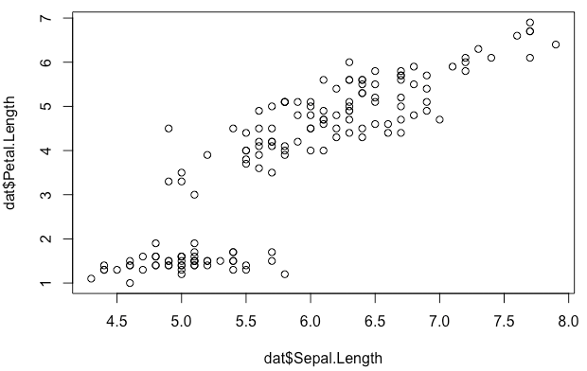
Visualizing data.
plot(x= dat$Sepal.Length, y = dat$Petal.Length)

Slide 47
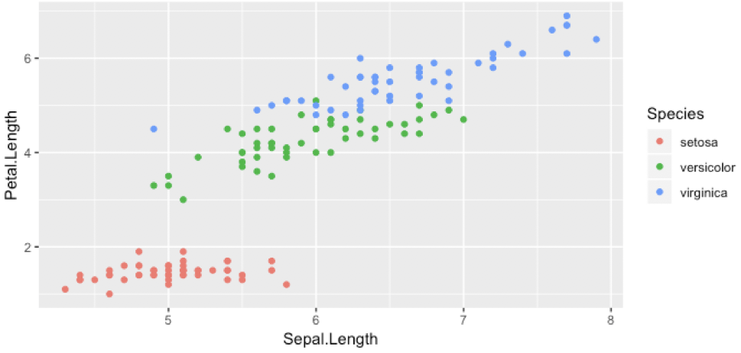
Visualizing data.
qplot(x = Sepal.Length, y = Petal.Length, data = dat, color = Species)

Slide 48
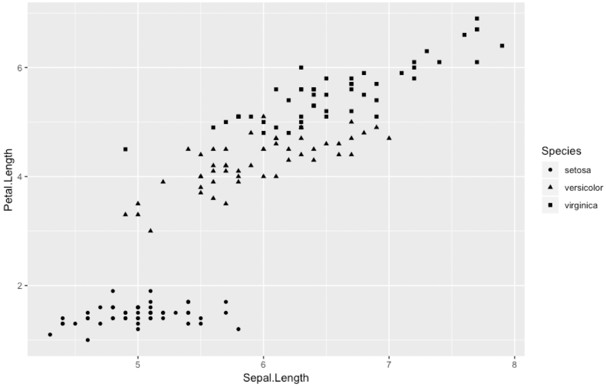
Visualizing data.
qplot(x = Sepal.Length, y = Petal.Length, data = dat, shape = Species)

Slide 49
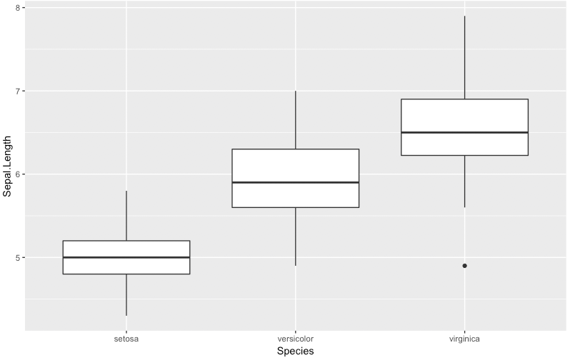
Visualizing data.
qplot(x = Species, y = Sepal.Length, data = dat, geom = "boxplot")

Slide 50
Loops and conditional statements.

Slide 51
Loop over rows in a tabular data
table <- read.table(“iris.csv”)
for (row in table) {
#Do some calculation for each row
...
…
}

Slide 52
Conditional statements
if (p < 0.05) {
print(gene_info)
…
} else {
print(gene_name)
}

Slide 53
Data structures.

Slide 54




Data structures are data organization/storage formats.
Storing data physically? Options:
Sticky note
Printer paper
Task pad
Long scroll

Slide 55
Data structures are data organization/storage formats.
Working with data in R? Options:
  Numeric vector
    c(2, 5, 10, 11)
  Character vector
    c(“apples”, “oranges”, “butter”, “dry yeast”)
  Data frames
    dat from Iris example.
  Matrix
    Example counts for genes in several samples.
  Lists
    Flexible data structures.
    mylist <- list(a = c(2, 5, 10, 11),
        b = c(“apples”, “oranges”, “butter”, “dry yeast”)
        )

Slide 56
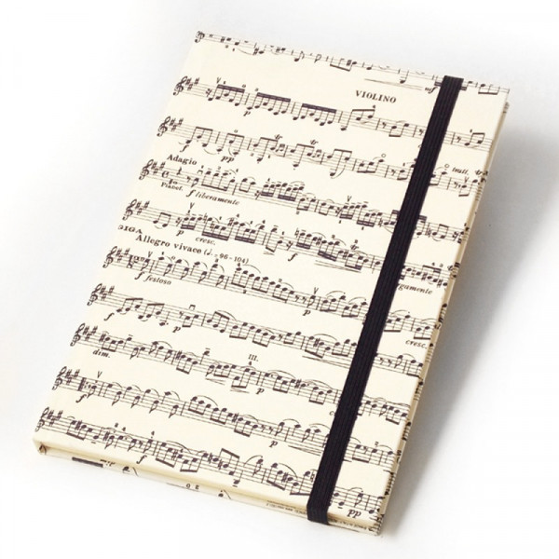
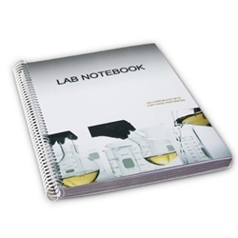
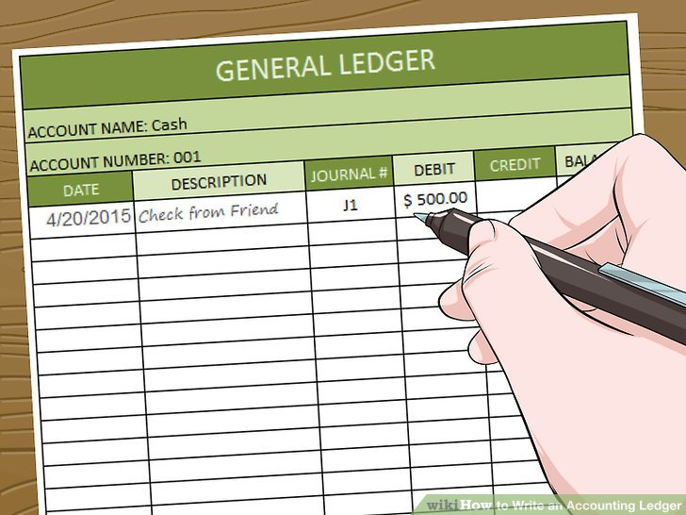
Data structures for special needs?
Storing data physically? Options:
Sheet music
Ledger
Lab notebook

Slide 57
Data structures for special needs?
Working with data in R?
  Packages may have author-defined data structures.
  Example – DGEList defined in edgeR.
    Stores counts, sample grouping information, normalization factors, etc. in one place.

Slide 58
Exercise

Slide 59
Reading unclean data.
“dirty_data.txt” contains data that is formatted differently.
Figure out how to read it.
Tips:
  Error message comes in peace. It is your friend!
  Google!

Slide 60
Alternative file types
Scientific studies may involve various kinds of files.
Example:
  FASTA files for sequences.
  FASTQ files for sequencing reads.
  SAM files for alignment.
  GTF files for gene annotations.
  Excel sheets with multiple sheets.
Google for how to read FASTA file in R. (5 min)
Notes:
Show them how to open the fasta file.

Slide 61
How to read in FASTA files?
Searching for packages returns:
  seqinr
  Biostrings
  …
Example with seqinr
  install.packages(“seqinr”)
  library(seqinr)
  read.fasta(“16S.fasta”)
Check options available with read.fasta.
  ?read.fasta
Notes:
Show them how to open the fasta file.

Slide 62
Recap of R topics covered
RStudio interface.
Addition, subtraction, basic math operations.
Assigning values to variables.
Commenting in a script.
Logical operators.
Intro to functions and libraries.
Reading data.
Troubleshooting error messages.
Exploring data. (Basic summaries such as mean, median, etc.)
Selecting subsets of data.
Plotting data.
Data structures available in R.

Slide 63
Your feedback is important to us!
https://bioinformatics-course-feedback.questionpro.com/
~3 min.

Slide 64
Possibilities

Slide 65
Detailed high resolution graphics : Examples
https://www.r-graph-gallery.com/

Slide 66
Bioconductor for biological data analysis
Packages
edgeR, DESeq2, limma, voom
phyloseq, microbiome
rWikipathways, KEGGgraph
MSstats
bsseq, methylKit
chipseq
CRISPRseek, gCrisprTools, CrispRVariants
Uses
Differential gene expression analysis
Microbiome data analysis
Pathway analysis
Proteomic data analysis
DNA methylation analysis
ChIP-Seq data analysis
CRISPR related data analysis

Slide 67
Conclusions
R is a “smart” version of calculators.
Error message comes in peace.
Google!

Slide 68
Upcoming workshops
Intro to RNA-seq data analysis (March 24 and 26)
Intermediate R: Data visualization (April 7 and 9)
Intermediate RNA-seq data analysis (April 28 and 30)
Intro to Unix command line (May 5)

Slide 69

Notes:
This is Gladstone – We were founded 40 years ago and we are a basic biomedical

