Slide 1
Statistics of Enrichment Analysis
Reuben Thomas
August 12th, 2021

Slide 2
Expectations for this session
Knowledge of basic statistics
Familiarity with one or more high-dimensional assays: RNA-seq, Mass-spec
Some experience working with R

Slide 3
Outline and main messages
Context and background for enrichment methods
Primer on statistics
Statistics of Enrichment Methods
  Choice of Parameter of Interest/Test statistic
  Choice of Null Hypothesis
  Sampling distribution of the Test statistic
Overview of the 6 enrichment methods
Hands-on
Guide to your choice of the method for your application
Questions

Slide 4
Outline and main messages
Context and background for enrichment methods
Primer on statistics
Statistics of Enrichment Methods
  Choice of Parameter of Interest/Test statistic
  Choice of Null Hypothesis
  Sampling distribution of the Test statistic
Overview of the 6 enrichment methods
Hands-on
Guide to your choice of the method for your application
Questions

Slide 5
Question 1
Have you used enrichment analyses methods in your work?
Answer in Chat!

Slide 6
Question 2
Please name some of the enrichment methods you have used
Answer in Chat!

Slide 7
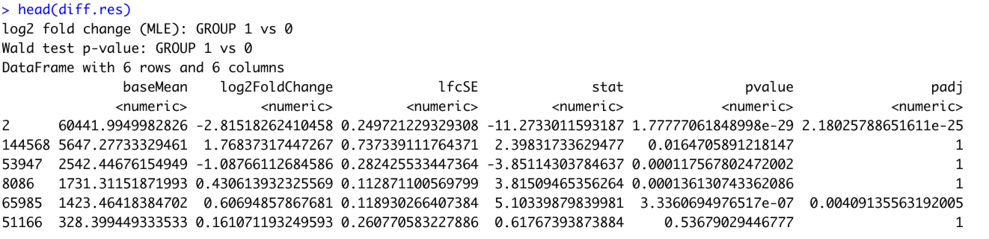
RNA-seq data for bladder cancer tumor vs normal patient samples
What pathways are differentially regulated in tumor vs normal tissue in bladder cancer patients?
PCA plot
MA plot

Slide 8
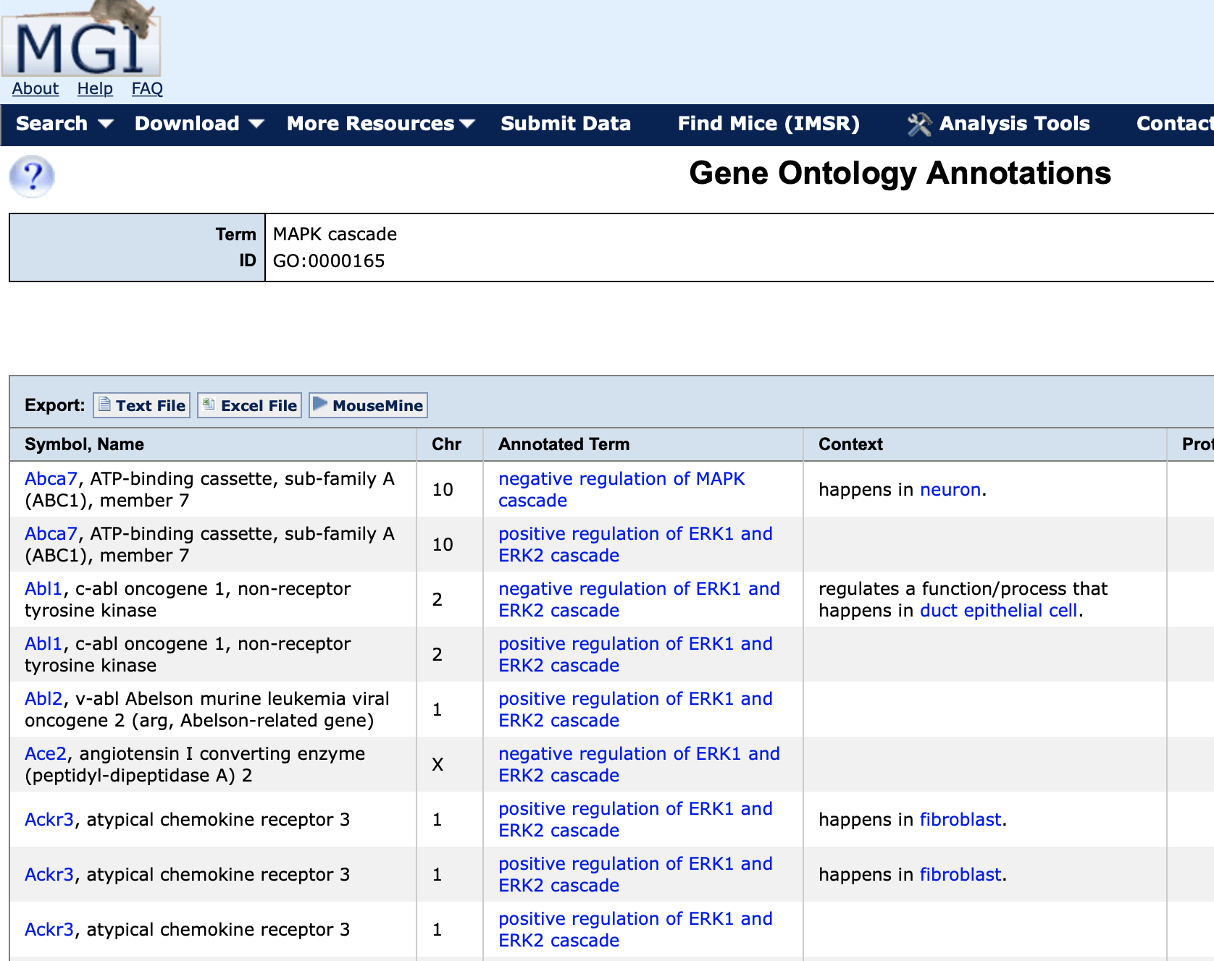
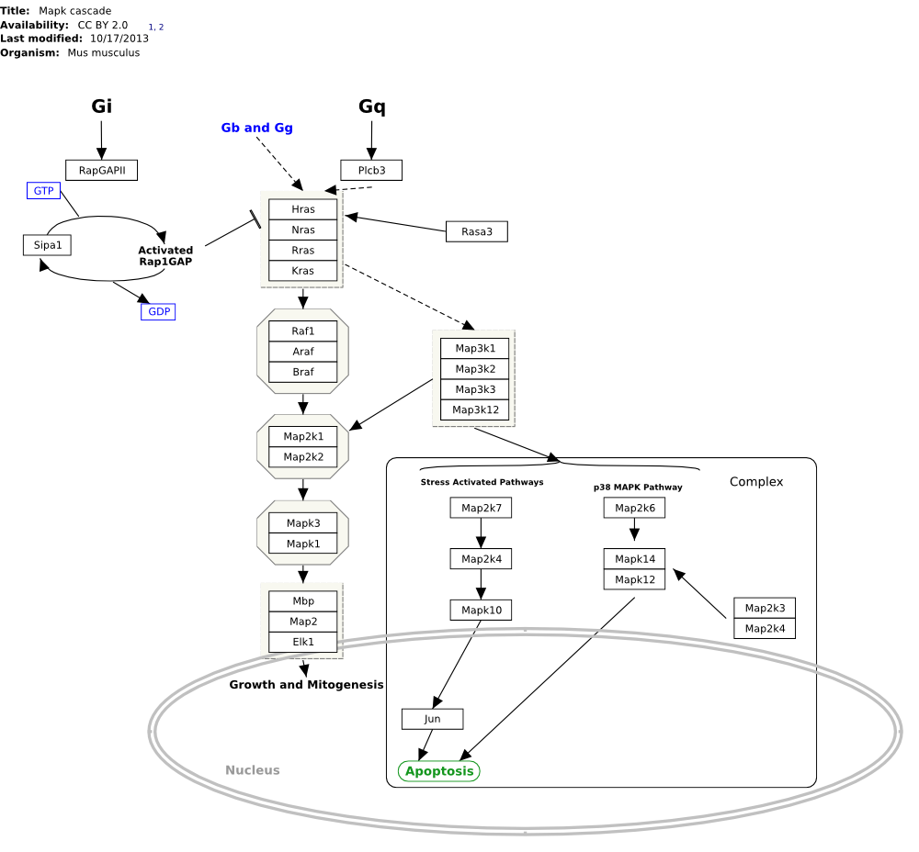
Pathways and Gene sets

Slide 9
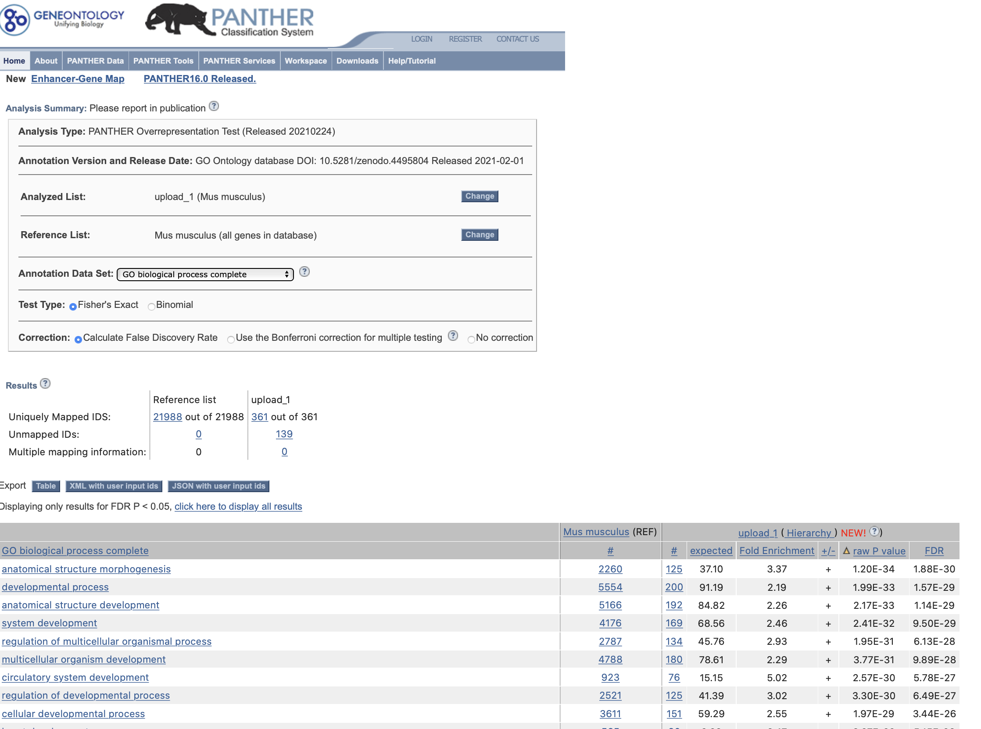
Pathway/gene set databases help us determine functional relevance of our high-throughput data
Databases
Gene Ontology (GO)
WikiPathways (WP)

Slide 10
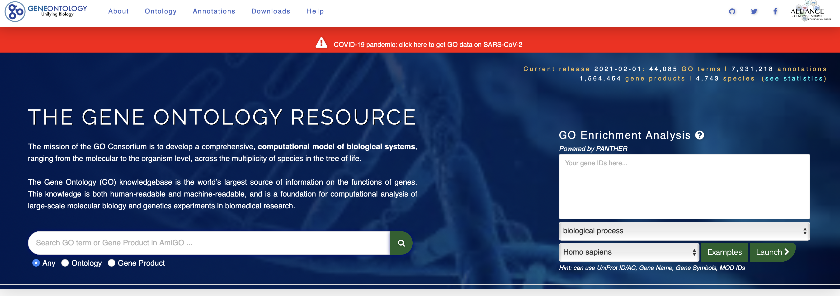
Gene ontology is a well-established source of gene sets
Started in 1998
Efforts from multiple research groups/consortia across the world
Over 30,000 gene sets attributed to biological processes, molecular functions and cellular components
Each gene set is just a “bag” of genes
http://geneontology.org

Slide 11
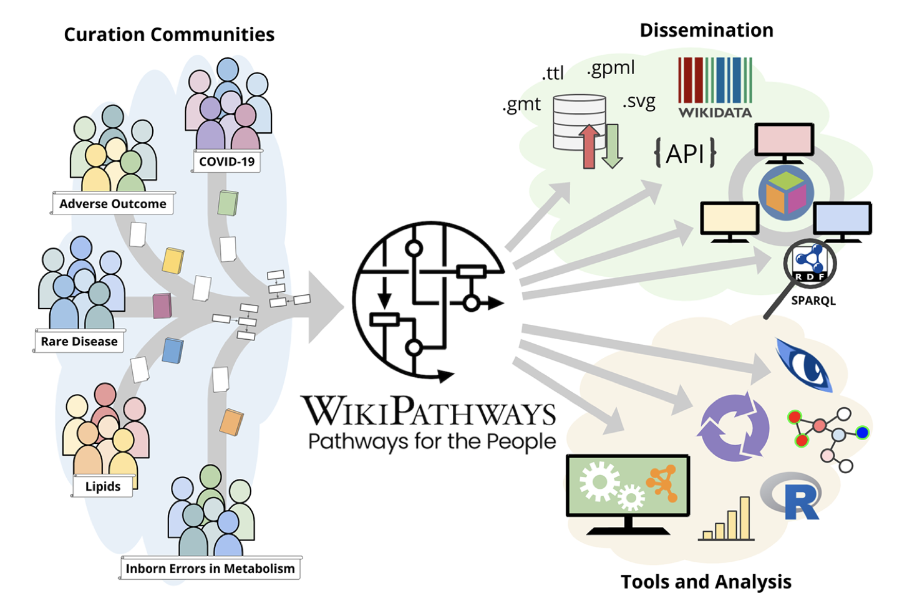
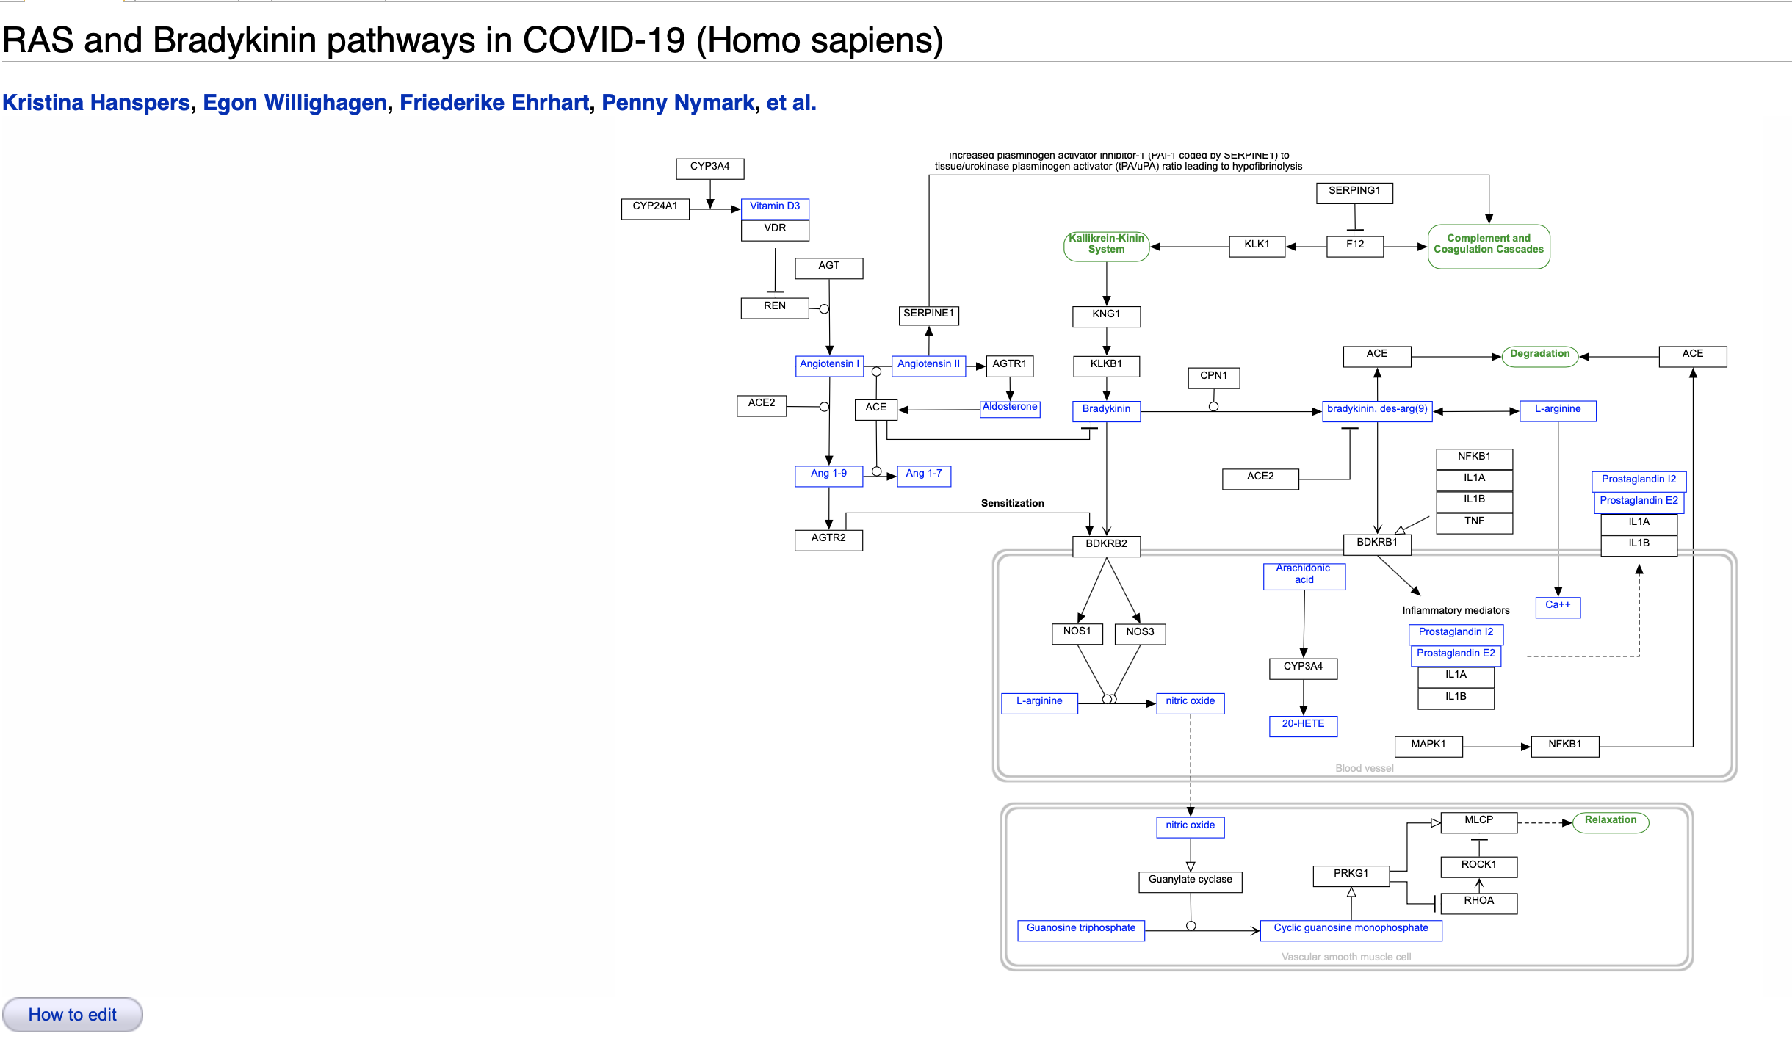
WikiPathways is a source of gene sets represented as pathways
Started in 2007
Open source, anyone can contribute to suggesting new pathways or curate existing ones
Over 1000 pathways/gene sets
Martens et al. Nucleic Acids Research, 2021, Vol. 49, Database issue
https://www.wikipathways.org/index.php/Pathway:WP4969

Slide 12
Various methods available for Enrichment Analyses
ORA: Over Representation Analyses
GSEA: Gene Set Enrichment Analyses
rSEA: Simultaneous Enrichment Analyses
SAFE: Significance Analyses of Function and Expression
PADOG: Pathway Analysis with Down-weighting of Overlapping Genes

Slide 13
Different numbers of bladder-cancer associated WikiPathways from different methods!
Six different methods evaluated with this data set
Some pathways are uniquely detected by one method
Why do different methods come up with different answers?
How does one decide on the right method to use for a given application?

Slide 14
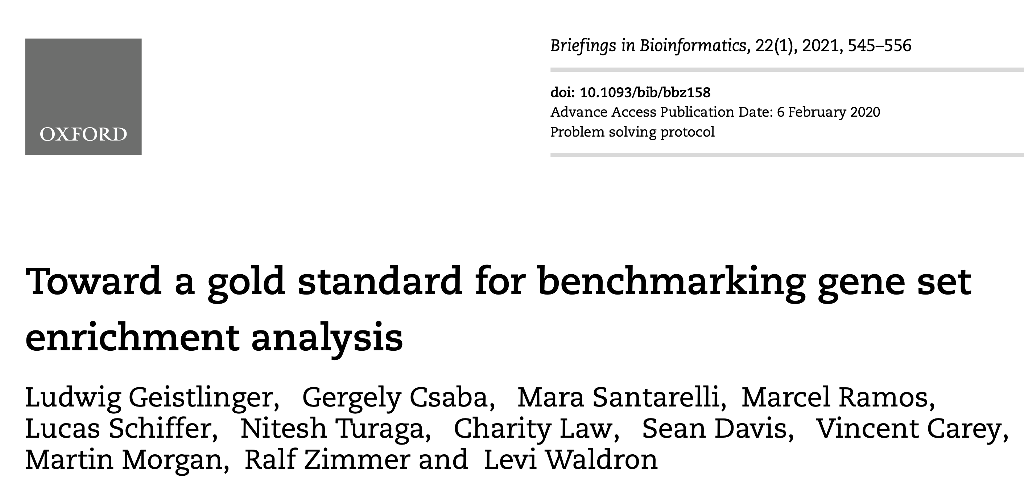
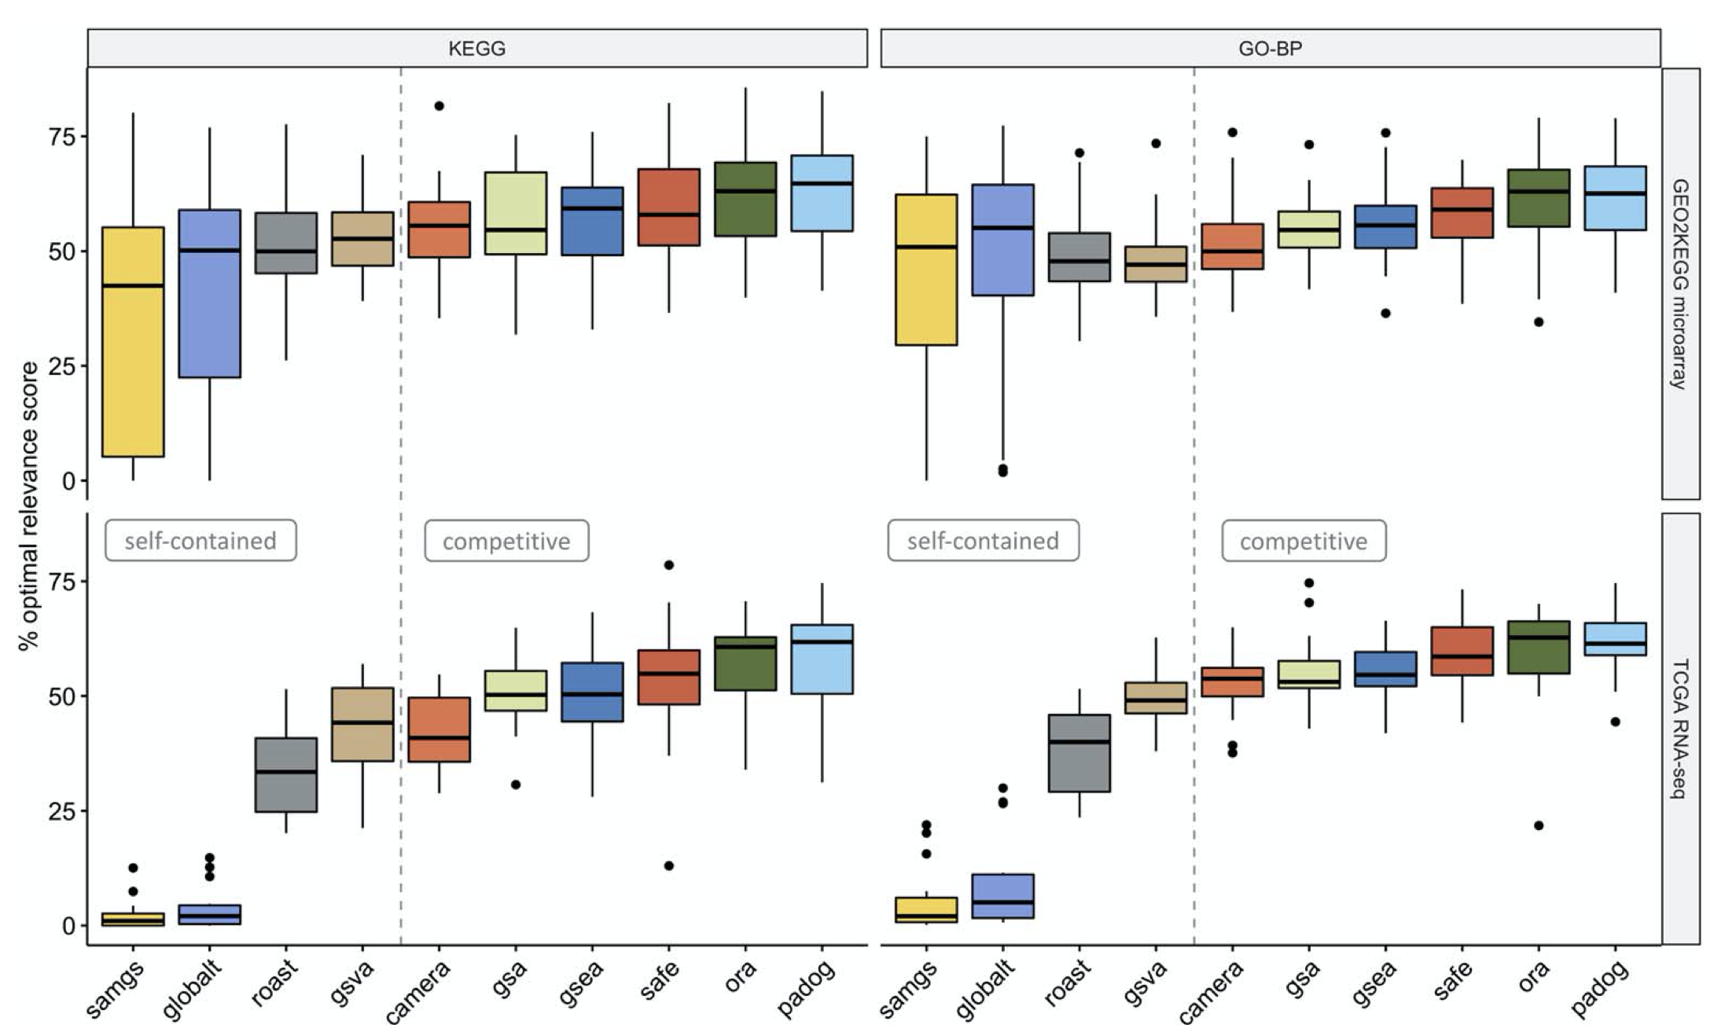
Check for recommendations in the literature!
Talk to the Gladstone Bioinformatics Core!
Listen to the rest of this session!

Slide 15
Outline and main messages
Context and background for enrichment methods
Primer on statistics
Statistics of Enrichment Methods
  Choice of Parameter of Interest/Test statistic
  Choice of Null Hypothesis
  Sampling distribution of the Test statistic
Overview of the 6 enrichment methods
Hands-on
Guide to your choice of the method for your application
Questions

Slide 16
Primer on Statistics
We are all working under constraints of limited resources – time and money
We empirically study biological phenomena by conducting experiments
With limited resources we would like to make generalizable conclusions across all samples in our target population
The Principles of Statistics guide us in our experimental designs and give us hypothesis tests that allow us to make generalizable conclusions

Slide 17
Is a gene differentially expressed between two developmental time-points?

Slide 18
Primer on Hypothesis Tests
Null hypothesis holds the skeptical viewpoint that the observed changes are uninteresting/driven by random chance
Significance threshold represent your decision point when making claims as to whether the association you observe is real or not
Type I error measures the fraction of time one claims there is a real association when in fact it is driven by random chance
Parameter of interest captures that effect you are studying – fold-change, slope, difference of means
Test statistic captures deviation from the null/skeptical expectation
Sampling distribution captures the distribution of the test statistic over repeated experiments under the null hypothesis

Slide 19
Outline and main messages
Context and background for enrichment methods
Primer on statistics
Statistics of Enrichment Methods
  Choice of Parameter of Interest/Test statistic
  Choice of Null Hypothesis
  Sampling distribution of the Test statistic
Overview of the 6 enrichment methods
Hands-on
Guide to your choice of the method for your application
Questions

Slide 20
Steps in coming up with a hypothesis test for Pathway Enrichment
Decide on a parameter of interest ~ what would capture the change in pathway activity?
Define the null hypothesis ~ Change in pathway activity = 0
Define a test statistic ~ e.g., Odds ratio, Proportion of affected genes
Identify the sampling distribution of the test statistic ~ e.g., Hypergeometric distribution
Characterize the Type I and II errors

Slide 21
Outline and main messages
Context and background for enrichment methods
Primer on statistics
Statistics of Enrichment Methods
  Choice of Parameter of Interest/Test statistic
  Choice of Null Hypothesis
  Sampling distribution of the Test statistic
Overview of the 6 enrichment methods
Hands-on
Guide to your choice of the method for your application
Questions

Slide 22
Capturing pathway activity
Most assays we work with provide only relative quantification of gene expression, protein levels
We are interested in differential regulation (disease vs control, treated vs control) of pathways
Most pathways/gene sets are made of proteins signaling to each other, involved in metabolic conversion of substrates etc.
BIG assumption: Changes in gene expression are a good surrogate for changes in “pathway activity”

Slide 23
How does one quantify changes in “pathway activity”?
“Large” proportion of altered genes/proteins in a given pathway
Increase in odds of an altered gene belonging to the pathway
Increase/decrease in the fold-changes of genes in the pathway

Slide 24
True Discovery Proportion (TDP)
TDP_{s}: fraction of genes is gene set, s associated with condition
TDP_{genome}
  Point estimate: 0.53
  95% confidence interval: (0.34, 1)
34% of all genes are altered in bladder cancer tumor vs normal samples

Slide 25
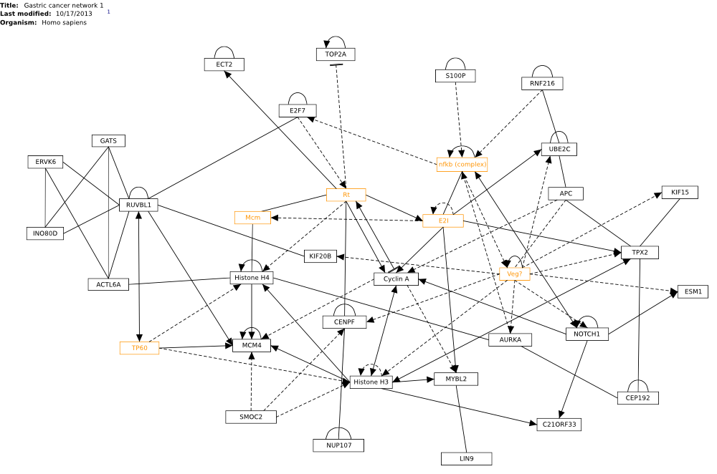
True Discovery Proportion (TDP) in Gastric Cancer Network 1
TDP_{s}: 0.72, TDP_{genome} :0.34

Slide 26
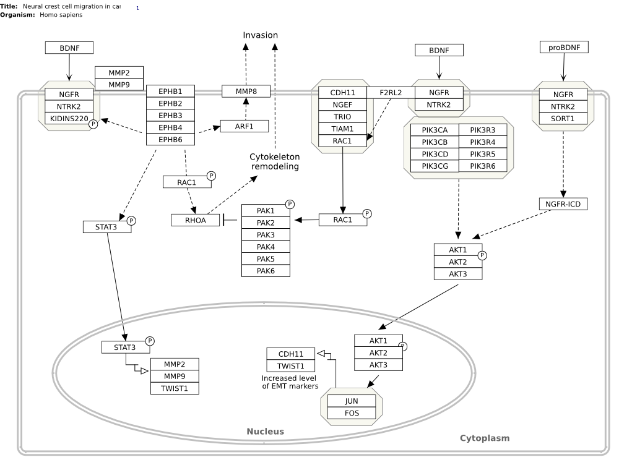
True Discovery Proportion (TDP) in Neural Crest Migration in Cancer
TDP_{s}: 0.17, TDP_{genome} :0.34

Slide 27
Odds ratio for Gastric Cancer Network1 Pathway
 | Differentially expressed | Not differentially expressed
In Gastric Cancer pathway | 16 | 6
Not in Gastric Cancer pathway | 1006 | 3811
Odds of finding a DE gene in the Gastric Cancer pathway = (16/22)/(6/22)=16/6
Odds of finding a DE gene not in the pathway =(1006/4817)/(3811/4817)=1006/3811
Odds Ratio = (16/6)/(1006/3811)=10.1

Slide 28
Odds ratio for Neural Crest Migration in Cancer Pathway
 | Differentially expressed | Not differentially expressed
In Neural Crest pathway | 6 | 30
Not in Neural Crest pathway | 1016 | 3787
Odds of finding a DE gene in the Neural Crest pathway = (6/36)/(30/36)=6/30
Odds of finding a DE gene not in the pathway =(1016/4803)/(3787/4803)=1016/3787
Odds Ratio = (6/30)/(1016/3787)=0.74

Slide 29
Average fold-change of genes in pathway
Gastric Cancer Network 1
Neural Crest Migration in Cancer

Slide 30
Statistics of Enrichment Methods
  Choice of Parameter of Interest/Test statistic
  Choice of Null Hypothesis
  Sampling distribution of the Test statistic

Slide 31
What should our null hypothesis be?
TDP_{s} = 0 OR TDP_{s} ≤ c
Average log2 fold-change ≠ 0 OR |Average log2 fold-change| ≤ c
Odds Ratio = 1
Self-contained hypothesis (c = 0): You have a pathway in mind and want to know if these genes in this pathway have altered expression
Competitive hypothesis (c from genome): You are interested pathway whose genes are “more” altered than other genes not in the pathway

Slide 32
Question 3
Does the definition of Odds Ratio imply a Self-contained or a Competitive Hypothesis?
Respond in Chat please
Competitive Hypothesis!
  The odds of finding a differentially expressed gene in the Gastric Cancer Network 1 pathway is 10 times the odds of finding a differentially expressed gene not in this pathway

Slide 33
Statistics of Enrichment Methods
  Choice of Parameter of Interest/Test statistic
  Choice of Null Hypothesis
  Sampling distribution of the Test statistic

Slide 34
There is a story behind every p-value…
…that reflects how likely a given observation is under repeated attempts at performing a given experiment
…knowing what this experiment is critical to interpreting the significance of the p-value, here specifically in the context of enrichment analyses methods

Slide 35
Question 4
What would be the experiment you want to repeat for the bladder cancer data to make sure that your findings on the identified pathways enriched in tumor over normal samples are reproducible?
Respond in Chat or speaking up by unmuting yourself!
Ideally, one would want to go back find new bladder cancer patient samples, isolate their tumor and normal tissues and sequence their RNA and verify that the same pathways are enriched in these samples as well

Slide 36
Question 5
What is the implied experiment in the definition of the Odds Ratio?

Slide 37
Gene permutation implicit in estimation of significance of odds ratio
Observed overlap of 2 altered genes with pathway genes
Pathway gene
1.
Altered gene
OR=Inf
Not pathway nor altered gene
Pemutation Possibilities of 2 altered genes across all genes
2.
9.
Probability of observing 2 altered genes
in the pathway = 3/15 = 20%
3.
OR=1
10.
4.
11.
OR=0
5.
12.
6.
13.
7.
14.
8.
15.

Slide 38
Implicit assumptions behind gene permutation used in ORA
Any gene can be swapped with any other gene: genes are independent of each other
Not a biologically valid assumption and it leads to elevated Type I error false positive rate
The resultant p-values do not represent the reproducibility of the results in terms of collection of new samples
Requires an a priori decision to made (e.g., FDR < 0.05) to decide on a set of differentially expressed genes
Despite all this, it is a quick method that does not perform “too badly” in practice

Slide 39
Sample permutations preserve gene-gene correlations
Observed expression of 2 altered genes
among 5 normal and 5 tumor samples
Sample permutation 1
Sample permutation 2
Gene 2
Gene 2
Gene 2
Gene 1
Gene 1
Gene 1
Normal sample
Tumor sample

Slide 40
Implicit assumptions behind sample permutation methods: rSEA, GSEA, SAFE, PADOG
Gene-gene correlation is preserved and therefore correct Type 1 error is maintained
Permutation of sample labels corresponds exactly with the null hypothesis for gene expression association (no change in expression between tumor and normal sample)
…this would imply a situation where you are resampling subjects from a population of bladder cancer patients with the assumption that there is no difference of the mean expression between the two groups
…therefore the results reflects their reproducibility
…drawbacks for methods that require explicit sample permutation
  Need large number of replicates per group (at least 10)
  Slow
Gene 1

Slide 41
Outline and main messages
Context and background for enrichment methods
Primer on statistics
Statistics of Enrichment Methods
  Choice of Parameter of Interest/Test statistic
  Choice of Null Hypothesis
  Sampling distribution of the Test statistic
Overview of the chosen enrichment methods
Hands-on
Guide to your choice of the method for your application
Questions

Slide 42
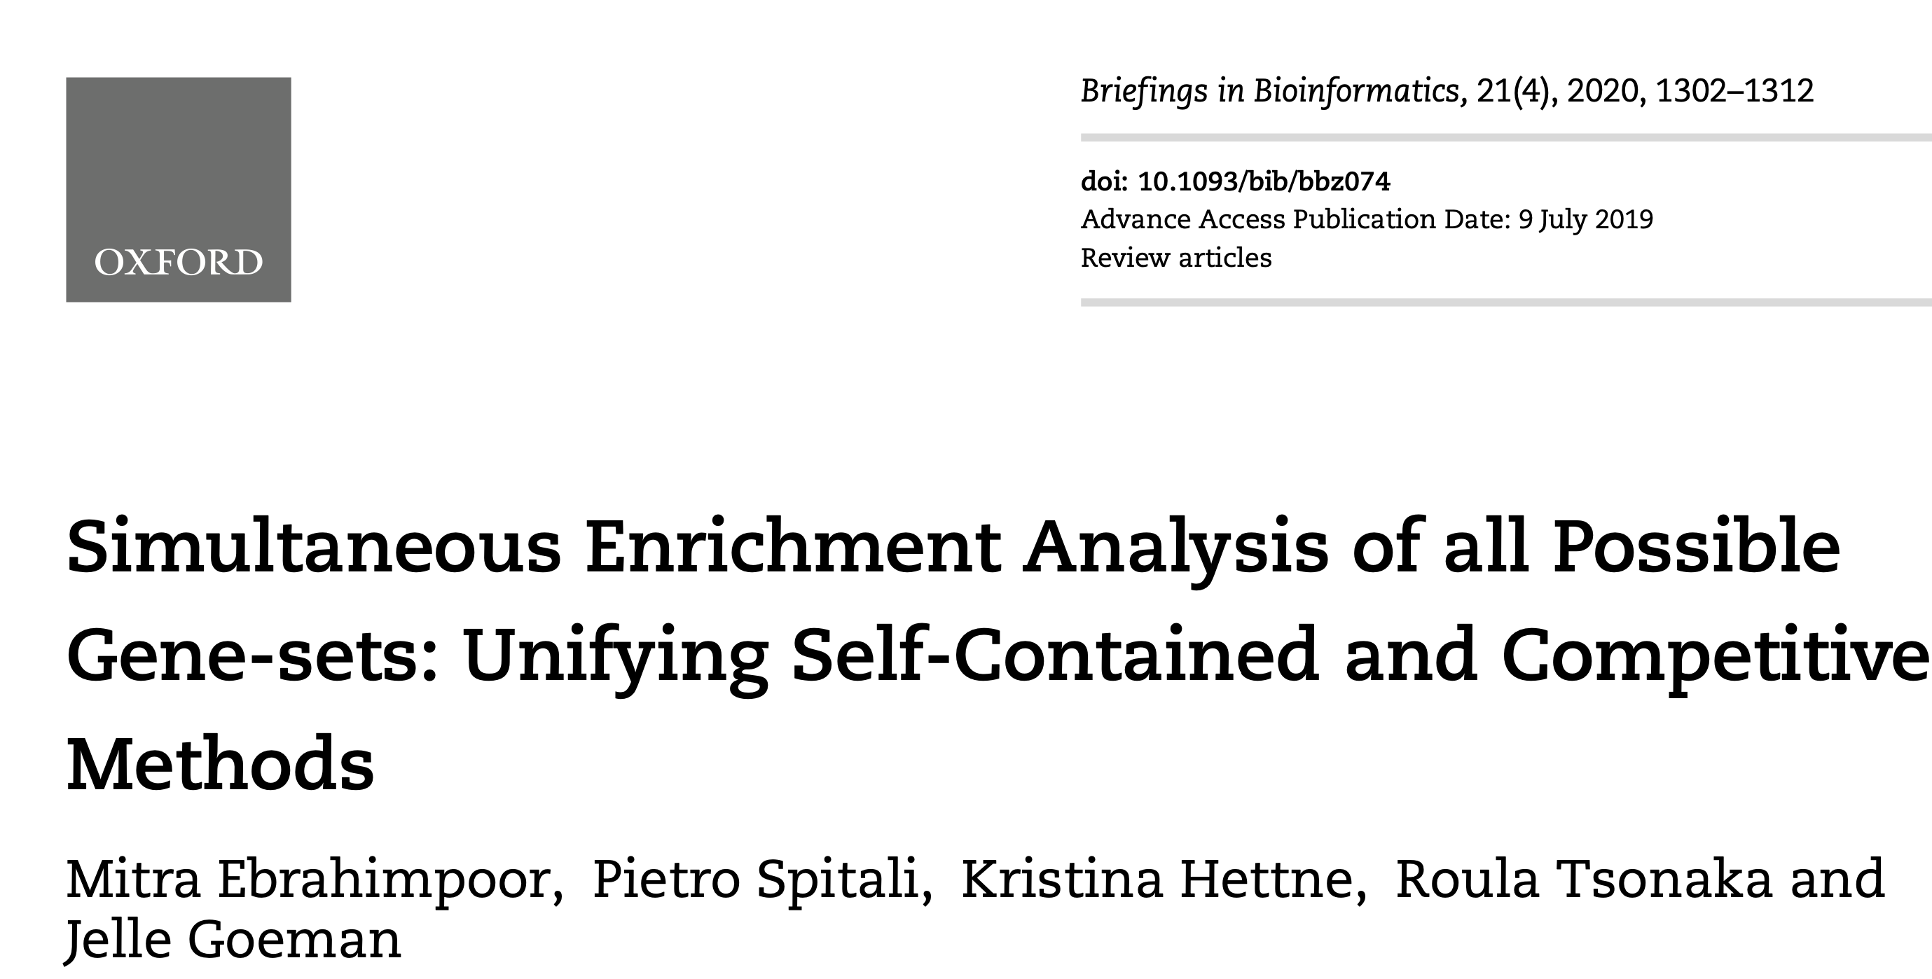
rSEA
For each gene set s,
Null hypothesis
TDP_{s} ≤ c
Choice of c determines the kind of hypothesis
c = 0: Self-contained
c = TDP_{genome} : Competitive
Significance estimates using closed set testing – one of the many multiple testing methods

Slide 43
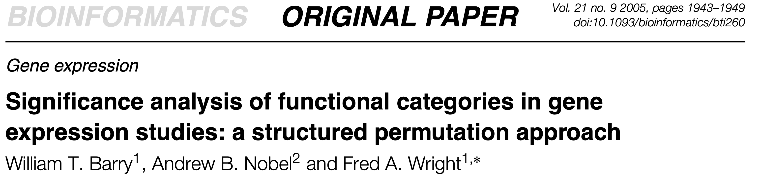
SAFE
Gastric Cancer Network 1
For each gene set s,
Null hypothesis
Mean log2FC among genes in set s = Mean log2FC among genes not in s
Can use gene or sample permutation to estimate
significance

Slide 44
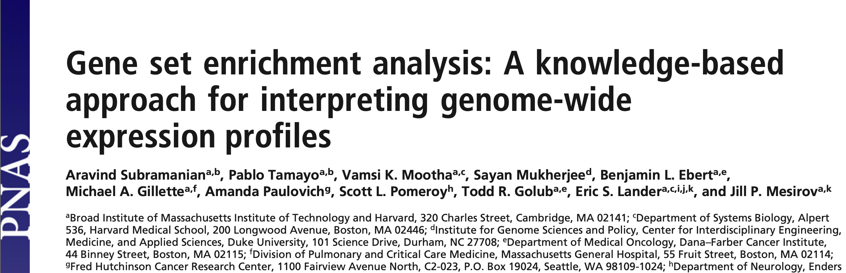
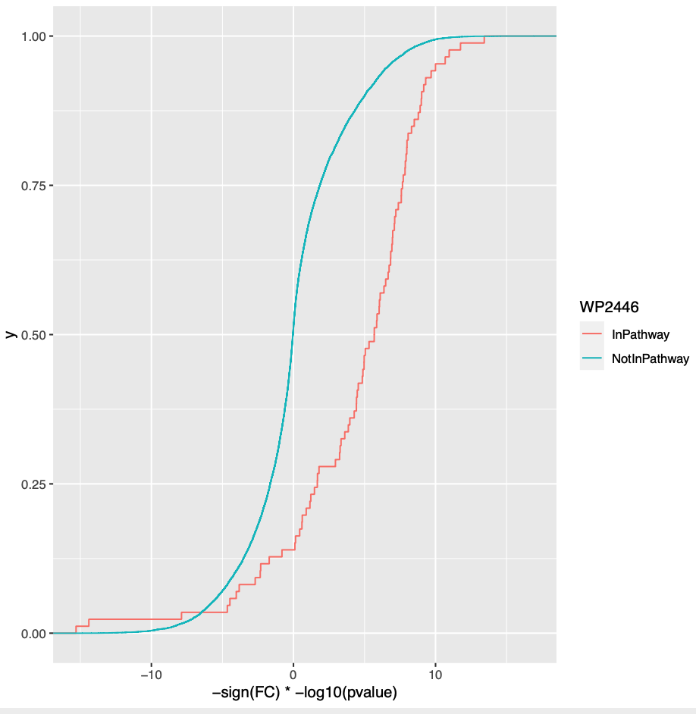
GSEA
For each gene set,
Null hypothesis
F(S) = F(S^{c})
F(S): distribution of “correlation” of gene expression with phenotype among genes in set S
F(S^{c}): distribution of “correlation” of gene expression with phenotype among genes not in set S
Enrichment Score (ES)
-1 ≤ ES ≤ 1
Probability
Can use gene or sample permutation to estimate
significance
Correlation

Slide 45
Over Representation Analyses
ORA
 | Differentially expressed | Not differentially expressed
In Gastric Cancer pathway | 16 | 6
Not in Gastric Cancer pathway | 1006 | 3811
Odds of finding a DE gene in the Gastric Cancer pathway = (16/22)/(6/22)=16/6
Odds of finding a DE gene not in the pathway =(1006/4817)/(3811/4817)=1006/3811
Odds Ratio = (16/6)/(1006/3811)=10.1
For each gene set s,
Null hypothesis
Odds Ratio = 1
Significance is evaluated using the Hypergeometric Distribution/Fisher’s Exact Test

Slide 46
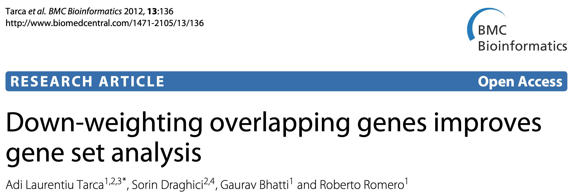
PADOG
Some genes are part of many WikiPathways
For each gene set s,
Null hypothesis
Mean weighted |log2FC| among genes in set s =
Mean weighted |log2FC| among genes not in s
Can use gene or sample permutation to estimate
significance

Slide 47
Outline and main messages
Context and background for enrichment methods
Primer on statistics
Statistics of Enrichment Methods
  Choice of Parameter of Interest/Test statistic
  Choice of Null Hypothesis
  Sampling distribution of the Test statistic
Overview of the 6 enrichment methods
Hands-on
Guide to your choice of the method for your application
Questions

Slide 48
Outline and main messages
Context and background for enrichment methods
Primer on statistics
Statistics of Enrichment Methods
  Choice of Parameter of Interest/Test statistic
  Choice of Null Hypothesis
  Sampling distribution of the Test statistic
Overview of the 6 enrichment methods
Hands-on
Guide to your choice of the method for your application
Questions

