Slide 1
Requirements for the demo
Please install the following library in Rstudio
install.packages("magrittr")
install.packages("statmod")
install.packages("tidyverse")
install.packages("ggplot2")
install.packages("BiocManager")
BiocManager::install("edgeR")
BiocManager::install("org.Mm.eg.db")
Verify the installation:
library(magrittr)
library(statmod)
library(tidyverse)
library(ggplot2)
library(edgeR)

Slide 2
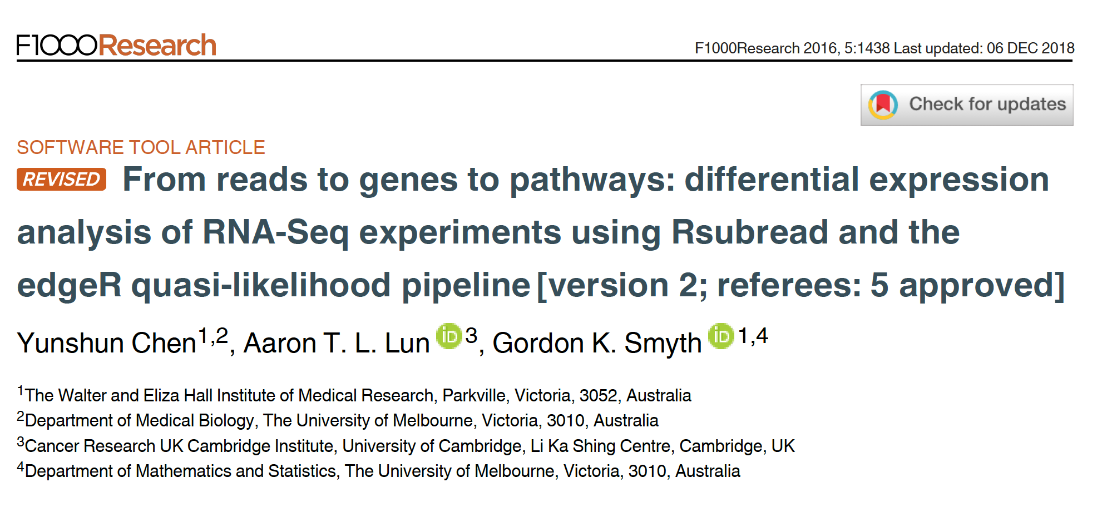
Reference for the workshop
Notes:
Relevant reading for theory:
1. Chen, Yunshun, Aaron TL Lun, and Gordon K. Smyth. "Differential expression analysis of complex RNA-seq experiments using edgeR." Statistical analysis of next generation sequencing data. Springer, Cham, 2014. 51-74.

Slide 3
Intermediate RNA-seq data analysis using R
Michela Traglia, Min-Gyoung Shin
Bioinformatics Core, GIDB
May 19th, 2025

Slide 4
Introductions
Min-Gyoung Shin
Bioinformatician III
Michela Traglia
Senior Statistician

Slide 5
Assumed background
Familiarity with R and RStudio
Familiarity with RNA-seq protocol
Familiarity with basic concepts of statistics and hypothesis testing

Slide 6
Poll 1
How familiar you are:
I attended the ‘Introduction to RNA-seq’ Gladstone workshop or I similar courses
I attended ‘Introduction to R’ Gladstone workshop/experience with R
I have experience in analysing the RNASeq data
No experience with RNAseq
No experience with R

Slide 7
Materials for this workshop
Please download the compressed file 2025Sept_intermediatRNAseq.zip
Double click on the file, the unzipped folder includes:
Hands-on session files:
- handson.R
- targets.txt
- DE_resutls.txt
- GSE60450_Lactation-GenewiseCounts.txt.gz
This presentation with concepts

Slide 8
Workshop outline
Intro to a real experiment
Approach for Differentially Expressed Gene analysis: edgeR
Filtering genes
Normalization
Demo I
Exploratory visualization: MDS – PCA
Fit the model for DEG
Compare groups and visualize the DEG
Demo II

Slide 9


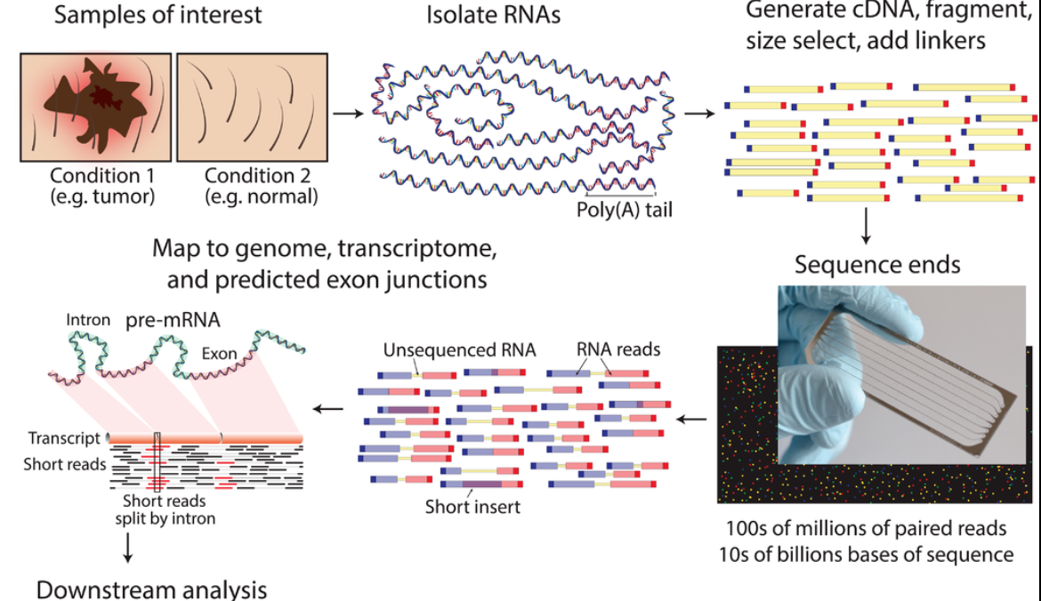
RNA-seq - analysis workflow
Biological samples
Library preparation
Sequencer: Reads Fastq
Quality check
FastQC
Trimming
cutadapt
Quality check
FastQC
Alignment/Mapping
STAR
Quality check
Counting Reads
featureCounts
Quality check
https://www.wikiwand.com/en/RNA-Seq

Slide 10
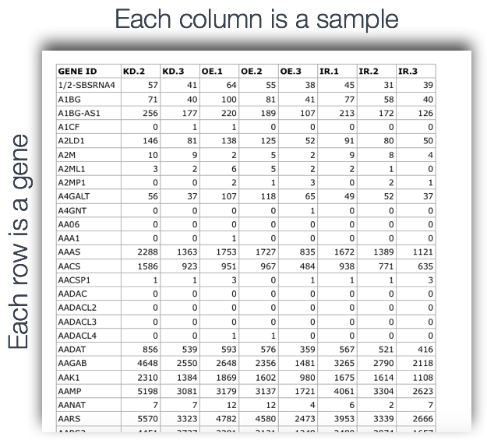
Today: From the count matrix to the DEG

Slide 11
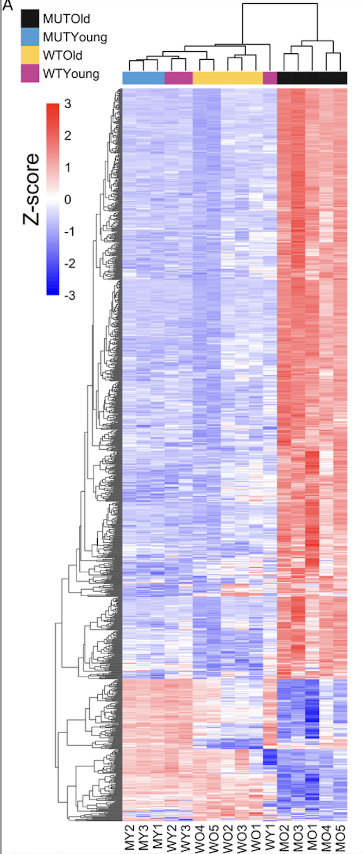
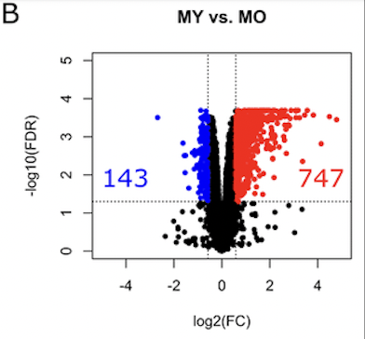
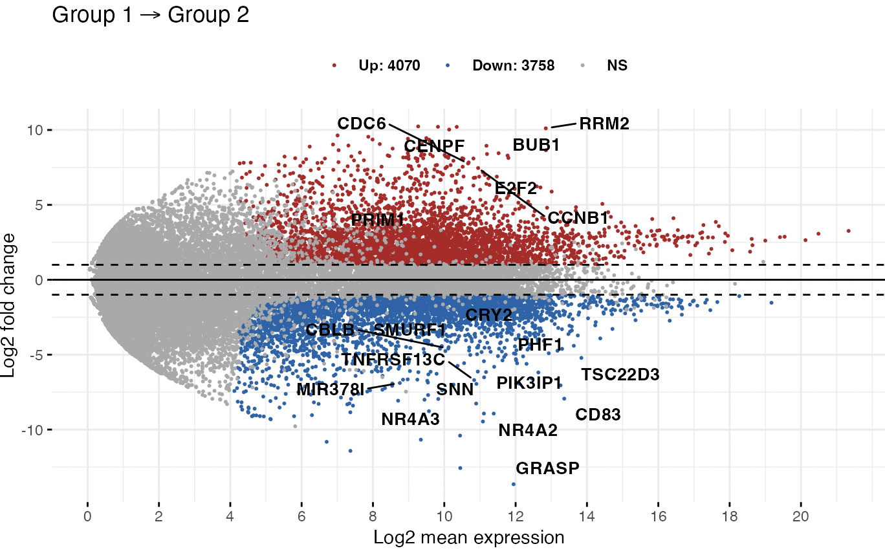
Goal of DEG analysis
Volcano plot
MA (mean-difference) plot
From Barham et al 2013
From Barham et al 2013
Heatmap
Identify genes (and molecular pathways) that are differentially expressed (DE) between two or more biological conditions
Notes:
Ma plot from https://rpkgs.datanovia.com/ggpubr/reference/ggmaplot.html
MA-plot is a scatter plot of log2 fold changes (M, on the y-axis) versus the average expression signal (A, on the x-axis). M = log2(x/y) and A = (log2(x) + log2(y))/2 = log2(xy)*1/2, where x and y are respectively the mean of the two groups being compared.

Slide 12
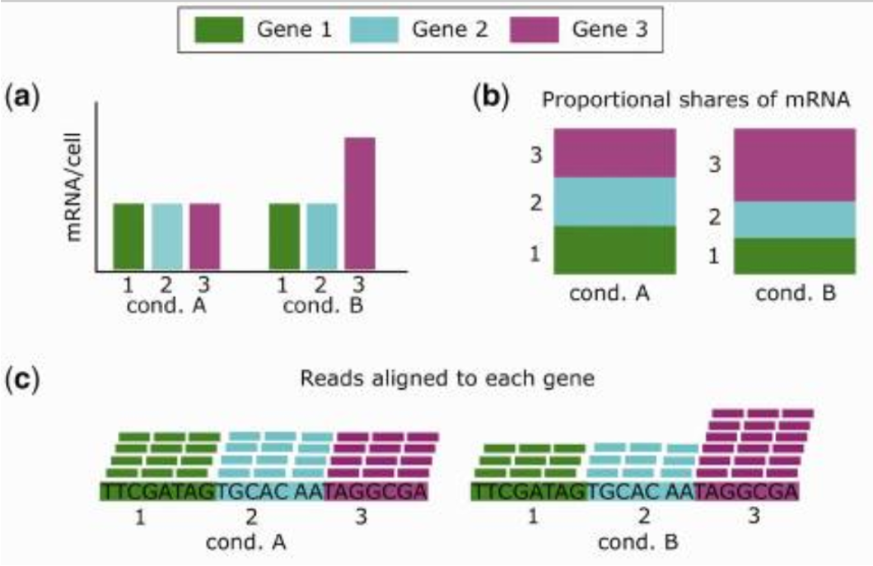
Highly expressed genes bias the real DEG
Total read count for each sample is the same.
Few highly expressed genes make up a greater share of the total molecules (total library size) of samples B.
Smaller fraction of the reads will be left for the other genes for that samples (undersampling).
doi: 10.1093/bib/bbx008

Slide 13
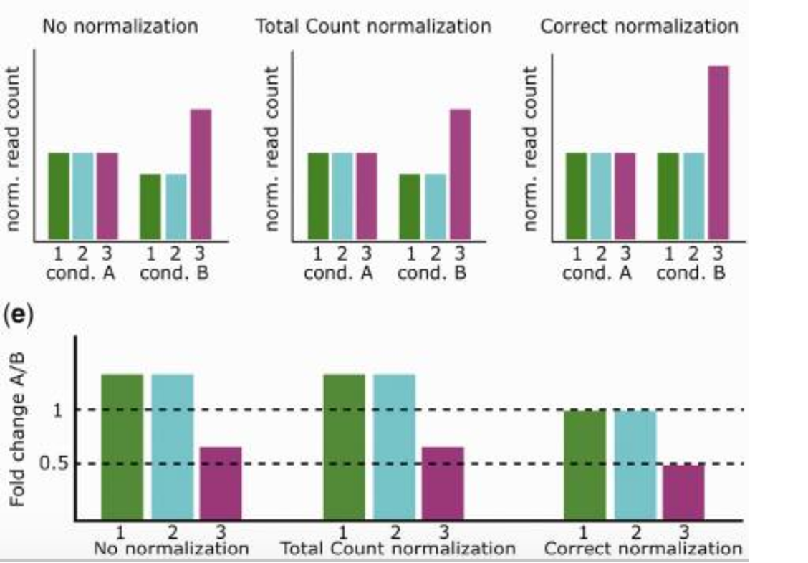
Gene 1 and 2 not-DE
Gene 3 is 2X DE

Slide 14
Please find more details on our wiki page
Introduction-to-RNA-Seq-Analysis

Slide 15
Scenario 1
3 replicates per sample
10 samples
2 conditions (5 samples per condition)
Quantify the gene expression for gene X across replicates for the same sample group (ex. condition, genotype)

Slide 16
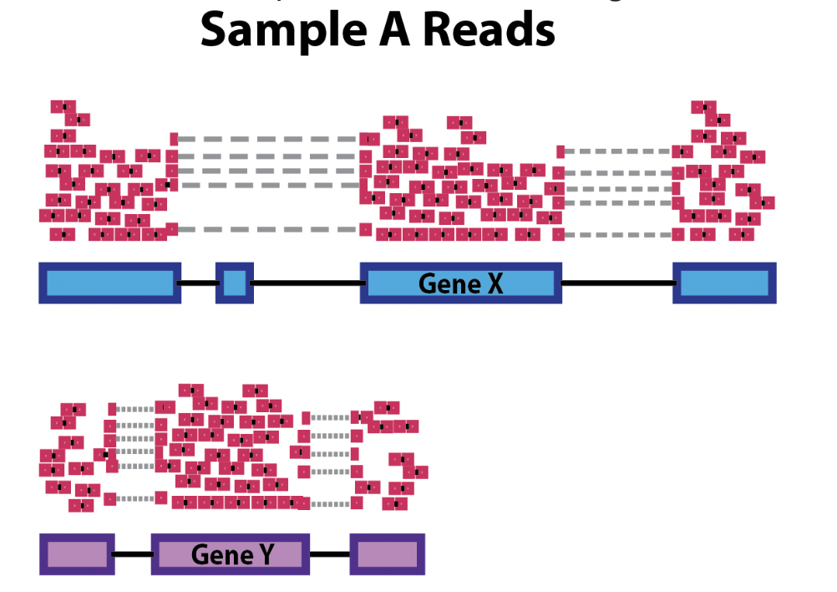
Scenario 1
Within sample replicates
Sample A.1 reads
Sample A.2 reads

Slide 17
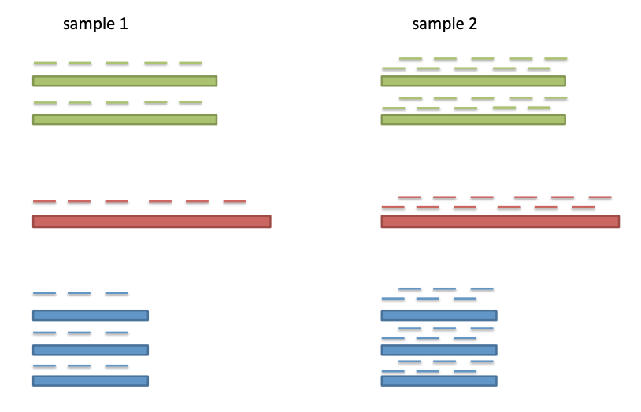
Source of bias
Higher sequencing depth, higher counts
Sequencing depth or library size or total number of reads

Slide 18
Scenario 2
3 replicates per sample
10 samples
2 conditions ( 5 samples per condition)
Quantify the gene expression of gene X and gene Y of interest in one sample of the same sample group (ex. condition, genotype)

Slide 19
Scenario 2
Within a sample
Gene X and Gene Y have different length!
Estimate and compare gene expressions across genes (features)

Slide 20
Source of bias
Higher sequencing depth, higher counts
Sequencing depth or library size or total number of reads

Slide 21
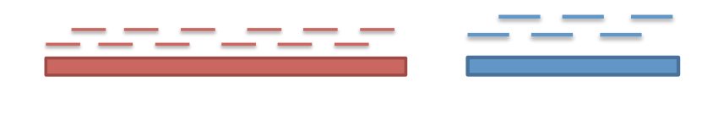
Source of bias between genes
At the same expression level, a long gene will have more reads than a shorter gene
N=12
N=6
Gene-length

Slide 22
Scenario 3
3 replicates per sample
10 samples
2 conditions ( 5 samples per condition)
Quantify if gene X and/or gene Y are differentially expressed in two sample groups (ex. condition, genotype)

Slide 23
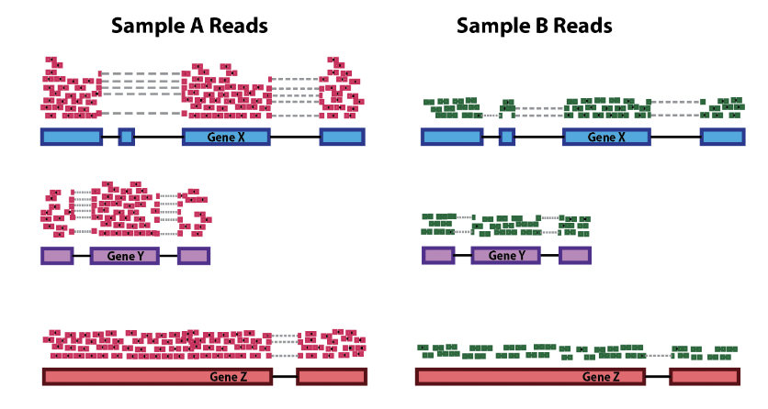
Scenario 3
Between samples - DEG
Pairwise -
Gene X group 1 compared to Gene Y group 2
Gene Y group 1 compared to Gene Y group 2
DEG: Compare gene expressions across samples

Slide 24
Source of bias
Higher sequencing depth, higher counts
Sequencing depth or library size or total number of reads

Slide 25
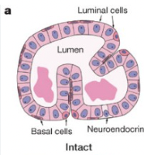
Different sequence depths cause variation in counts
Variation in sequencing depths => Need to normalize counts
Group | Total counts
B.virgin | 23085177
B.virgin | 21628857
B.pregnant | 23919152
B.pregnant | 22490570
B.lactating | 21382233
B.lactating | 19884434
Group | Total counts
L.virgin | 20213223
L.virgin | 21509988
L.pregnant | 22073815
L.pregnant | 21837341
L.lactating | 24638939
L.lactating | 24581591
Library size about 20M

Slide 26
Source of technical variability
Identify and correct technical biases removing the least possible biological signal based on your biological question and experiment
Gene length
Library size or sequence depth (number of mapped reads)
RNA sample composition
Batch effects
Various normalized gene expression units such as RPM (or CPM), RPKM, FPKM, TPM, TMM (edgeR), DESeq

Slide 27
Scenario 1
Within sample replicates
Sample A.1 reads
Sample A.2 reads

Slide 28
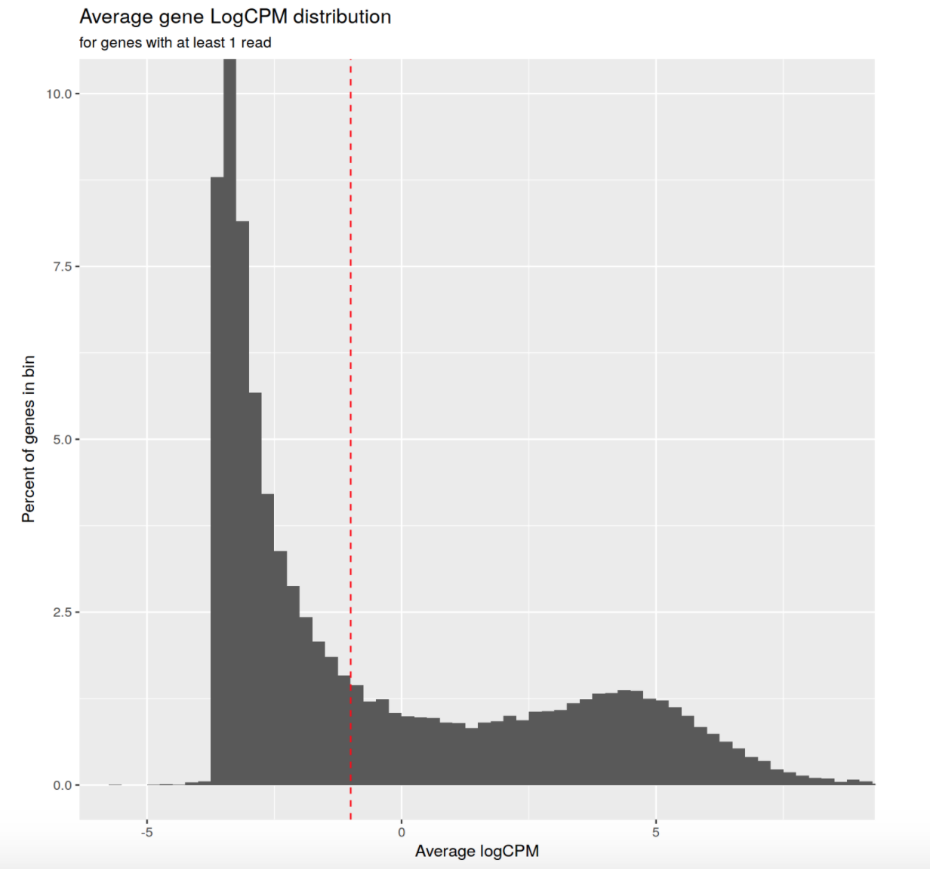
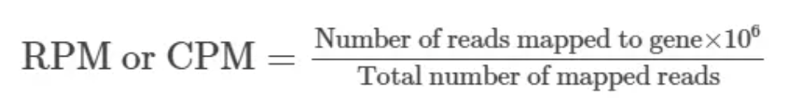
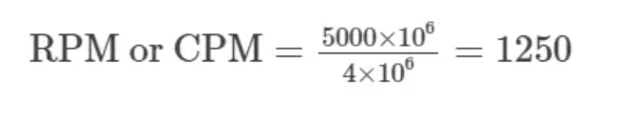
Sequence depth/Library size - Count Per Million mapped reads
Sequenced one library with 5 million(M) reads.
Total 4 M matched to the genome sequence
5000 reads matched to a given gene
Filter on count-per-million (CPM) values to avoid favoring genes that are expressed in larger libraries over those expressed in smaller libraries
A gene at least 10–15 counts in at least some libraries before it is considered to be expressed -> Identifying the CPM that corresponds to 10-15 counts
For comparison within replicates or same group, NOT for within sample, NOT for DEG

Slide 29
Scenario 2
Within a sample
Gene X and Gene Y have different length!
Estimate and compare gene expressions across genes (features)

Slide 30
Common methods to normalize the counts considering gene length
Commonly used normalization method that includes sequence depth and gene length correction:
RPKM /FPKM (Reads/Fragments Per Kilobase per Million)
TPM (Transcripts Per kilobase Million)
Notes:
https://www.rna-seqblog.com/rpkm-fpkm-and-tpm-clearly-explained/

Slide 31
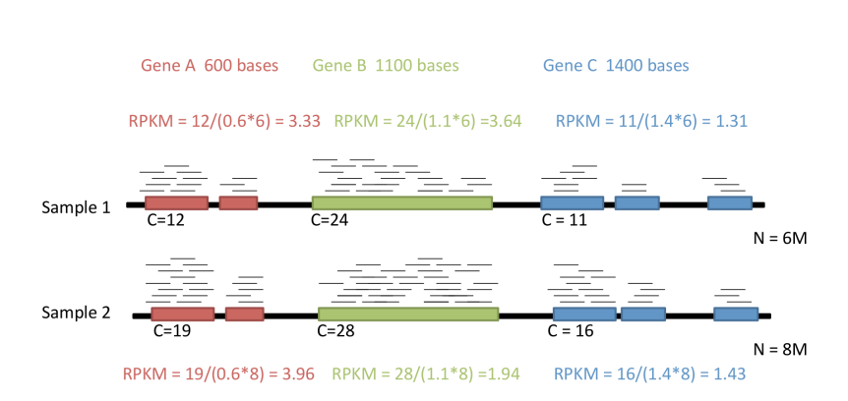
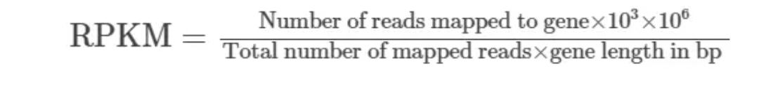
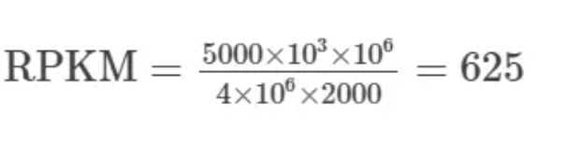
RPKM: seq depth and gene length bias
Reads/Fragments Per Kilobase per Million
One library with 5 M reads
Total 4 M matched to the genome sequence
5000 reads matched to a given gene with a length of 2000 bp.
RPKM and FPKM -> the sum of the normalized reads in each sample may be different, and this makes it harder to compare samples directly.
Notes:
https://www.rna-seqblog.com/rpkm-fpkm-and-tpm-clearly-explained/
RPKM:
Count up the total reads in a sample and divide that number by 1,000,000 – this is our “per million” scaling factor.
Divide the read counts by the “per million” scaling factor. This normalizes for sequencing depth, giving you reads per million (RPM)
Divide the RPM values by the length of the gene, in kilobases. This gives you RPKM.
FPKM is used especially for normalizing counts for paired-end RNA-seq data in which two (left and right) reads are sequenced from the same DNA fragment. Generally, the higher the FPKM of a gene, the higher the expression of that gene.

Slide 32
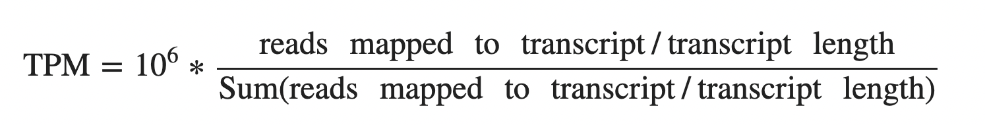
TPM: seq depth and gene length bias
TPM: Normalize for gene length first to get the Reads Per Kilobase, sum up all the RPK in a sample (across all genes), and then normalize for sequencing depth
Represent the relative abundance of a transcript among a population of sequenced transcripts
The sum of all TPMs in each samples are the same -> to compare the proportion of reads that mapped to a gene in each sample.
Same denominator -> comparable - NOT for RPKM (different denominator)
Sample1 - gene1 TPM=2.5
Sample2 - gene1 TPM=2.5
Notes:
https://translational-medicine.biomedcentral.com/articles/10.1186/s12967-021-02936-w
https://www.biostars.org/p/273537/
https://www.ncbi.nlm.nih.gov/pmc/articles/PMC7373998/
TPM:
Divide the read counts by the length of each gene in kilobases. This gives you reads per kilobase (RPK).
Count up all the RPK values in a sample and divide this number by 1,000,000. This is your “per million” scaling factor.
Divide the RPK values by the “per million” scaling factor. This gives you TPM.

Slide 33
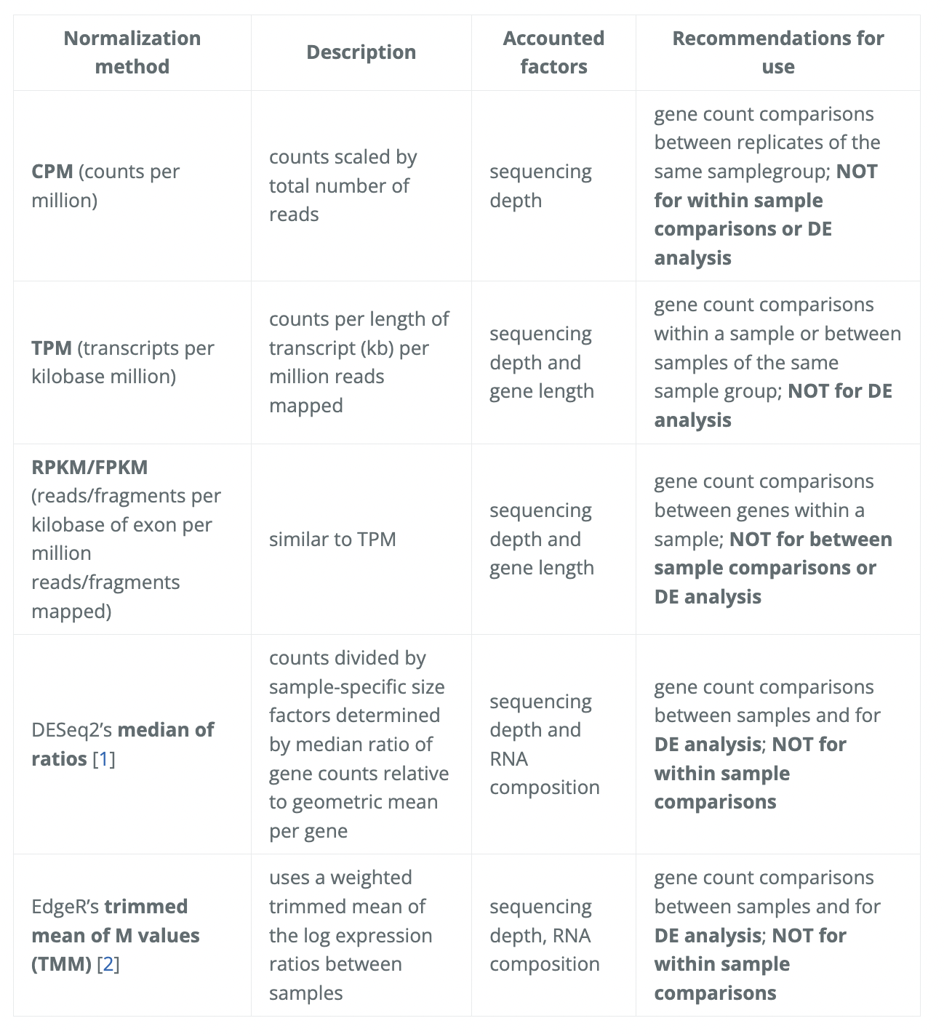
Main normalization approaches summary
https://hbctraining.github.io/Training-modules/planning_successful_rnaseq/lessons/sample_level_QC.html

Slide 34
Poll 2
In a pairwise comparison between two sample groups, is the gene length a course of bias?
Yes
No

Slide 35
Scenario 3
Between samples - DEG
Pairwise -
Gene X group 1 compared to Gene Y group 2
Gene Y group 1 compared to Gene Y group 2
DEG: Compare gene expressions across samples

Slide 36
Don’t use the previous methods for between condition/groups comparison!
When total RNA composition is similar across samples, these methods could be potentially used.
But you can’t assume it!
Cells don’t necessarily produce similar levels of RNA/cell between cell types, disease states or developmental stages is not always valid
Sample-to-sample variability in total RNA concentration

Slide 37
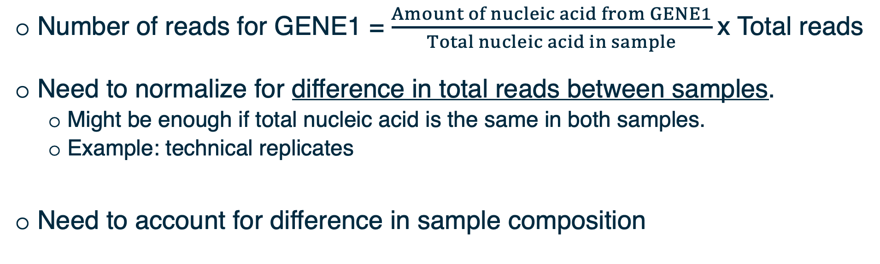
Observed counts depend on total reads sequenced AND sample composition

Slide 38
Methods for between samples comparisons / DEG

Slide 39
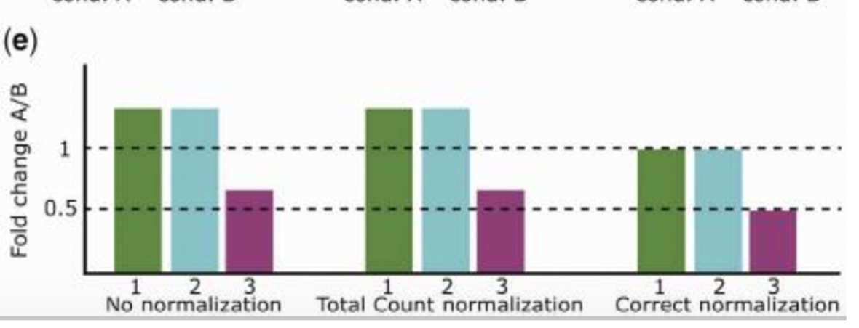
A few highly differentially expressed genes may have a strong influence on read counts -> minimizing effect of such genes
Assumption: A majority of transcripts is not differentially expressed
Adjust counts such that for most genes, counts are not differential.

Slide 40
Compositional biases: certain genes have much higher read counts due to technical reasons
-> Consider when calculating the library size
-> Scaling factors used to adjust the library size
Normalize for RNA composition by a set of scaling factors that minimize the log-fold changes between the samples for most genes
y <- calcNormFactors(y)

Slide 41
Approach to identify DE genes: edgeR
Bioconductor package edgeR utilizes a theoretical model that captures some of the known processes leading to noise in counts data. (null model)
If the probability is very low (e.g., p < 0.05), infer that something may be happening that we did not account for in the null model. (e.g., biological processes in L cells for milk production) - biological signal
Notes:
p-value is the probability of an observed (or more extreme) result assuming that the null hypothesis is true
For all the details see: http://bioconductor.org/packages/devel/bioc/vignettes/edgeR/inst/doc/edgeRUsersGuide.pdf

Slide 42
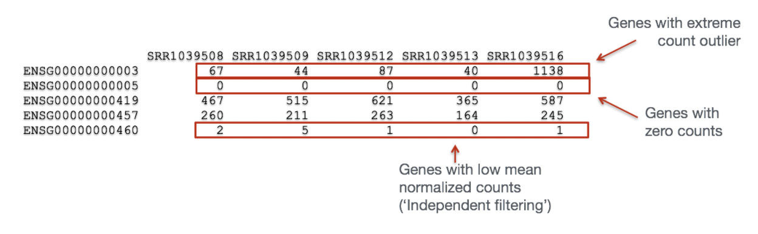
“Uninteresting” genes Filtering
Biological point of view: minimal expression level of a gene -> translation into a protein -> biologically relevant
Statistical point of view: low counts -> not enough statistical evidence.
Genes with consistently low counts are very unlikely be assessed as significantly DE
Using cpm to filter out genes

Slide 43
Need to correct for multiple testing
P value represents the chance that we may be wrong in calling something significantly differential. Example:
P = 0.01 means 1% chance that we may be wrong.
P = 0.50 means 50% chance that we may be wrong.
More than 20k genes under consideration
=> if a certain difference in expression levels has only 1% chance of happening given the null model, it
might be observed for 200 genes even if the null model were true for all the genes.
=> 200+ false positives
Hence, there is a need to adjust the p-values.
- The more genes we test, the more we must adjust.
- Reduce the number of tests by filtering out “uninteresting” genes.

Slide 44
Scaling factors to minimize the log-fold changes between the samples for most genes
Reference sample: have the closest average expressions to the mean of all samples
Test samples: other samples
Generate a gene set removing most/lowest expressed genes (avg read counts) and genes with highest/lowest log ratios (differences in expression)
The weighted mean of log ratios between the test and reference on the gene set is the scaling factor for the library
y <- calcNormFactors(y)

Slide 45
Other approaches to normalization
Relative Log Expression (RLE) approach by Anders and Huber (2010)
Reference: geometric mean of all samples
Normalization factor: median ratio of each sample to the reference
RLE and TMM give similar results with real and simulated data
R package DESeq - tutorial
Upper quartile normalization by Bullard et al (2010)
Normalization factor: 75% quantile of the counts for each sample
Not recommended in general
Control genes (housekeeping genes, spike-in) to estimate technical noise (RUVSeq – 2014 Remove Unwanted Variation)
Notes:
More about normalization methods: https://bmcgenomics.biomedcentral.com/articles/10.1186/s12864-020-6502-7
Relative Log Expression - Anders, S, Huber, W (2010). Differential expression analysis for sequence count data. Genome Biology 11, R106.
Bullard JH, Purdom E, Hansen KD, Dudoit S. (2010) Evaluation of statistical methods for normalization and differential expression in mRNA-Seq experiments. BMC Bioinformatics 11, 94.
RUVSeq https://bioconductor.org/packages/devel/bioc/manuals/RUVSeq/man/RUVSeq.pdf

Slide 46
Best practice to choose a normalization
An effective normalization should result in a stabilization of read counts across samples (eliminate composition biases between libraries)
TC, RPKM, UQ - Adjustment of distributions, implies a similarity between RNA molecular repertoires expressed
DESeq, TMM - More robust ratio of counts using several samples, suppose that the majority of the genes are not DE
RUVSeq - Powerful when a large set of control genes can be identified
Notes:
Suggested:
Selecting between-sample RNA-Seq normalization methods from the perspective of their assumptions: https://www.ncbi.nlm.nih.gov/pmc/articles/PMC6171491/
A comprehensive evaluation of normalization methods for Illumina high-throughput RNA sequencing data analysis : https://academic.oup.com/bib/article/14/6/671/189645?login=false

Slide 47
Main normalization approaches summary
Why DESeq and TMM are not suitable for within sample comparison?
https://hbctraining.github.io/Training-modules/planning_successful_rnaseq/lessons/sample_level_QC.html

Slide 48
Break (5 min)
Notes:
For multidimensional scaling and PCA:
Look up Ali Ghodsi’s lectures on youtube.

Slide 49
Demo I

Slide 50
Hands-on session
Load and reformat the data
Exploratory visualization : MA plot
Create DGElist object and retrieve gene symbols
Filter genes with inadequate information
Normalization
Exploratory visualization : MDS and PCA plots
Define and fit a model
Hypothesis testing (four example hypotheses)
Save results as a table and explore in Excel

Slide 51
Dataset
Transcriptome analysis of luminal and basal cell subpopulations in the lactating versus pregnant mammary gland
GEO (gene expression omnibus) accession: GSE60450
Tissue of origin: Mammary glands of mouse
Cell types: Basal stem-cell enriched cells (B) and committed luminal cells (L)
Biological conditions: Virgin, Lactating (2 day) and Pregnant (18.5 day)
# of groups: 2 cell types (B/L) x 3 conditions (V/L/P) = 6 groups
# of replicates: 2 of each group
Illumina Hiseq sequencer - about 30 million 100bp single-end reads for each sample.
https://www.ncbi.nlm.nih.gov/geo/

Slide 52
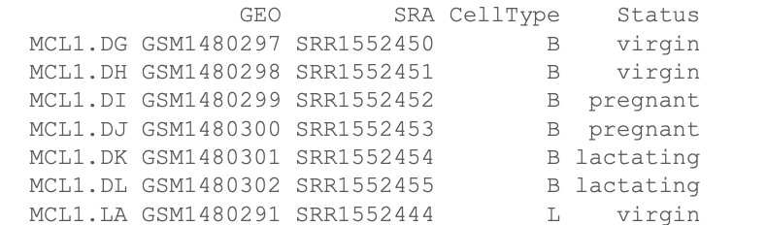
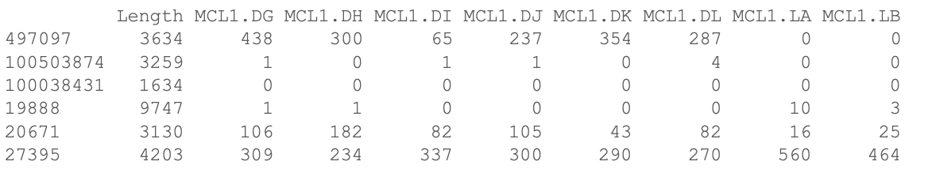
Files for the hands-on session
targets.txt
Phenofile
GSE60450_Lactation-GenewiseCounts.txt.gz
Counts for each sample for each gene (Entrez Gene Identifiers)

Slide 53
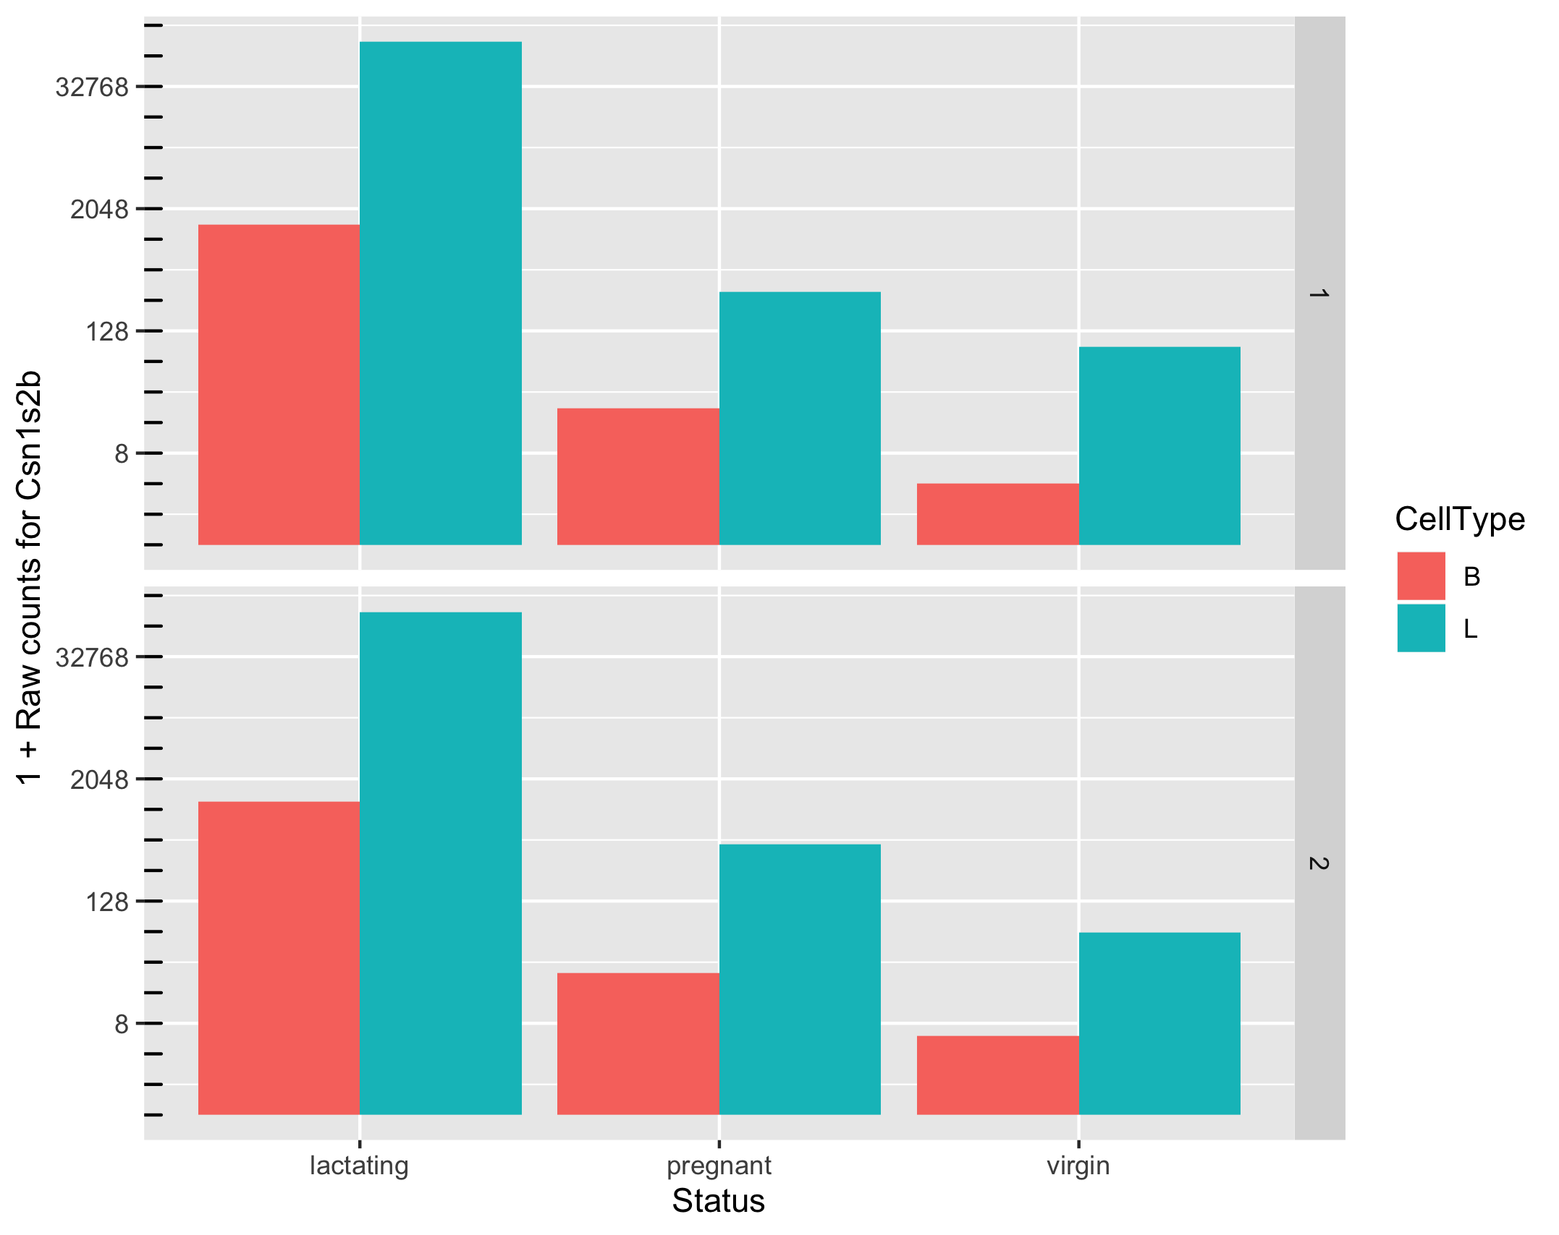
Potential biological questions
Which comparisons are we interested in?
Example:
B vs L,
B.lactating vs L.pregnant,
...
All of them
Or not interested in comparisons but in gene expression of one sample

Slide 54
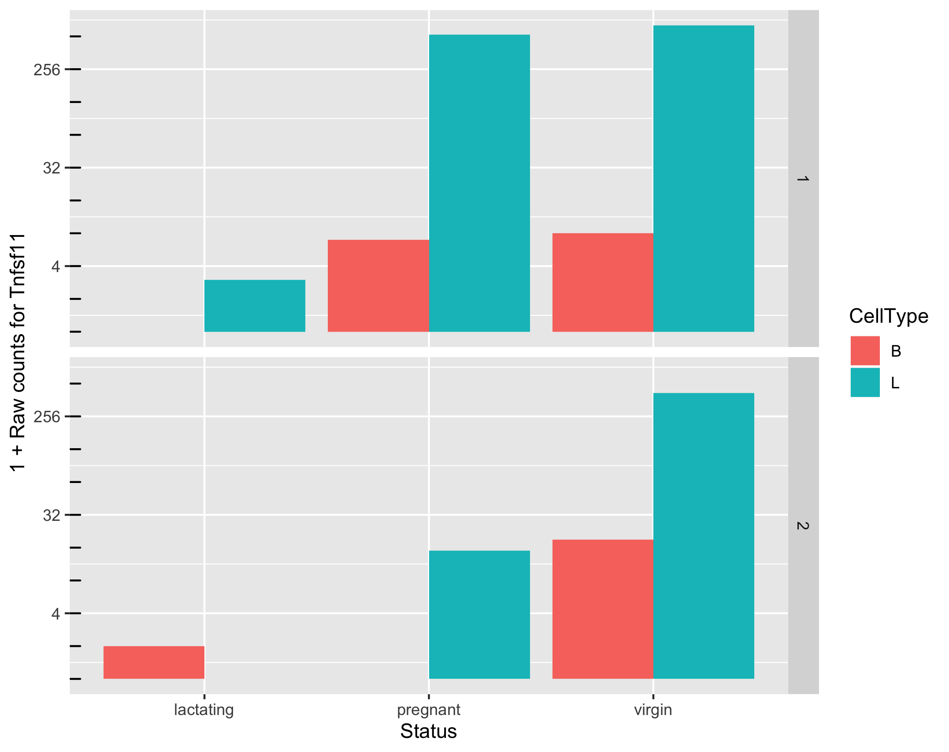
Potential issues
Can we make reliable inferences for genes with very low counts? What should we consider “very low”?

Slide 55
MDS and PCA plots
Notes:
For multidimensional scaling and PCA:
Look up Ali Ghodsi’s lectures on youtube.

Slide 56
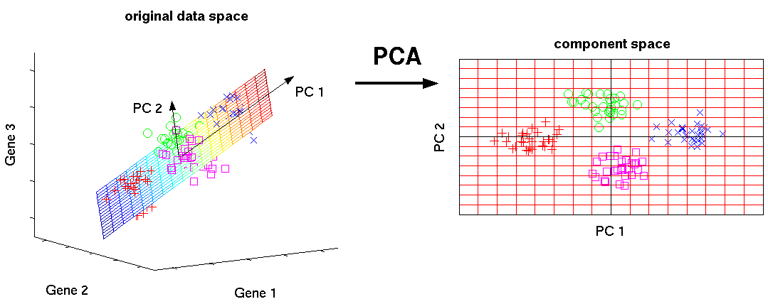
Assessing overall similarity across samples
Which samples are similar to each other, which are different?
Does this fit to the expectation from the experiment’s design?
What are the major sources of variation in the dataset?
Notes:
Biological phenomena more likely driven by sets of genes than individual genes
Dimensions = Number of coordinates of data points = Number of genes
=> Too many to visualize
Cells may be separated in the direction of hidden “factors”
=>1st dimension: disease-associated pathway
=>2nd dimension another hidden factor, e.g., batch effect
PC1 is the projection direction that maximizes the variance of the projected data
PC2 is the projection direction that is orthogonal to PC1 and maximizes variance of the projected data

Slide 57
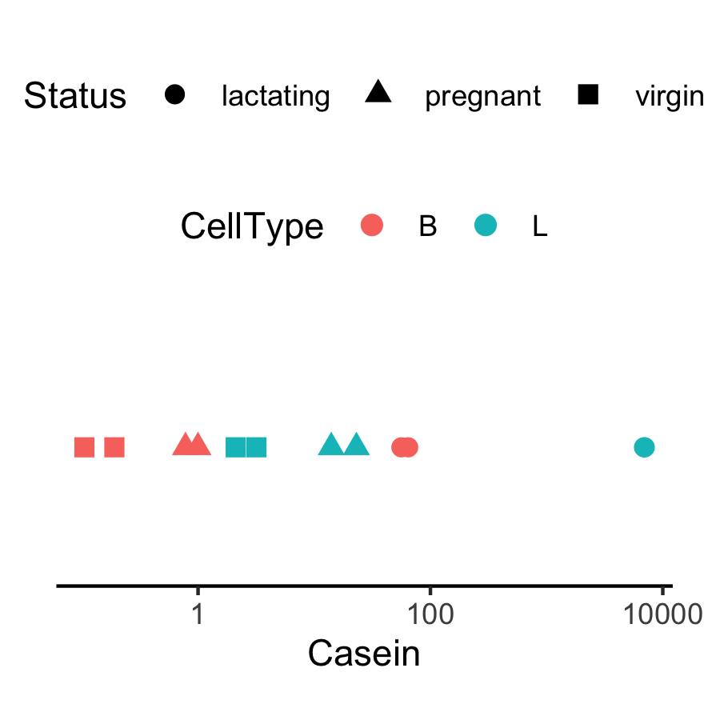
Expression level of Casein varies in a way that is strongly indicative of the effect of CellType and Status.
Why are the B.lactating samples not close to B.virgin and B.pregnant samples?
Could it be due to batch effects?

Slide 58
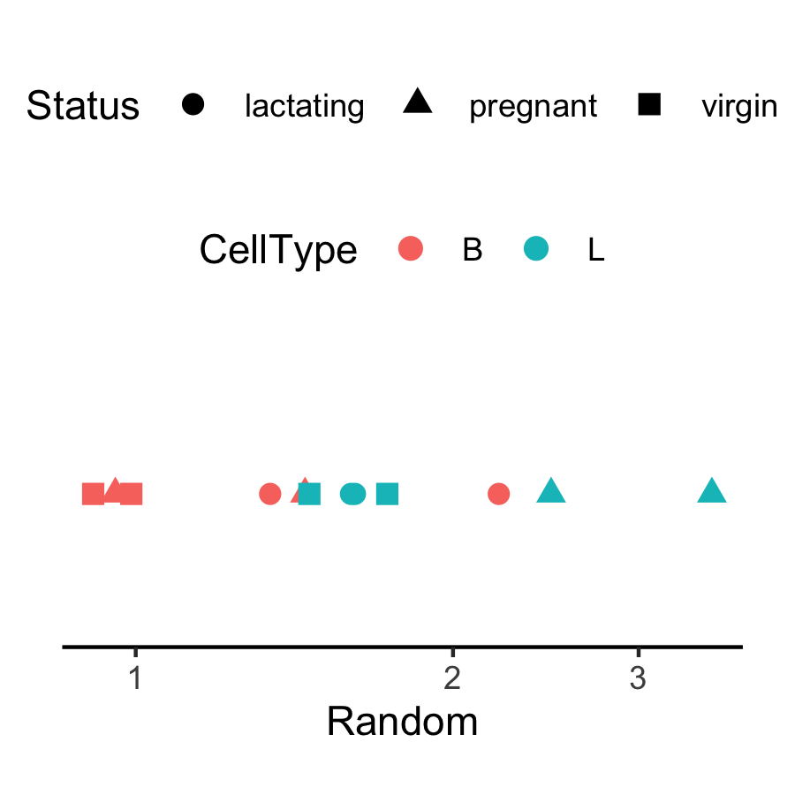
Expression appears to vary across samples but…
In general, the way expression appears to vary across samples could be dominated by noise, batch effects, real signal, etc.
Identify the source for technical variability!

Slide 59
Fitting the model

Slide 60
How to model the normalized RNA-seq red counts
Total number of reads for a sample ~ millions
Counts per gene ~ tens /hundreds /thousands.
The chance of a given read to be mapped to any specific gene is rather small.
Discrete events sampled out of a large pool with low probability are usually modeled with Poisson distribution

Slide 61
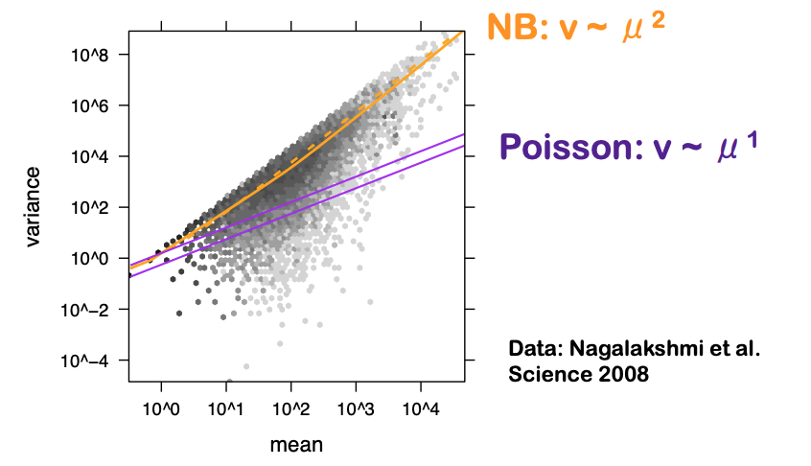
Modeling the read counts mapped to a gene
The number of reads mapped to a gene was first modeled using a Poisson distribution (Marioni et al. (2008))
Assumption: assumes that mean and variance are the same
BUT the variance grows faster than the mean in RNAseq data.
Pooled gene-level variance
Mean gene expression level
Why?

Slide 62
Overdispersion of read counts between samples
-> counts from biological replicates vary
-> variance is exceeding the mean for highly expressed genes
-> underestimation of the biological variance increased the probability to falsely declare a gene DE when it is non-DE (type I error rate)

Slide 63
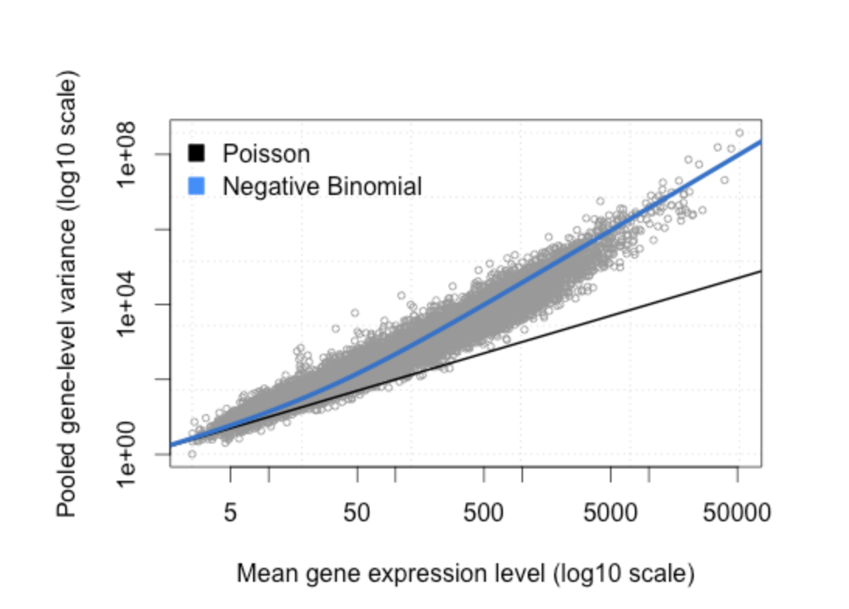

Alternative model: NB
Negative binomial (NB) distribution
-> alternative to model the read counts for each gene in each sample
The variance is always larger than the mean for the negative binomial ⇒ suitable for RNA-seq data
Many genes, few biological samples - difficult to estimate φ on a gene-by-gene basis
Using information across all genes for stable estimates of φ.
CV(the standard deviation divided by the mean) describes the relative deviation of the gene expression distribution relative to its mean, where a low CV indicates low dispersion with respect to the mean.
Notes:
Phi is the variation of a gene’s expression relative to its mean

Slide 64
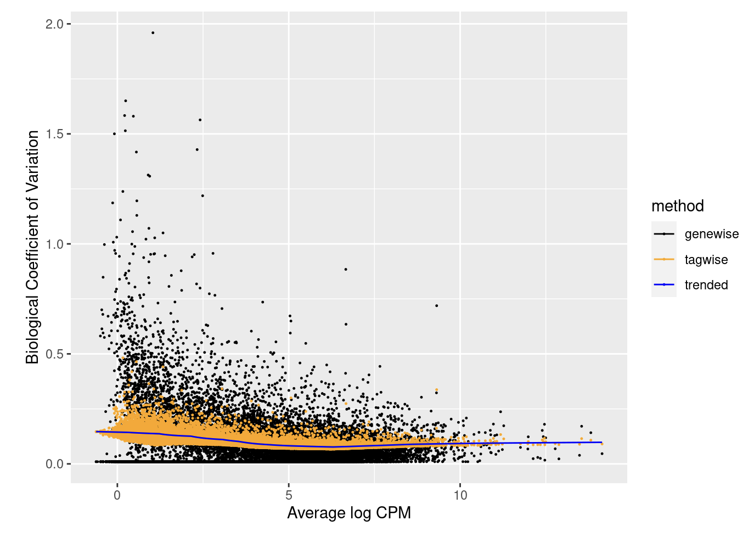
Empirical Bayes estimates of dispersion parameters
Dispersion accounts for variability between biological replicates
Common dispersion: a global dispersion estimate averaged across the genes – not enough
Trended dispersion: dispersion of a gene is predicted from its abundance – similar abundant genes
Tagwise dispersion: measure of the degree of consistent inter-library variation for that tag - EB shrinkage to a common (trended) dispersion
Empirical Bayes estimates need to be controlled for the possibility of outlier genes with exceptionally large or small individual dispersions (robust=TRUE)
The tag-wise dispersions (orange dots) are the result of shrinking the gene-wise dispersion (black dots) to the trend (blue line)
plotBCV (biological coeff variation)
y <- estimateDisp(y, design)
Notes:
plotBCV() plots the tagwise biological coefficient of variation (square root of dispersions) against log2-CPM.
https://smartech.gatech.edu/bitstream/handle/1853/35125/efron_videostream.html?sequence=8&isAllowed=y
Robbins, Herbert. An Empirical Bayes Approach to Statistics. Proceedings of the Third Berkeley Symposium on Mathematical Statistics and Probability, Volume 1: Contributions to the Theory of Statistics, 157--163, University of California Press, Berkeley, Calif., 1956. https://projecteuclid.org/euclid.bsmsp/1200501653
http://seqanswers.com/forums/showthread.php?t=5591
See other example of tagwise dispersion DOI:10.1371/journal.pone.0119254

Slide 65
edgeR fitting models
Classic (pairwise comparisons between two or more groups), glm and glmQL
QL for bulk RNA-seq:
+ stricter error rate control (more rigorous dispersion and uncertainty)
+ speed improvement compared to other quasi-methods
+ for multiple treatment factors and with small # of biological replicates
+ relative changes in expression levels between conditions (not absolute)
Limma package for large scale datasets – high overlap across methods
Notes:
https://www.bioconductor.org/packages/release/bioc/vignettes/edgeR/inst/doc/edgeRUsersGuide.pdf
Quasi likelihood https://pubmed.ncbi.nlm.nih.gov/23104842/
About limma /edgeR / Deseq2 differenceS: chrome-extension://efaidnbmnnnibpcajpcglclefindmkaj/https://www.e3s-conferences.org/articles/e3sconf/pdf/2021/47/e3sconf_icepe2021_03058.pdf

Slide 66
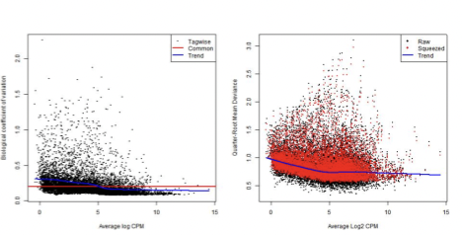
Fitting the model : glmQLFit
NB dispersions - higher for genes with very low counts - decrease smoothly with abundance and asymptotically to a constant value for genes with larger counts.
Extended NB model to account for gene-specific variability from both biological and technical sources (quasi-likelihood)
NB dispersion trend is used to describe the overall biological variability across all genes (fit GLM)
For each gene-specific variability above and below the overall level (deviance) is picked up by the QL dispersion

Slide 67
Get the DE genes - glmQLFTest
Identifies differential expression based on statistical significance regardless of how small the difference might be -> 5000 DE genes between condition and control groups
Interested only in genes with large expression changes -> subset of genes more biologically meaningful.
Modify the statistical test to evaluate variability as well as the magnitude of change of expression values -> expression changes greater than a specified threshold
Not equivalent to a simple fold change cutoff : “the fold-change below which we are definitely not interested in the gene”
The total number of DE genes identified at an FDR of 5% can be shown with decideTestsDGE() – set cutoff

Slide 68
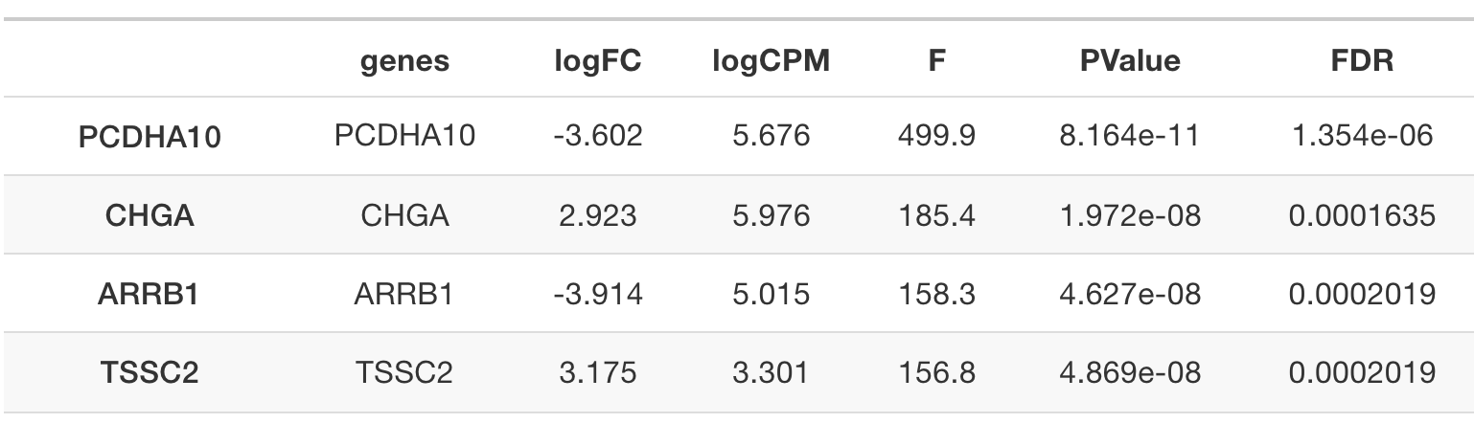
Get the DE genes - glmQLFTest
Complicated contrasts - makeContrasts()
- between lactating and pregnant mice is the same for basal cells as it is for luminal cells
- the interaction effect between mouse status and cell type

Slide 69
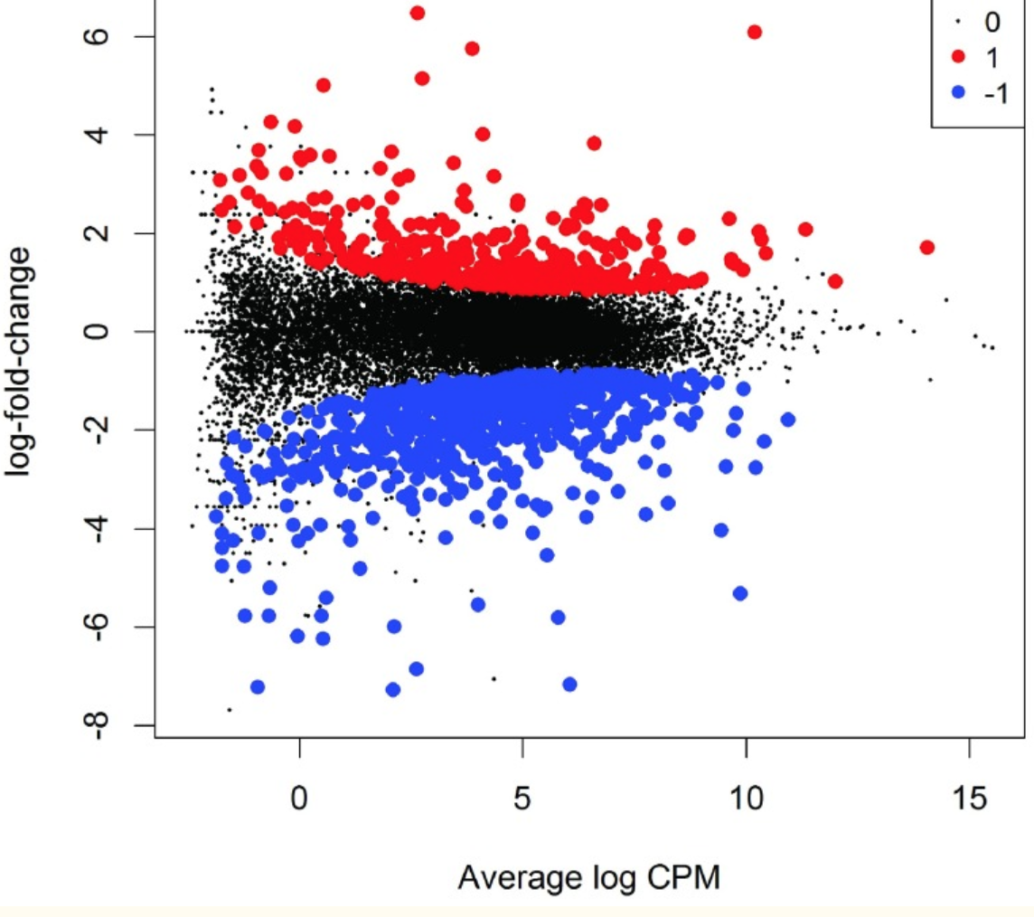
MD plot: Over and under expressed genes
Library size-adjusted log-fold change between two libraries (the difference) vs the average
log-expression across those libraries (the mean).
Log-fold change and average abundance of each gene

Slide 70
Demo II

Slide 71
Hands-on session
Load and reformat the data
Exploratory visualization : MA plot
Create DGElist object and retrieve gene symbols
Filter genes with inadequate information
Normalization
Exploratory visualization : MDS and PCA plots
Define and fit a model
Hypothesis testing (four example hypotheses)
Save results as a table and explore in Excel

Slide 72
In summary
Raw counts are not comparable across samples/genes within a sample
Several normalization methods: some more suitable for DEG
Estimate the dispersion, visualize the technical variability
Fit the model: counts variance exceeding the mean
Make all the comparisons that you wish using complex contrast
Visualize the DEG and get a list for pathway analysis

Slide 73
Your feedback is important to us!
At the end of the hands-on session:
Please take the survey ~3 min:
https://www.surveymonkey.com/r/F75J6VZ
Real data might need additional analyses choices that need experience.
Consult with the Gladstone Bioinformatics core for such scenarios and data.
Fall workshops schedule - Data Science Training Program

Slide 74
Thank you!

Slide 75


