Slide 1
Introduction to Linear Mixed Effects Models
Reuben Thomas
Gladstone Bioinformatics Core
October 13th, 2022

Slide 2
Expected background for my talk
Basic understanding of statistics (mean, standard errors, variance, co-variance, experimental design)
Be used to interpreting plots of data (bar plots, scatter plots, heatmaps, histograms, density plots)
Manipulation of data frames in dplyr and implementation of simple linear models in R

Slide 3
Outline for this session
Repeated measures experimental designs are ubiquitous in our field
  Several examples from our work
Specialized analyses of data from repeated measures are required to
  Capture interesting biology
  To not be overwhelmed with false positives
Linear mixed effects models provide a very flexible approach to work with these data
  Introduction and assumptions for these models
These models can be implemented in the lme4 package in R
  Illustrate implementations of these models using different datasets derived from varying experimental designs
Concluding remarks

Slide 4
Outline for this session
Repeated measures experimental designs are ubiquitous in our field
  Several examples from our work
Specialized analyses of data from repeated measures are required to
  Capture interesting biology
  To not be overwhelmed with false positives
Linear mixed effects models provide a very flexible approach to work with these data
  Introduction and assumptions for these models
These models can be implemented in the lme4 package in R
  Illustrate implementations of these models using different datasets derived from varying experimental designs
Concluding remarks

Slide 5
Repeated measures experimental design
Designs where multiple responses from the same biological unit are assessed
  Examples include measuring changes in biomarker levels (e.g. CD4 counts) in subjects over time

Slide 6
Cellular assays
Experiment1
Experiment2
Plate 1
Plate 2
Plate 3
Plate 4
CL1
CL 2
CL3
CL1
CL 2
CL3
CL: Cell Line
CL 4
CL 5
CL6
CL 4
CL 5
CL6
Min-Gyoung Shin

Slide 7
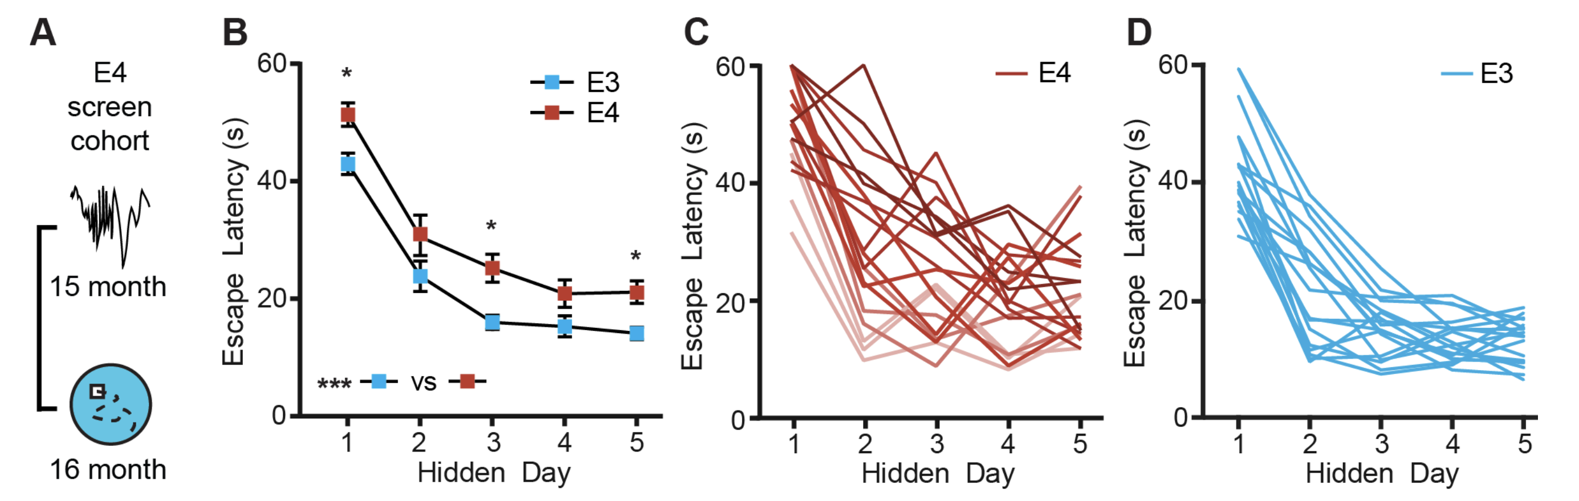
Learning in Alzheimer’s Disease mice assayed in the Morris-Water Maze
Jones et al. 2019

Slide 8
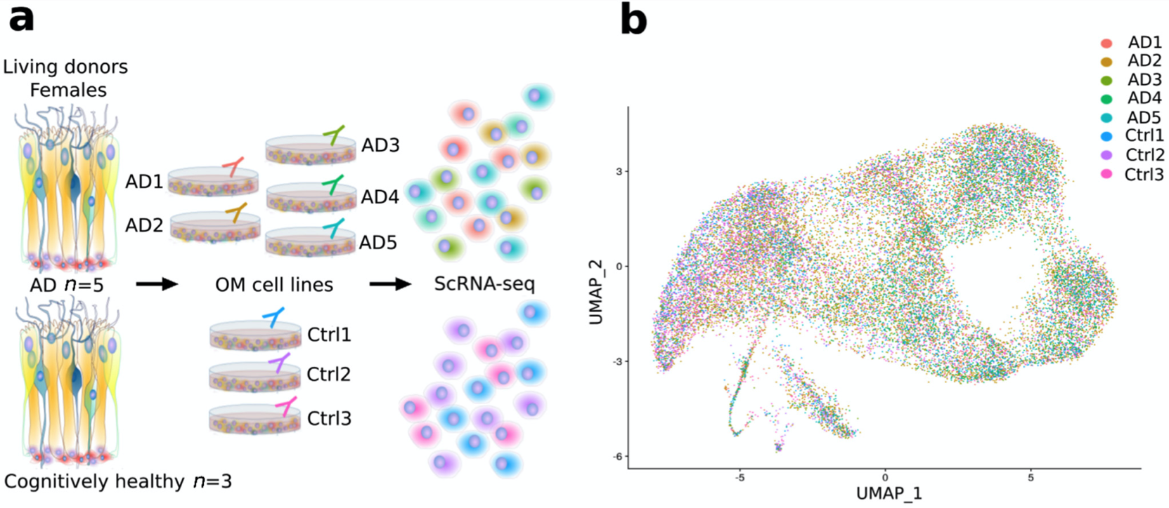
Olfactory mucosa differences between AD patients and cognitively healthy subjects
Lampinen at al. 2022
Notes:
https://www.ncbi.nlm.nih.gov/pmc/articles/PMC8870160/pdf/cells-11-00676.pdf

Slide 9
Outline for this session
Repeated measures experimental designs are ubiquitous in our field
  Several examples from our work
Specialized analyses of data from repeated measures are required to
  Capture interesting biology
  To not be overwhelmed with false positives
Linear mixed effects models provide a very flexible approach to work with these data
  Introduction and assumptions for these models
These models can be implemented in the lme4 package in R
  Illustrate implementations of these models using different datasets derived from varying experimental designs
Concluding remarks

Slide 10
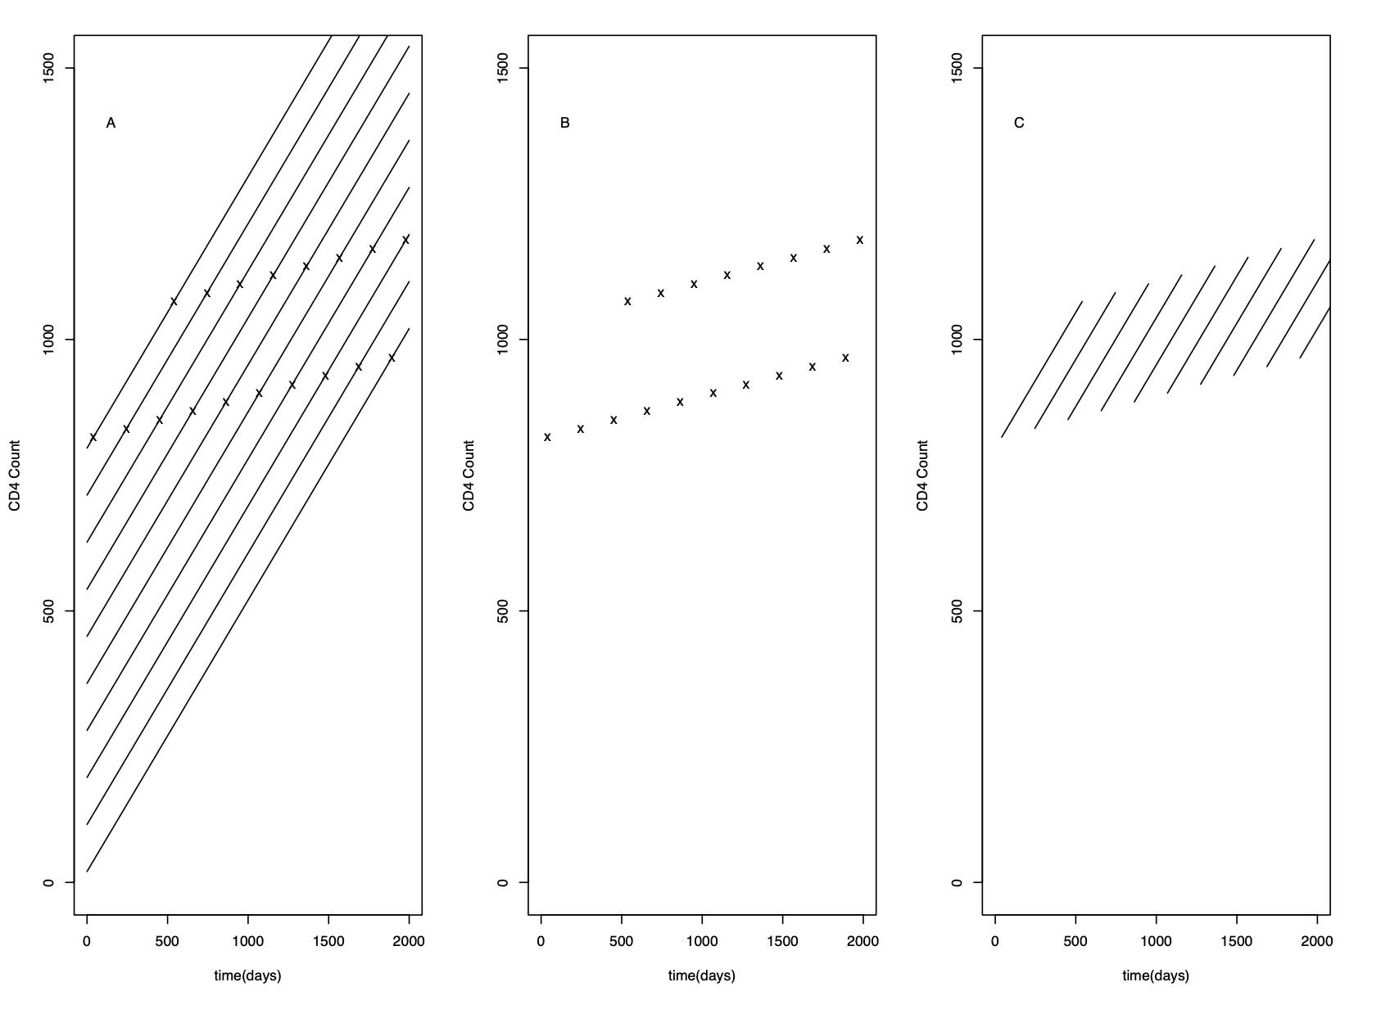
Estimate changes in CD4 count over time in patients undergoing ART
Subject 1
Longitudinal effect
Subject 10
CD4 cell count
Cross-sectional effect
Later you sample
the patients the
higher their starting
CD4 counts are
Cross-sectional effect ≠ Longitudinal effect
Time since initiation of ART

Slide 11
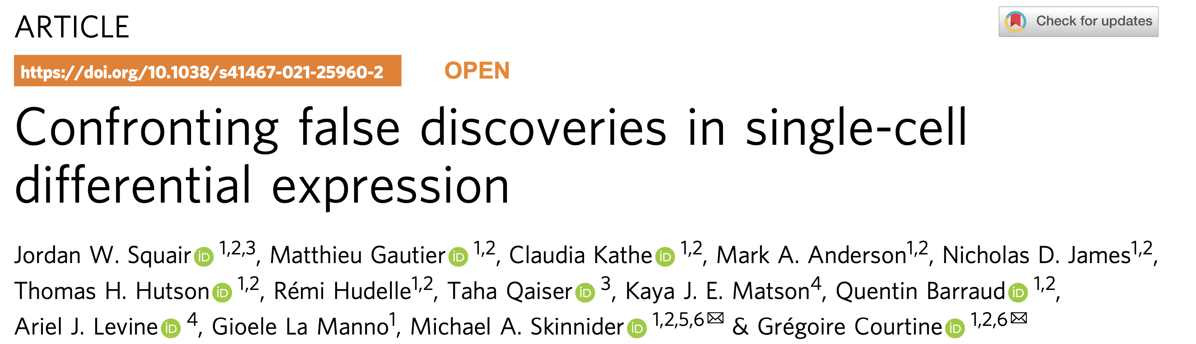
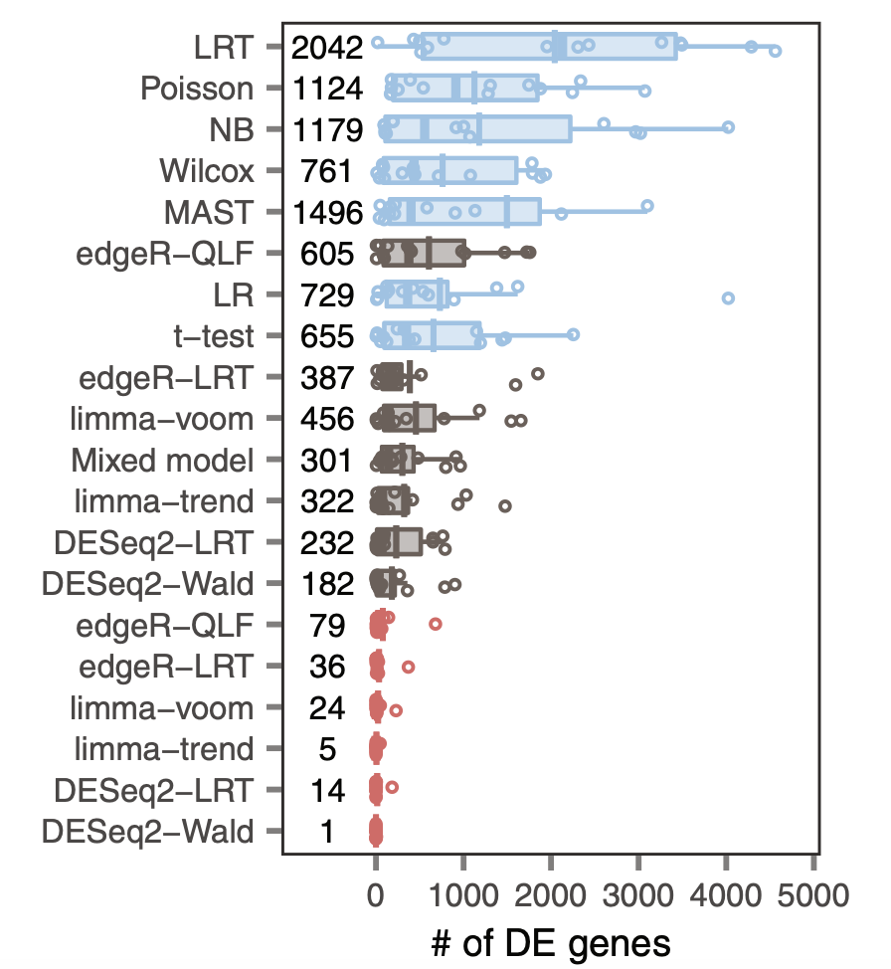
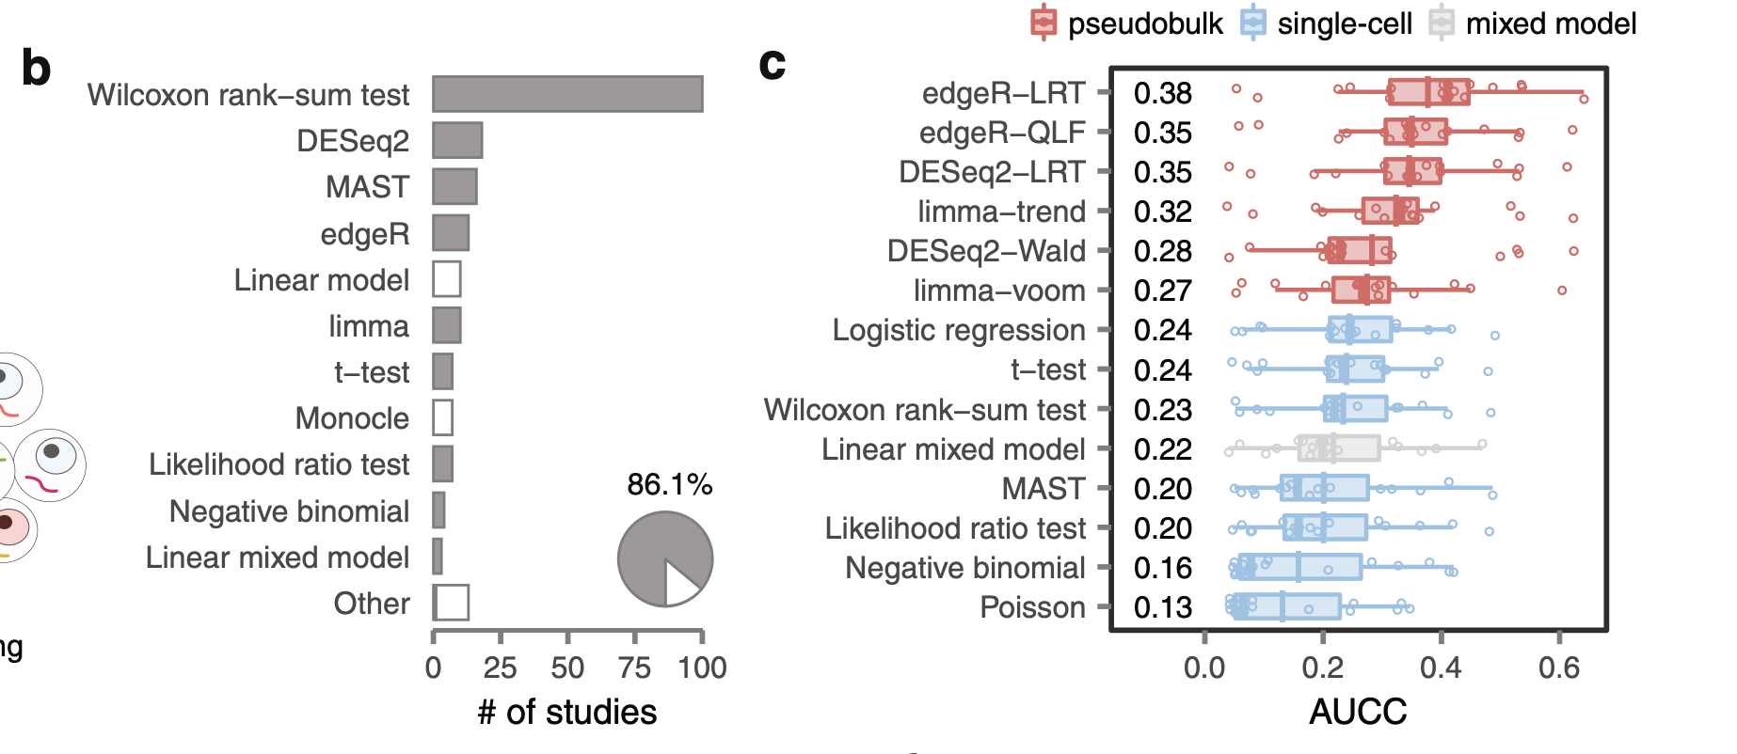
Assessment of True Positives
Assessment of False Positives

Slide 12
Let us do some math to explain the increased false-positive observations

Slide 13
1. Aggregation: one number (mean) to capture an entire distribution

Slide 14
Sampling distribution captures the distribution of the chosen statistic over repeated experiments
Standard error captures the spread of this distribution
Area under the curve provides the fraction of time one observes given ranges of the difference
in means

Slide 15
How does the sampling distribution change with different estimates of standard error?
Larger standard error
Smaller standard error
What happens of one incorrectly estimates the standard errors?
Elevated or lower than expected false positives!

Slide 16
Problem and model of the data
Objective: Estimate the mean of the average CD4 count at the two time points of the m subjects in the study

Slide 17
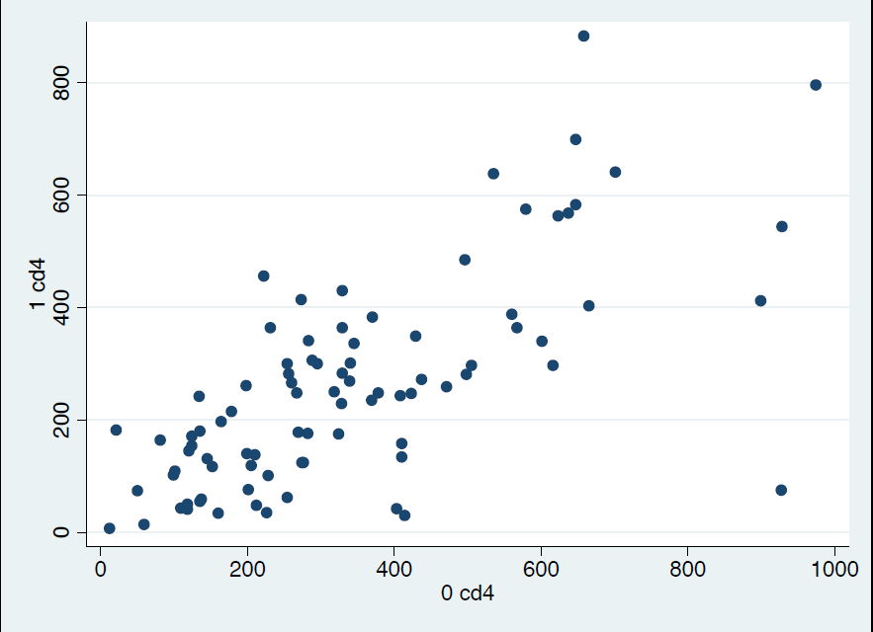
Subjects with higher CD4 counts at first time-point tend to have higher CD4 counts at the second time-point

Slide 18
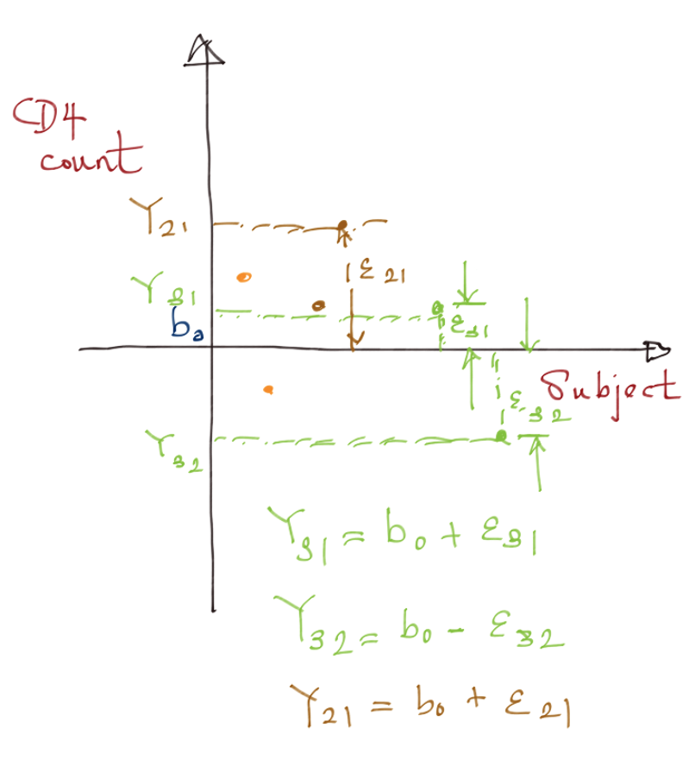
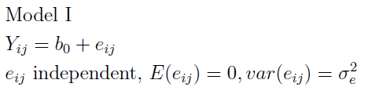


$$Y_{ij}=b_{0}+{Error}_{ij}$$
$${Error}_{ij}=e_{ij}$$
How would a picture of the model look like?
Y_{ij} is the CD4 count for subject i at time-point j
b₀ is the mean CD4 count that we are trying to estimate

Slide 19
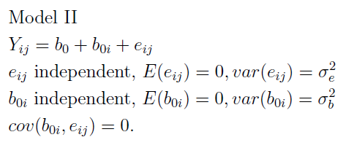
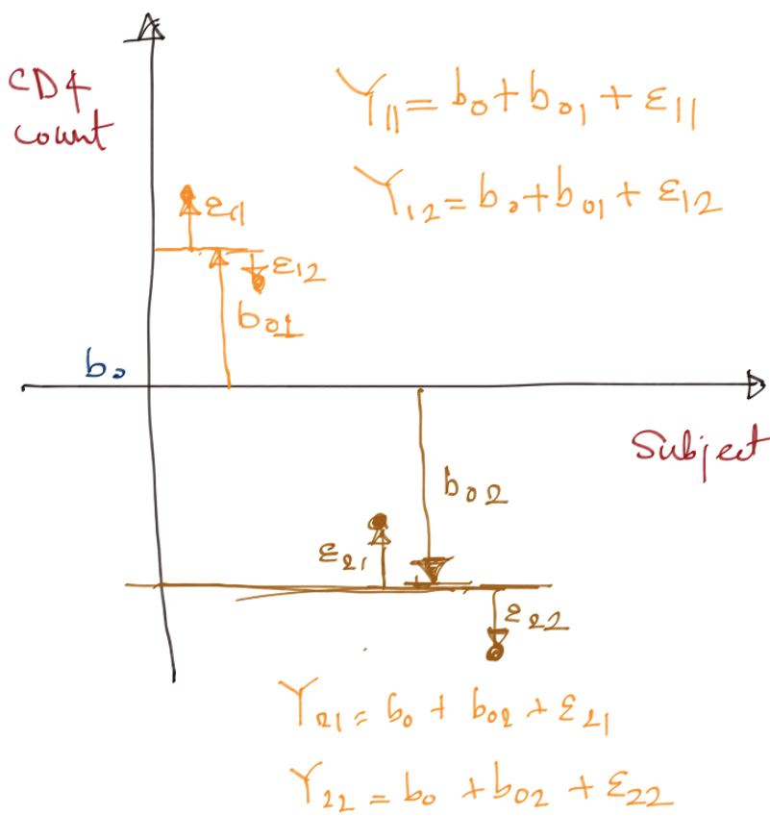

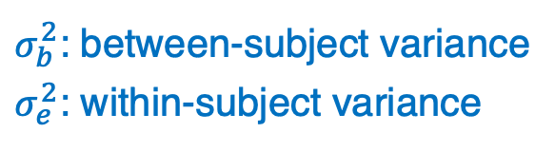

$$Y_{ij}=b_{0}+{Error}_{ij}$$
$${Error}_{ij}={b_{0i}+e}_{ij}$$
How would a picture of the model look like?
$σ_{b}^{2}$: between-subject variance
$σ_{e}^{2}$: within-subject variance
This model better captures the correlation between
CD4 counts for the same subject

Slide 20
True versus Naïve estimates of standard error of mean
True standard error of a mean estimate takes into account of the fact that observations made within a subject are correlated with each other
Naïve standard error of a mean estimate ignores this fact

Slide 21

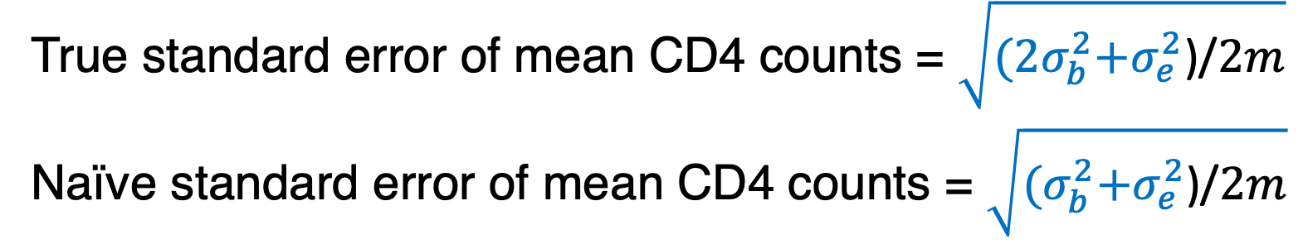
Useful formulae
Given two random variables A, B
$$E\left[A+B\right]=E\left[A\right]+E\left[B\right]$$
$$Var\left[A+B\right]=Var\left[A\right]+Var\left[B\right]+2cov\left[A,B\right]$$
$$cov\left[A,B\right]=E\left[AB\right]−E\left[A\right]E[B]$$
If c is a constant then $E\left[cA\right]=cE[A]$
If A and B are independent then
  $$E\left[AB\right]=E\left[A\right]E[B]$$
True standard error of mean CD4 counts = $\sqrt{{(2σ}_{b}^{2}+σ_{e}^{2}\text{)/}2m}$
Naïve standard error of mean CD4 counts = $\sqrt{{(σ}_{b}^{2}+σ_{e}^{2}\text{)/}2m}$

Slide 22
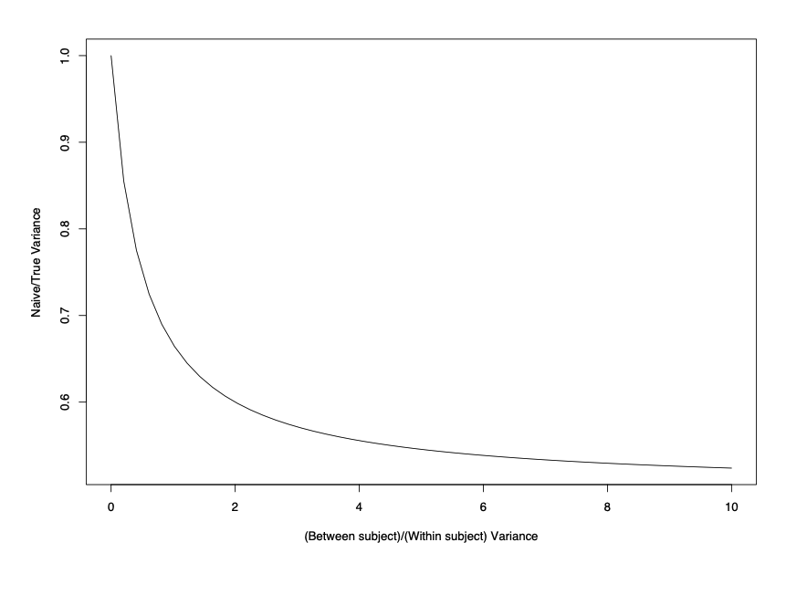

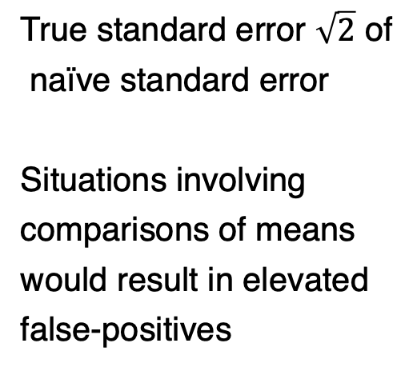

False-positives will blow up if you fail account for correlations between measurements within each subject
True standard error $\sqrt{2}$ of
naïve standard error
Situations involving
comparisons of means
would result in elevated
false-positives
${(σ}_{b}^{2}+σ_{e}^{2}$)/${(2σ}_{b}^{2}+σ_{e}^{2}$)
$σ_{b}^{2}$/ $σ_{e}^{2}$

Slide 23
Deficiencies of standard approaches
Increased false positives
Biased estimates in cases where you have time-varying predictors (e.g. see CD4 count example)
Unable to quantify variability due to different sources – inter-animal/inter-person variability, plate-to-plate variability

Slide 24
Approaches to statistically model repeated measures
Work with pseudo-bulk/consolidate the repeated measures
Repeated measures ANOVA
Linear Mixed Effects Models
Generalized Estimating Equations (GEE)

Slide 25
Pseudo-bulk/consolidate the repeated measures
Take mean of all repeated observations from a given biological replicate
  scRNA-seq: Mean counts of gene expression across all cells for a given biological sample
  Proceed with “standard” analysis at the biological replicate level
Works in only simple experimental designs
Statistical analyses may not end up being powerful particularly if the responses are binary, count-based
Unable to quantify variability due to different sources – inter-animal/inter-person variability, plate-to-plate variability

Slide 26
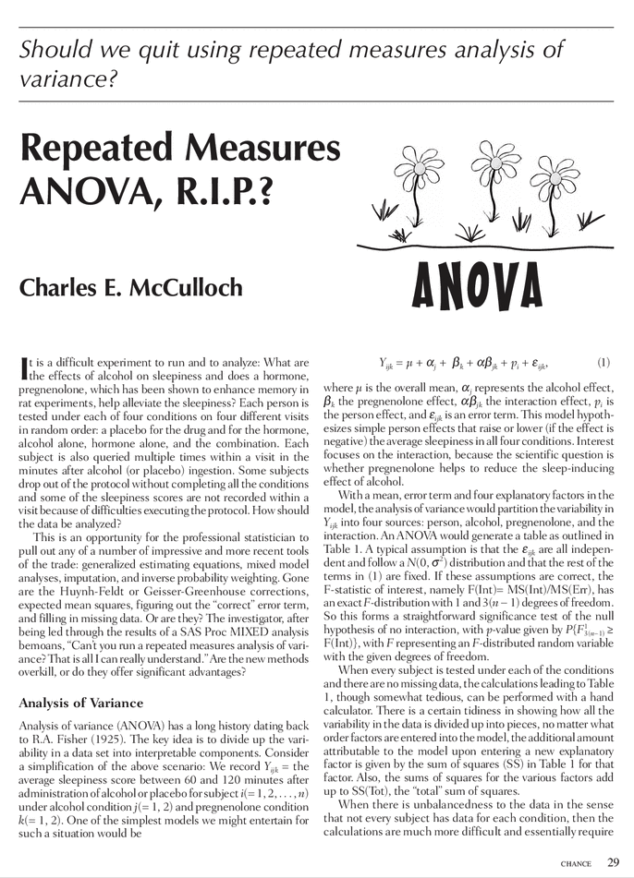
Repeated measures ANOVA, R.I.P.
Works only with discrete covariates
Require complete data, no missing data
Assumption of “sphericity”: all measurements from the same biological replicate are equally correlated with each other no matter how far apart in time they are
Never use!

Slide 27
Outline for this session
Repeated measures experimental designs are ubiquitous in our field
  Several examples from our work
Specialized analyses of data from repeated measures are required to
  Capture interesting biology
  To not be overwhelmed with false positives
Linear mixed effects models provide a very flexible approach to work with these data
  Introduction and assumptions for these models
These models can be implemented in the lme4 package in R
  Illustrate implementations of these models using different datasets derived from varying experimental designs
Concluding remarks

Slide 28
Linear Mixed effects Models (LMM)
Linear mixed effects models are statistical models of data generated/observed under repeated measure scenarios
It does this through the use of fixed and random effects
Fixed effects
  Capture population characteristics
  Shared by all individuals in the population
Random effects
  Subject-specific effects
  Varies from subject to subject
  Assumes it is drawn from a Normal Probability distribution

Slide 29
Advantages of LMM
Works with continuous and discrete covariates
Accommodates any level of imbalance or missing data
Accommodates data at all levels of the hierarchy involved in the experimental design
Doesn’t make the “sphericity” assumption

Slide 30
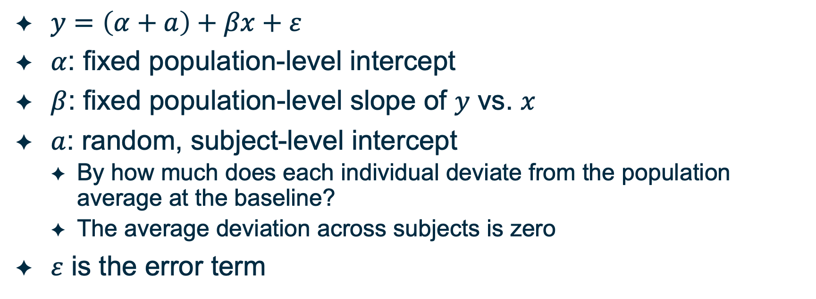
LMM: Simple Random Intercept Model
$y=\left(α+a\right)+βx+ε$
$α$: fixed population-level intercept
$β$: fixed population-level slope of $y$ vs. $x$
$a$: random, subject-level intercept
  By how much does each individual deviate from the population average at the baseline?
  The average deviation across subjects is zero
$ε$ is the error term

Slide 31
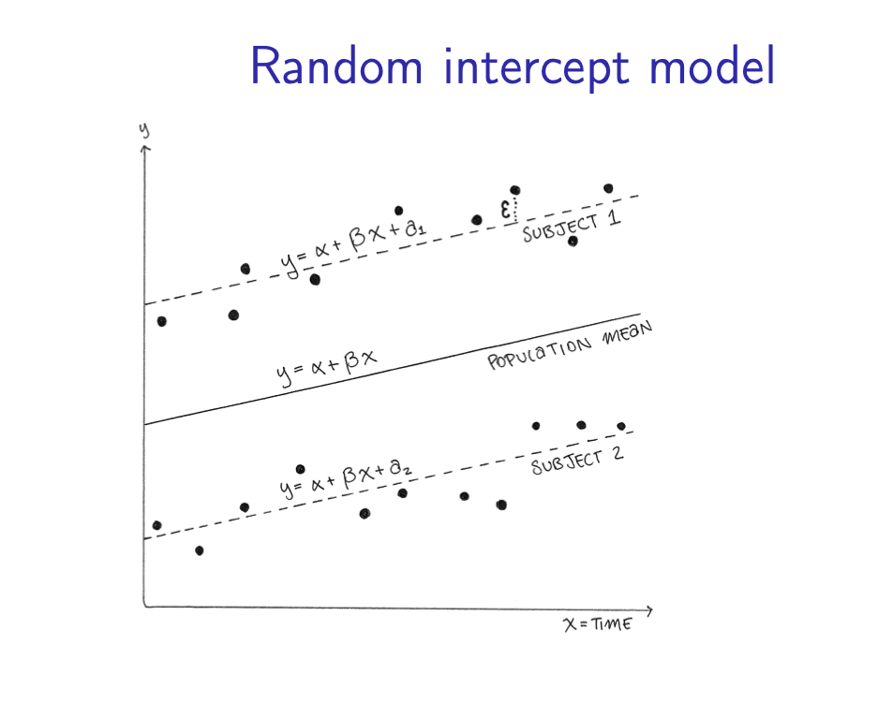
LMM: Simple Random Intercept Model

Slide 32
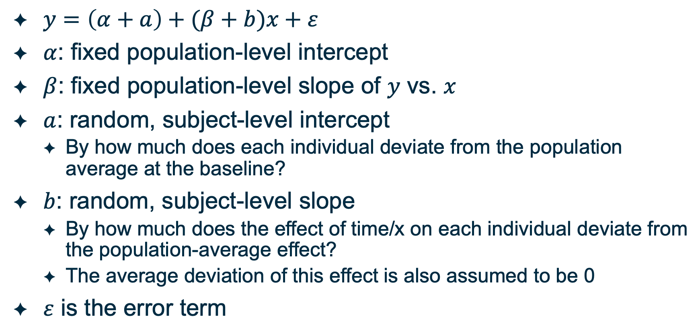
LMM: Random slope, Random intercept Model
$y=\left(α+a\right)+(β+b)x+ε$
$α$: fixed population-level intercept
$β$: fixed population-level slope of $y$ vs. $x$
$a$: random, subject-level intercept
  By how much does each individual deviate from the population average at the baseline?
$b$: random, subject-level slope
  By how much does the effect of time/x on each individual deviate from the population-average effect?
  The average deviation of this effect is also assumed to be 0
$ε$ is the error term

Slide 33
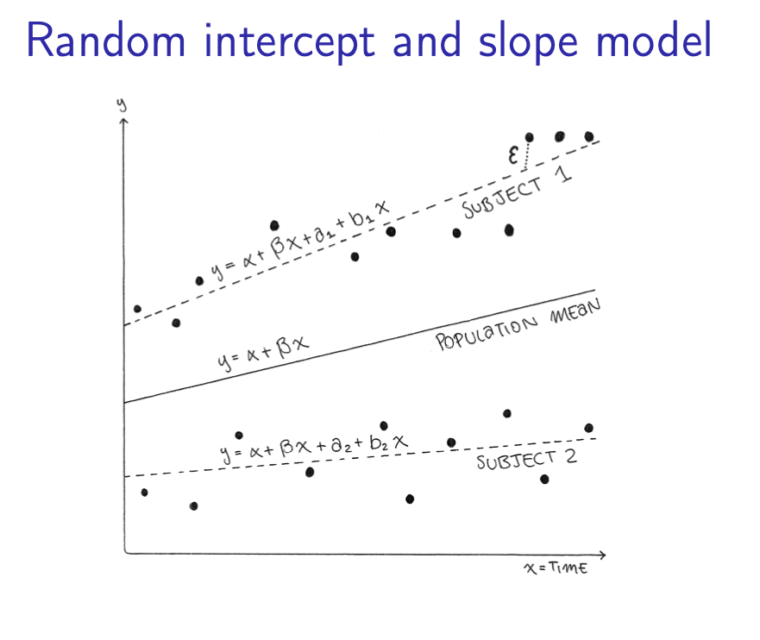
LMM: Random slope, Random intercept Model

Slide 34
Outline for this session
Repeated measures experimental designs are ubiquitous in our field
  Several examples from our work
Specialized analyses of data from repeated measures are required to
  Capture interesting biology
  To not be overwhelmed with false positives
Linear mixed effects models provide a very flexible approach to work with these data
  Introduction and assumptions for these models
These models can be implemented in the lme4 package in R
  Illustrate implementations of these models using different datasets derived from varying experimental designs
Concluding remarks

Slide 35
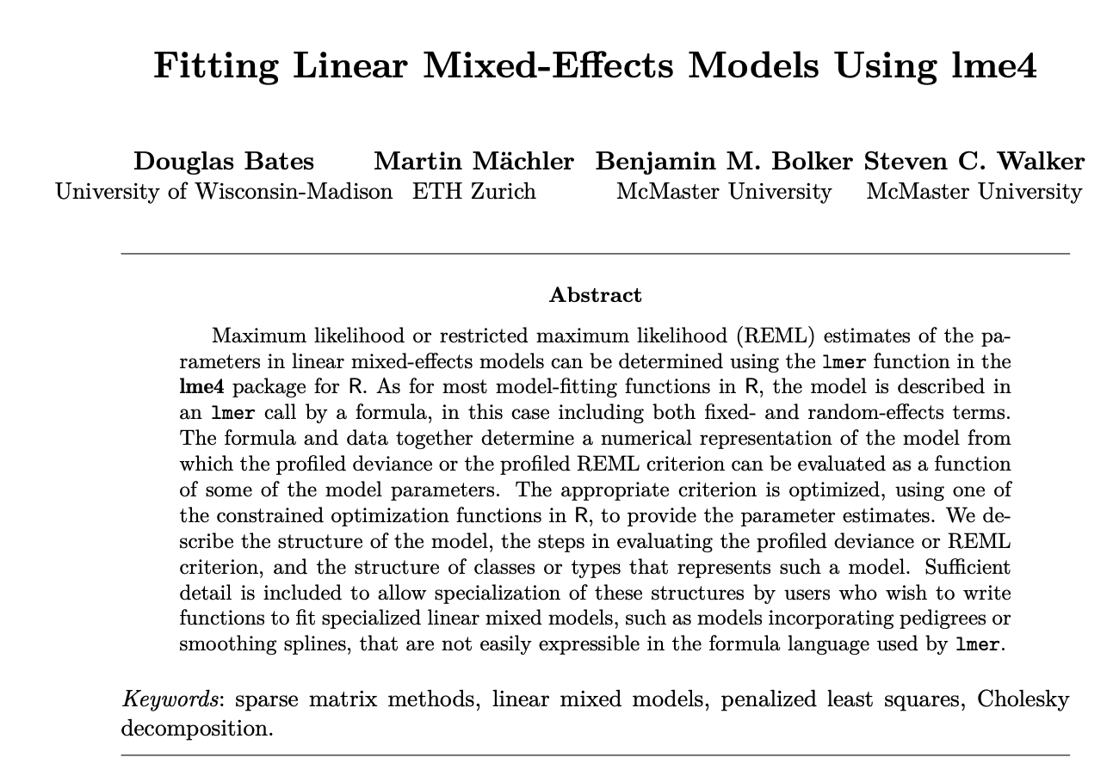
lme4 R package is a well-accepted standard implementation of LMM

Slide 36
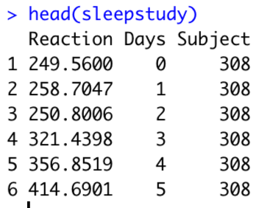
sleepstudy: How does Reaction time change with the amount of sleep deprivation?

Slide 37
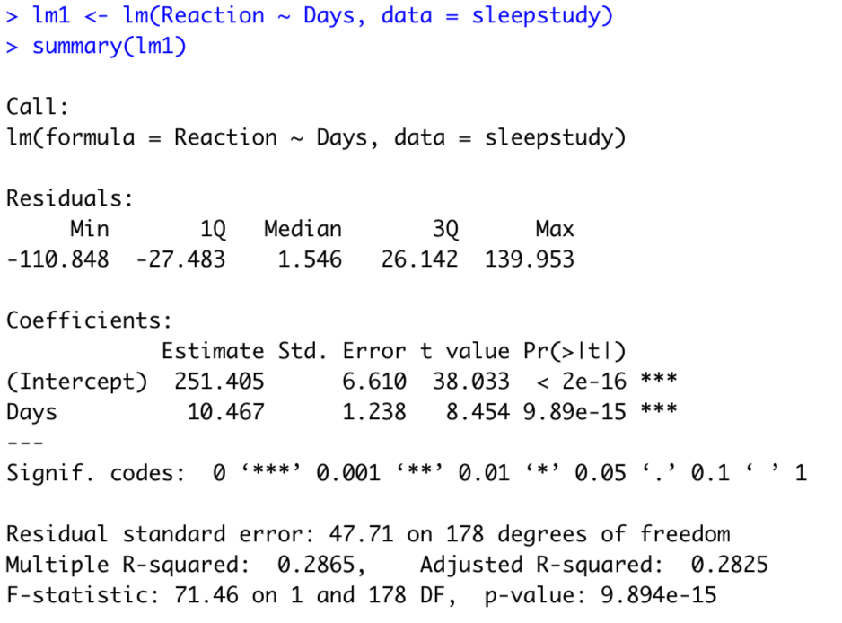
sleepstudy: How does Reaction time change with the amount of sleep deprivation?

Slide 38
sleepstudy: Reaction times in a sleep deprivation study

Slide 39
sleepstudy: Baseline reaction times and change with sleep deprivation changes from subject-to-subject

Slide 40
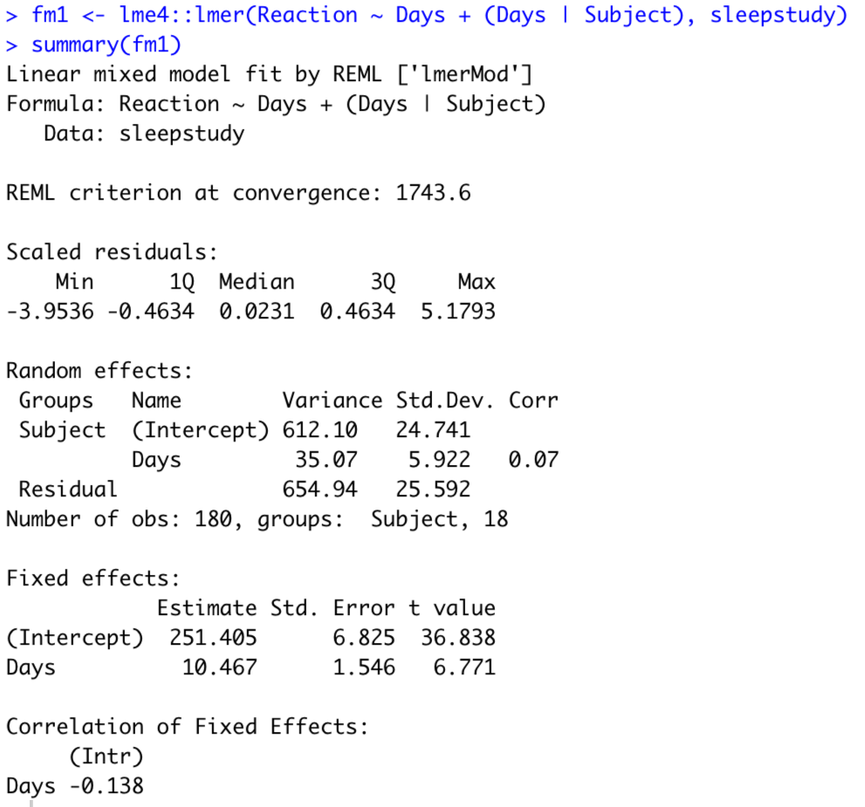
sleepstudy: LMM vs. LM implementation
LMM implementation
Random slope and intercept model
LM implementation
Fixed effects are the same!

Slide 41
sleepstudy: LMM vs. LM implementation
LMM implementation
LM implementation
Standard errors are different!

Slide 42
sleepstudy: LMM vs. LM implementation
LMM implementation
Between-subject variance of baseline reaction times
Between-subject variance of change of reaction times with time

Slide 43
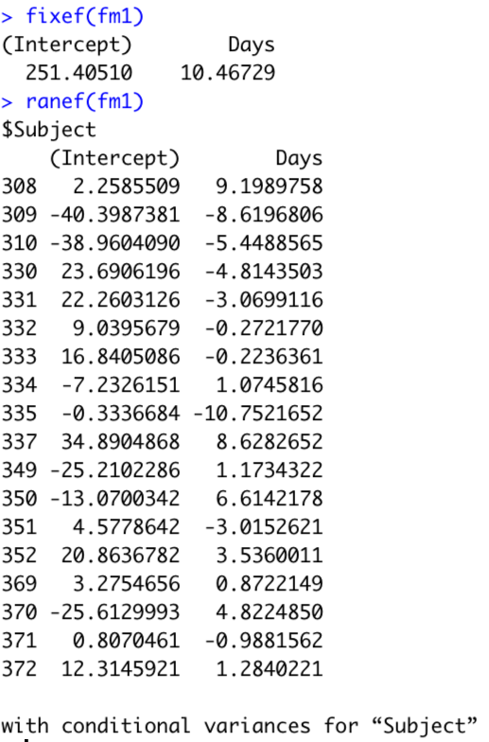
sleepstudy: LMM vs. LM implementation
Fixed effects
LMM implementation
Random effects

Slide 44
sleepstudy data: conclusions
Experimental design involves longitudinal data collected for multiple subjects
The LMM correctly treats individual subjects in the study as replicates or independent units
The linear model incorrectly treats individual observations as independent units
The linear model pretends that there is more information than is really presents
Consequently, it under-predicts the standard error

Slide 45
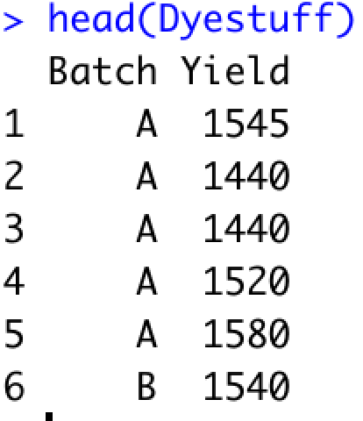
Dyestuff: Does the Batch of an intermediate product affect the Yield of dye?

Slide 46
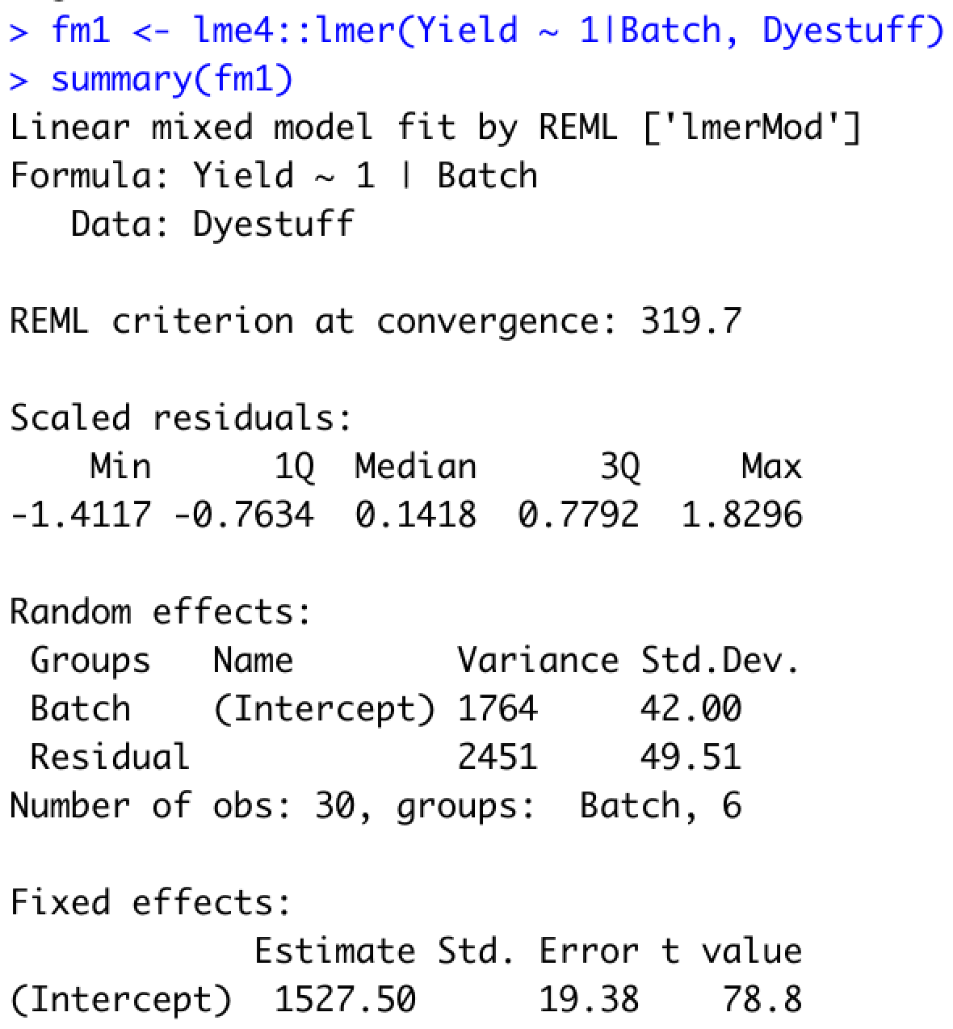
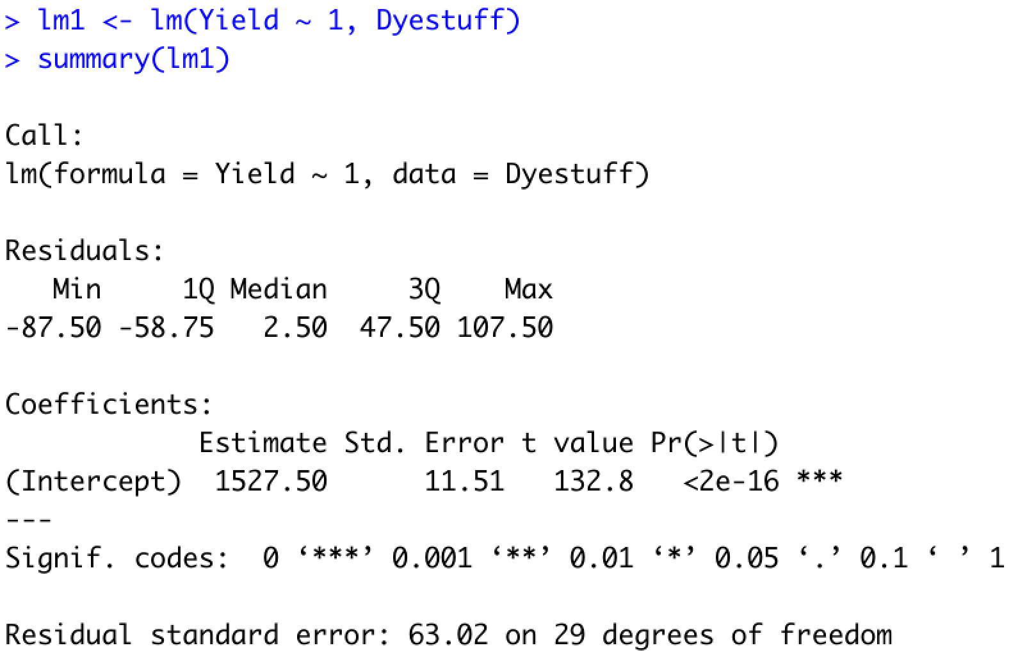
Dyestuff: LMM vs LM implementation to estimate mean Yield
Standard errors are different, like before!

Slide 47
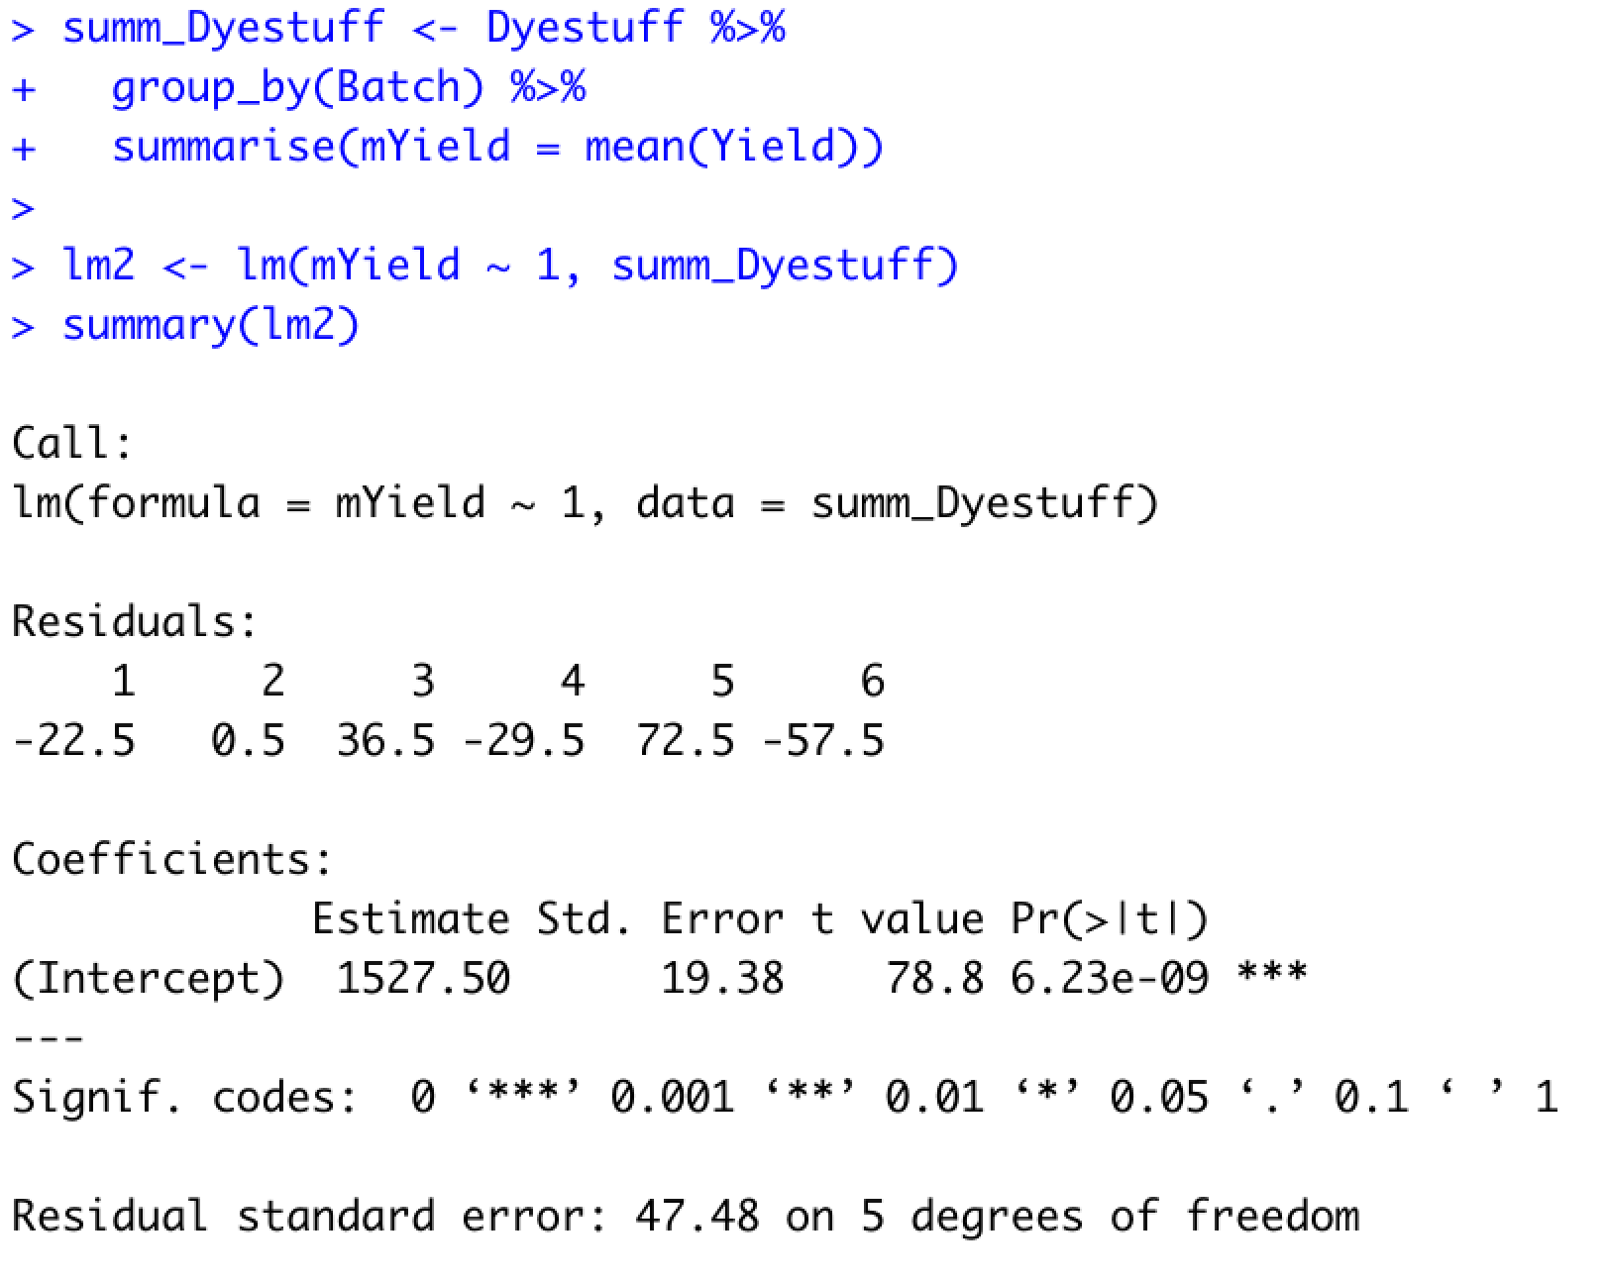
Dyestuff: Instead of LMM, we can “pseudo-bulk” the Yield within each batch
Pseudo-bulk Yield
Pseudo-bulking resulted in the correct standard errors!

Slide 48
Dyestuff data: conclusions
Experimental design involving a simple random effect
The simpler strategy of pseudo-bulking the response results in the same standard error estimates as the more complex LMM

Slide 49
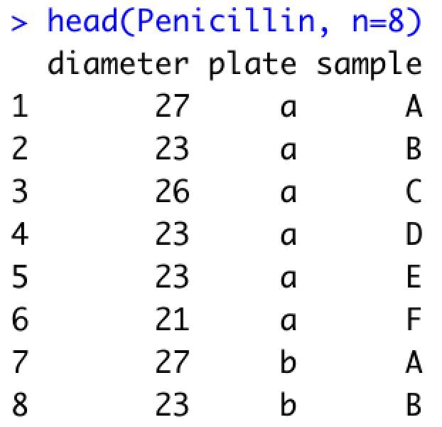
Penicillin: Variation in Penicillin testing
Six samples of penicillin were tested using the B. subtilis plate method on each of 24 plates. The response is the diameter (mm) of the zone of inhibition of growth of the organism.

Slide 50
Penicillin: We would like to estimate the mean diameter
What should be regard as replicates?
  Individual observations?
  Individual plates?
  Individual samples?

Slide 51
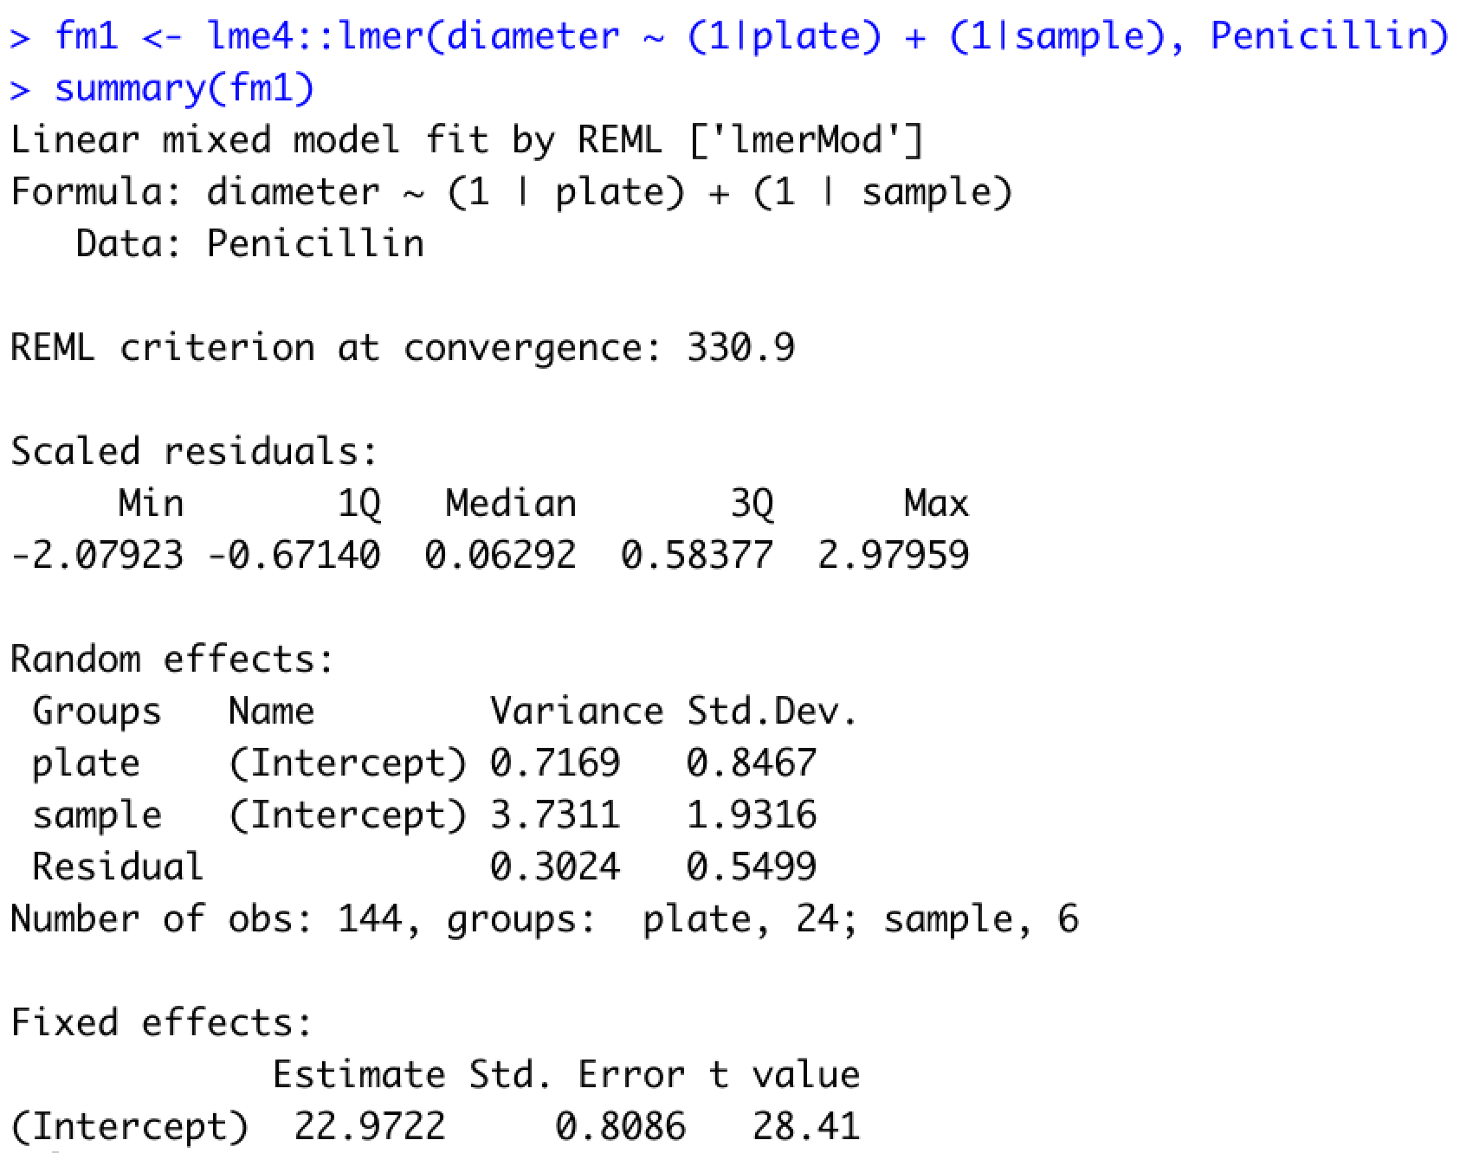
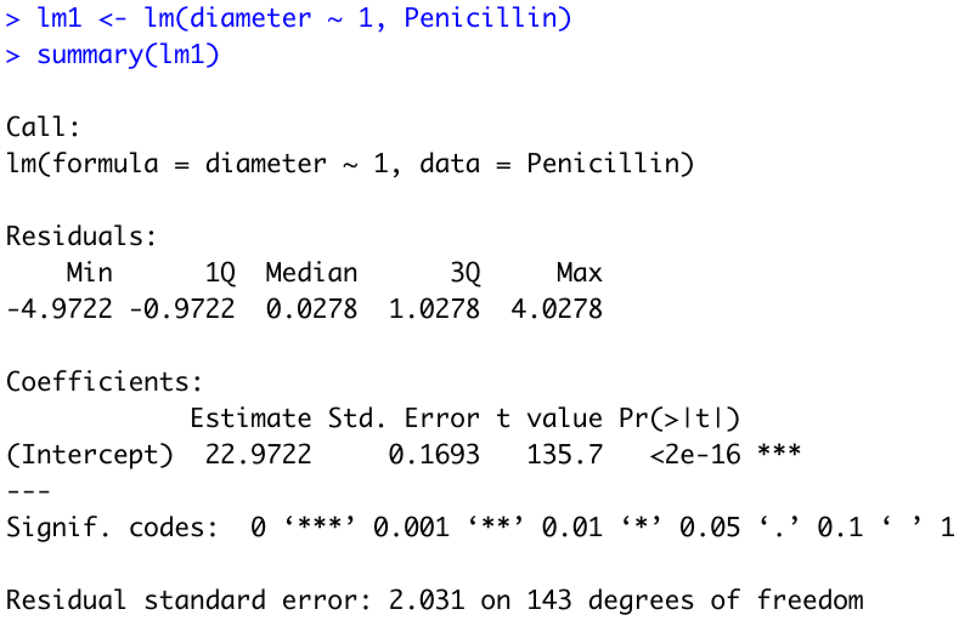
Penicillin: LMM vs LM implementation to estimate mean diameter
Two random effects
Mean estimate exactly same, whereas standard errors differ!

Slide 52
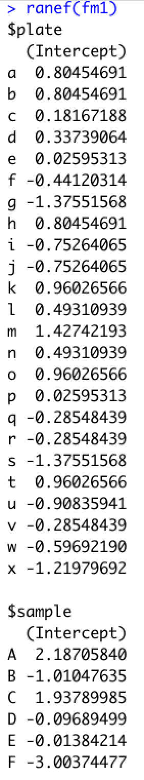
Random effect/intercept estimates from Penicillin data

Slide 53
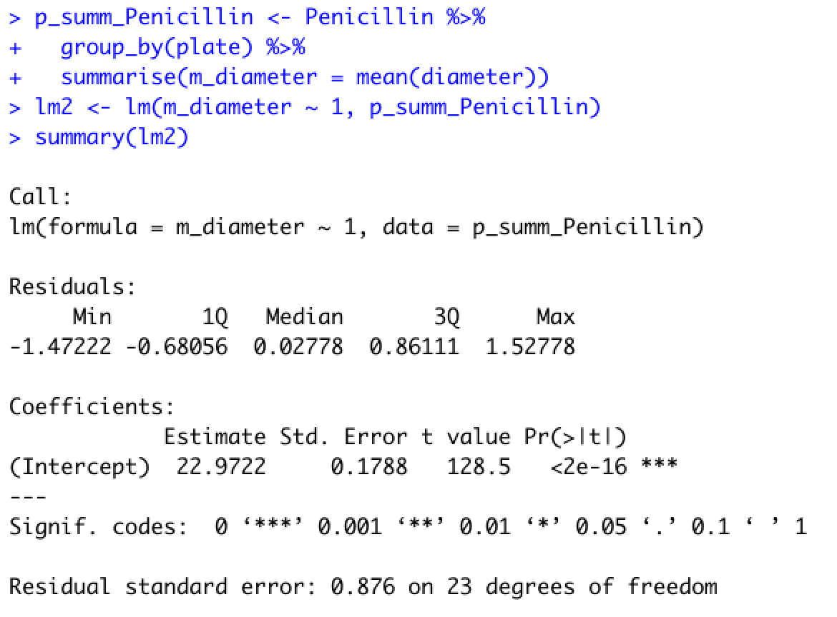
How about we pseudo-bulk by plate?
Two random effects
Pseudo-bulk diameter
Standard errors are different!

Slide 54
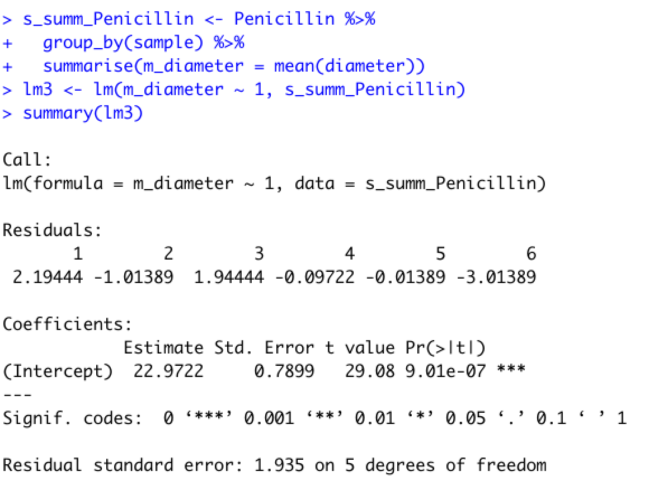
How about we pseudo-bulk by sample?
Two crossed random effects
Pseudo-bulk diameter
Standard errors are still different!

Slide 55
Penicillin data: conclusions
Experimental design involves two crossed random effects
Pseudo-bulking by one of these random effects does not result in the correct estimates of the standard errors
LMM does not necessitate defining what the replicates represent while taking into account the correlation in the responses induced by plate and sample

Slide 56
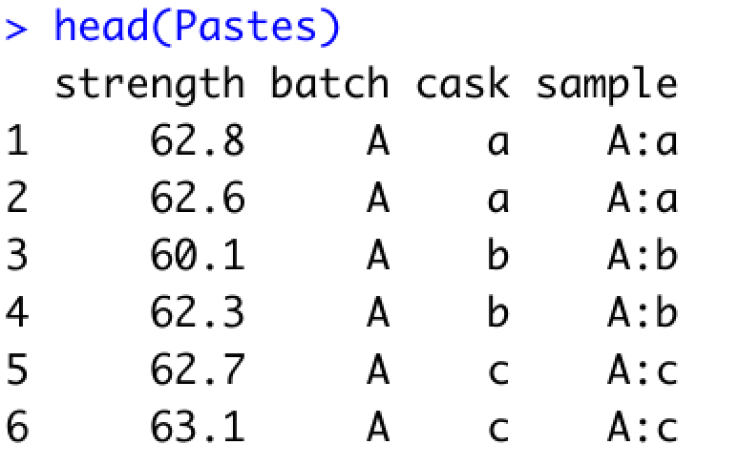
Pastes data
Strength of a chemical paste product; its quality depending on the delivery batch, and the cask within the delivery batch.

Slide 57
Pastes: We would like to estimate the mean strength
What should be regard as replicates?
  Individual observations?
  Individual batches?
  Individual casks?
Casks are not independent of batches
Similarly, in cellular assays responses measured in wells are dependent on the plates from which they were measured

Slide 58
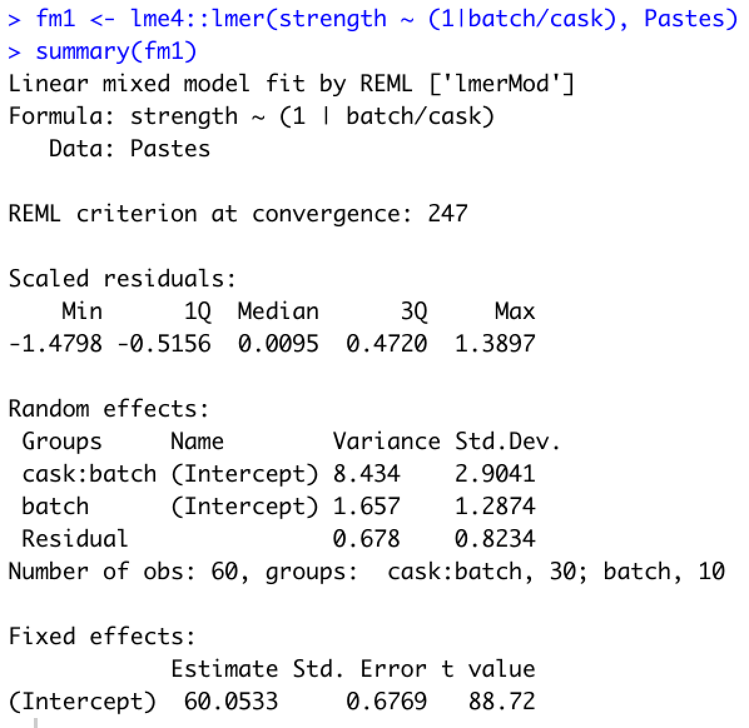
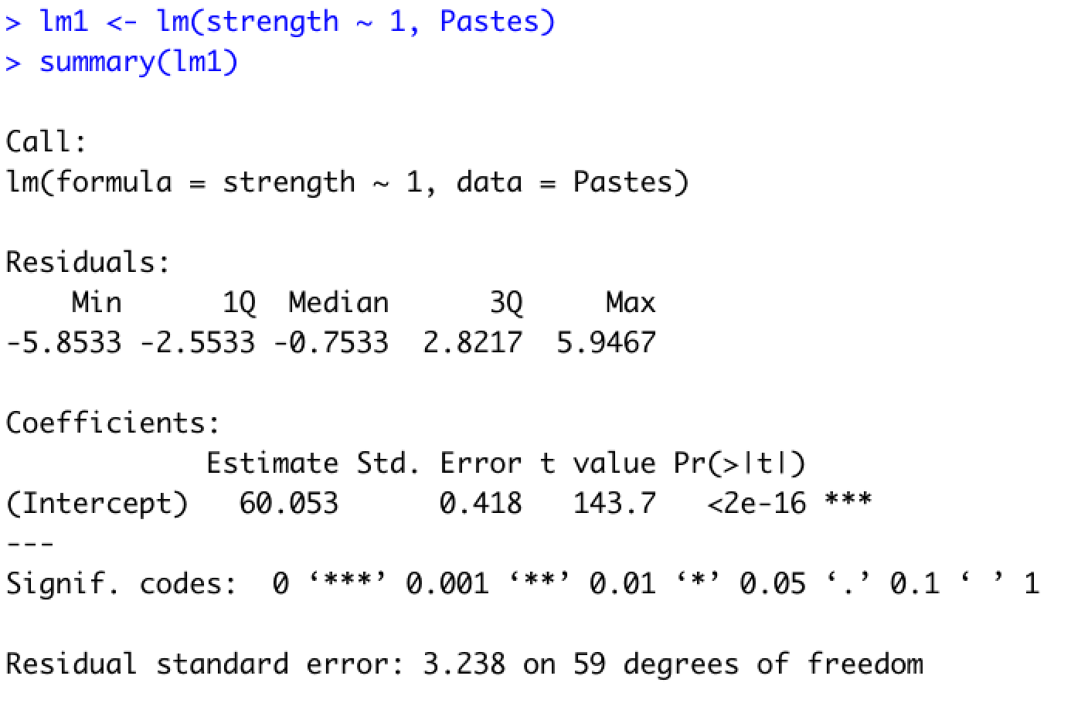
Pastes: LMM vs LM implementation to estimate mean strength
LMM implementation
LM implementation
Two nested random effects
Standard errors are different!

Slide 59
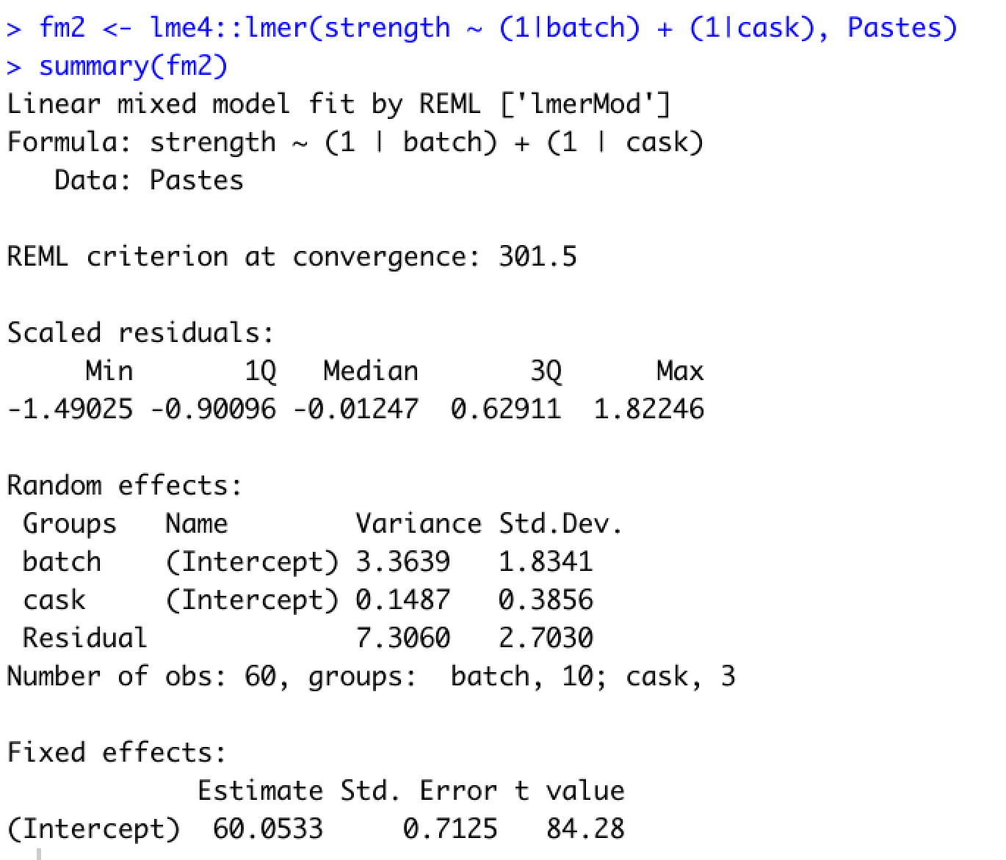
Pastes: Correct vs Incorrect LMM implementation to estimate mean strength
Correct implementation
Incorrect implementation
Two nested random effects
Nested random effects treated as crossed
Standard errors and Variance estimates are different!

Slide 60
Pastes data: conclusions
Hierarchical experimental design involves two nested random effects
LMM does not necessitate defining what the replicates represent while taking into account the correlation in the responses induced by batch and casks within a batch
Need to correctly specify the hierarchical nature of the design in the LMM specification

Slide 61
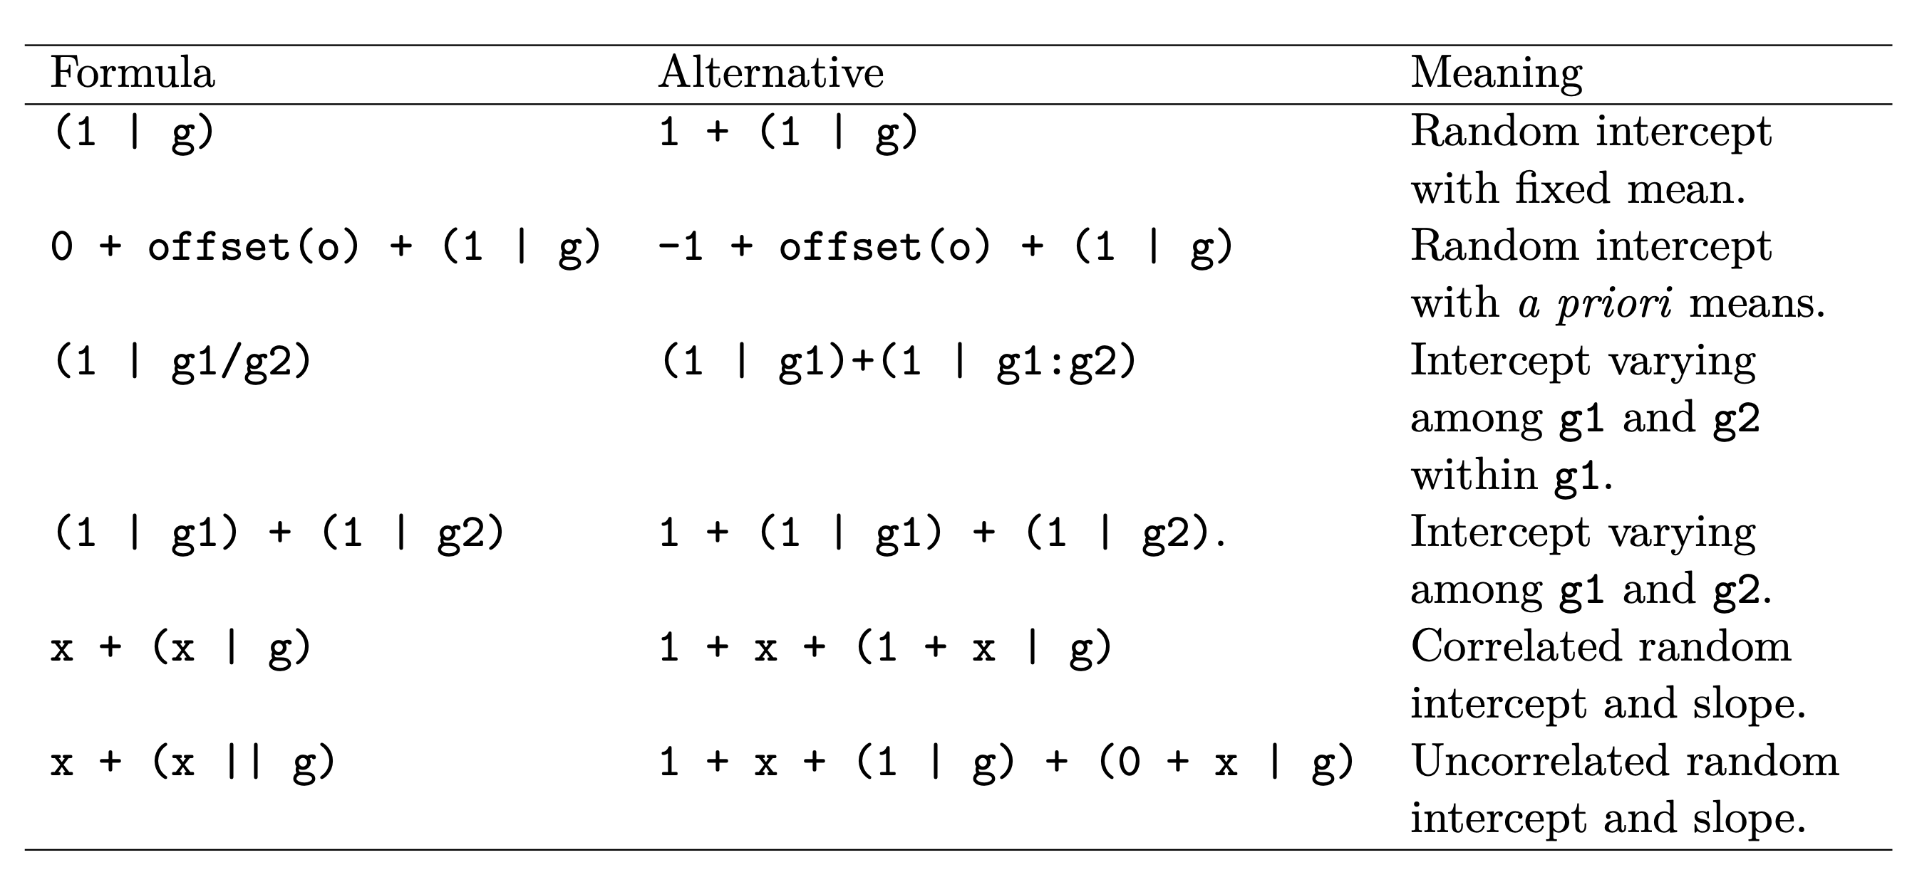
Specification of random and fixed effects
Dyestuff
Pastes
Penicillin
sleepstudy

Slide 62
Additional considerations
LMM comes with the same assumptions as linear models
In addition, it makes distributional assumptions about the random effects, i.e., assumption of normality for not only the residuals but also for each of the random effects
Residual and q-q plots are useful diagnostics to verify assumptions

Slide 63
Outline for this session
Repeated measures experimental designs are ubiquitous in our field
  Several examples from our work
Specialized analyses of data from repeated measures are required to
  Capture interesting biology
  To not be overwhelmed with false positives
Linear mixed effects models provide a very flexible approach to work with these data
  Introduction and assumptions for these models
These models can be implemented in the lme4 package in R
  Illustrate implementations of these models using different datasets derived from varying experimental designs
Concluding remarks

Slide 64
Conclusions
Linear mixed effect models are used to model data collected under repeated measures scenarios
It requires you to clearly be able to identify the key variables involved in generating your data
It is very flexible in modeling diverse experimental designs
Correct modeling results in right control of false-positives
It implicitly deals with the need to identify the independent replicates while remaining true to the underlying experimental design for the data

Slide 65
It is a bit of learning curve, so…
..please contact/consult/collaborate with us,
  particularly, in situations where you are dealing with repeated measures data and are unsure on how to construct a model to derive estimates of interest.
  We are a Core with the primary function of providing statistical and bioinformatic support
Email: bioinformatics@gladstone.ucsf.edu
Website: https://gladstone.org/science/bioinformatics-core
Slack channel: https://gladstoneinstitutes.slack.com/archives/C0145F1L7QS

Slide 66
Your feedback is important to us!
https://www.surveymonkey.com/r/F75J6VZ
~3 min.

